Slide 1
Effectiveness of Clorox on Removing Bacteria from Cell Phones
By Haley Bresnahan, Ally Jo Salomon, and Trevor Allum
Dr. Dale Beach,
Biology 120
October 4, 2017

Slide 2
Introduction
Observation: People use and trust Clorox wipes to clean counter tops, sinks, etc.. Cell Phones are widely used in many people's daily lives, collecting germs and whatnot.
Question: Will Clorox wipes clean bacteria off cell phone screens?
Hypothesis: If we use clorox wipes on the cell phone screens, then there will be a decrease in bacteria on the cell phone screens.

Slide 3
Materials and Methods
Experiment methods modeled after “Surveillance Study of Bacterial Contamination…”
The purpose of this experiment was to measure bacteria living on the front screen of our mobile phones before cleaning the mobile phone with a Clorox Wipe and after.
We used sterile swabs to the front screen of each of our phones. Both a LB dish and a MSA petri dish was used. Each dish is split in half (pre-clean and post-clean). Then Clorox cleaning wipes were used to wipe down and clean the phone screen. The phone was left to sit for 2 minutes to dry, then swabbed the front of the screen with a sterile swab again.
The petri dishes are incubated at 37 degrees Celsius for 24 hours.

Slide 4
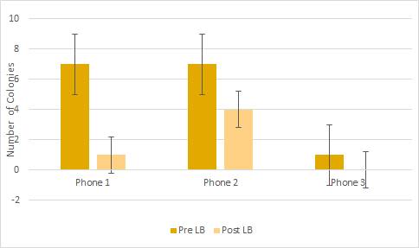
Figure 1: LB Petri Dish

Slide 5
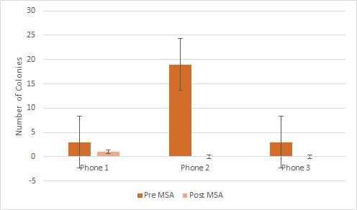
Figure 2: MSA Petri Dish

Slide 6
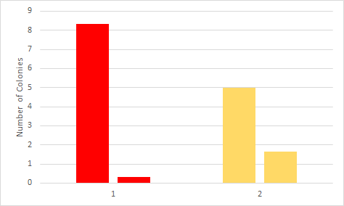
Figure 3: Colony Count
Red bar: MSA
Yellow bar : LB
Anomaly

Slide 7
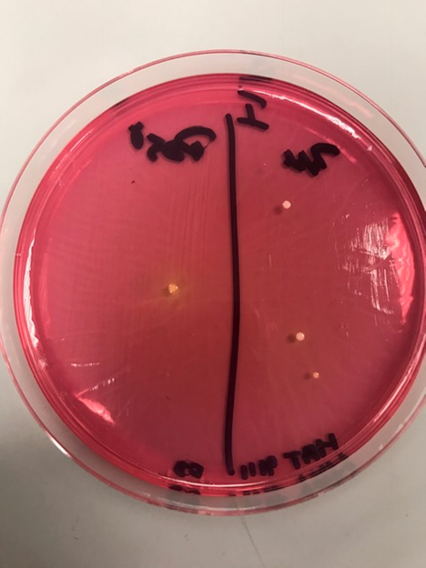
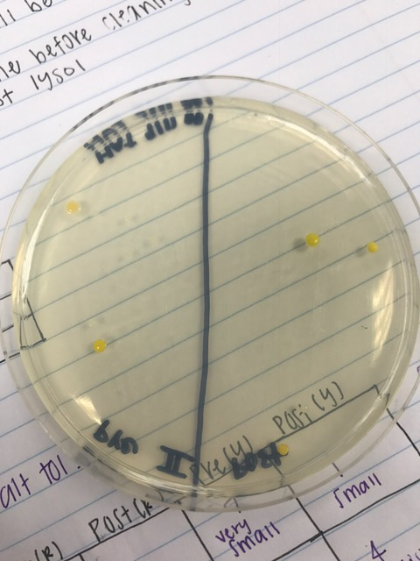
Petri Dish 1 and 2 (Female)

Slide 8
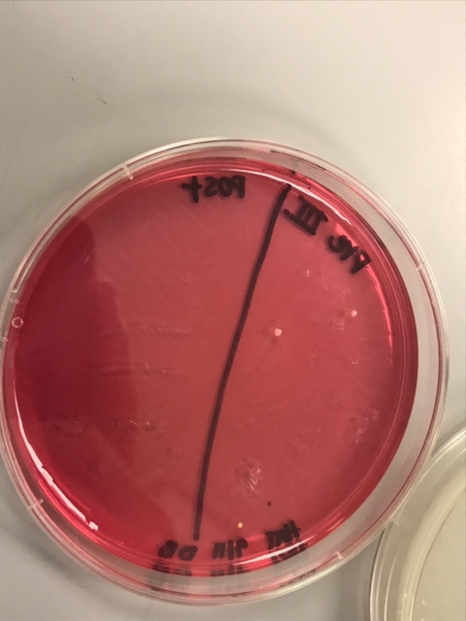
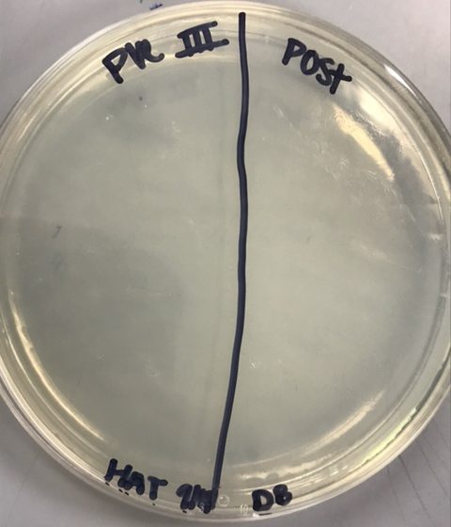
Petri Dish 3 (Male)

Slide 9
Results
We measured the Petri dishes by the count of bacteria colonies.
Every dish had lesser than the “pre-clean” or zero colonies on the “post-clean” side.
Clorox wipes obviously are effective in removing bacteria from the cell phone surface.
The colonies are likely from contact with the skin, which is in contact with everything you touch, collecting a lot bacteria.
People should consider cleaning their cell phone semi-frequently, as they are used and put in the open and in contact with your skin quite often.

