Slide 1
Plant Growth
Haley Bresnahan, Ally Jo Salomon,
Trevor Allum

Slide 2
Introduction
Question: Does mixing coffee grounds in soil help Wisconsin Fast Plants grow taller and healthier at a faster rate than using traditional fertilizer?
Hypothesis: If we mix coffee grounds as a replacement fertilizer, then the Wisconsin Fast Plants will grow taller and healthier faster.
Why coffee? We chose to use coffee as fertilizer because we thought it would be interesting to see what a fertilizer with caffeine would do to a plant since coffee energizes and keeps humans awake longer.
The Purpose: Determine if coffee grounds would promote growth in plants.

Slide 3
Materials + Methods
We used 2 grams of soil and three fertilizer pellets for the control plants. For the experimental plants we mixed 1.5 grams of soil and 0.5 grams of coffee grounds.
Each plant was placed in its own slot, and had a wick placed in the bottom to retrieve water.
All of the plants received the same amount of water and the same amount of light, so that the conditions were all the same.

Slide 4
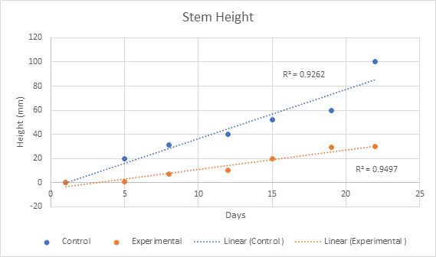
Stem Height
This graph displays the growth of the Wisconsin Fast Plants with and without coffee grinds measured by the height in millimeters, day by day. Both the control and experimental have a fairly linear growth, however, the experimental grew at a substantially lower rate.

Slide 5
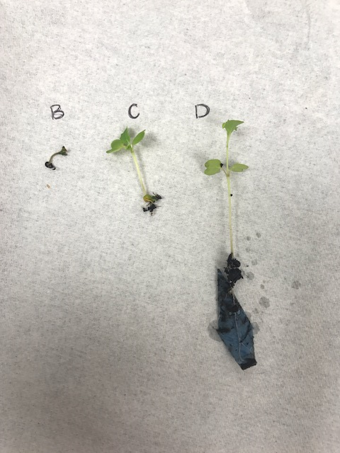
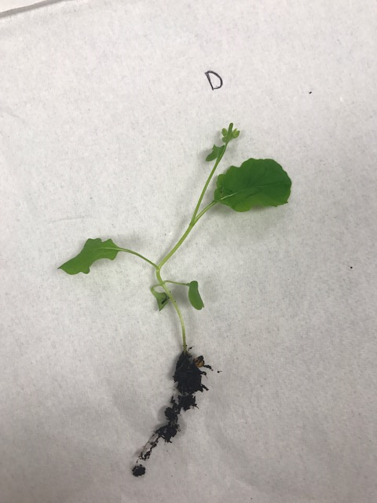
Experimental Control
The image on the far left shows the three surviving experimental plants at the experiment's conclusion. The plants are significantly shorter, as well as less healthy looking than the control plants. The control plant is taller, has more leaves that have grown larger, and is a healthier shade of green.

Slide 6
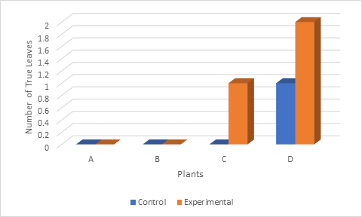
Plant Leaf Number
This graph displays the above pictures data quantitatively, so the numbers can be studied. As with the pictures above, the caudal leaves are not counted as true leaves.

Slide 7
Results
Out of eight plants only four of the plants grew. Three from the experimental and one from the control.
The control plant grew much taller than the experimental plants.
The control plant was healthier and had a flower bud on it.
The experimental plants did not grow as much and were much weaker since they did not have proper fertilization.

Slide 8
Conclusions
The caffeination could’ve helped the rate of potential plant growth, but the coffee grounds provided atypical nutrients that the Wisconsin Fast Plant does not thrive in.
Plants in general need C (carbon), H (hydrogen), and O (oxygen). Naturally, they receive them from air and water. Plant also require Ni (nitrogen), P (phosphorus), and K (potassium).
Grounds contain Ni (nitrogen), P (phosphorus), K (potassium) which should satisfy plant nutrient needs. Grounds also contain Mg (magnesium) and Cu (copper) and tend to be slightly acidic, which may upset the Wisconsin Fast Plant, as that is not common for the soil it typically grows in.

Slide 9
Whats next? Future Work/ Discussion
With our findings, we understand that coffee lacks the nutrients required for a plant grow to its full potential.
Perhaps adding coffee grinds in with fertilizer and using decaffeinated and caffeinated as the dependant variable will provide some insight as to whether or not caffeine affects plant growth speed or health.

