Slide 1
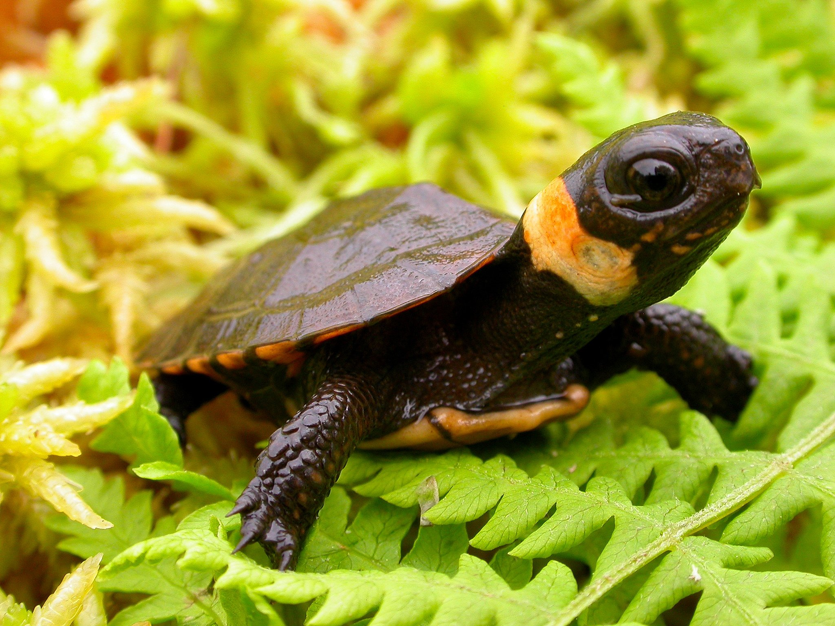
Bog Turtle
Hannah Harrington
ISCI 361

Slide 2
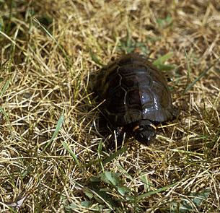
Glyptemys muhlenbergii
Full grown at only 4 inches long
America's smallest turtle species
Dark colored shell with splotches of yellow, orange, or red
Lifespan of 20-30 years

Slide 3
Glyptemys muhlenbergii
Spends most of the day basking on the sunlight or hunting for food
Eats marsh insects, snails, and worms
Lives in underground tunnels
Hibernates from September to April

Slide 4
Distribution and Habitat
Semi aquatic living in bog habitats
Live in groups no larger than 20
Found from New York to South Carolina

Slide 5
Status and Threats
Listed as a threatened species
Threatened by habitat loss
Invasion of non-native plants
Poached for illegal pet trade

Slide 6
Conservation
US Fish and Wildlife Service works towards habitat protection and restoration
Population monitoring
Growth of populations in protected areas

Slide 7
References
https://www.fws.gov/northeast/ecologicalservices/turtle/species/bogturtle.html
https://www.endangered.org/animals/bog-turtle/
https://www.virginiaherpetologicalsociety.com/reptiles/turtles/bog-turtle/bog_turtle1.php

