Slide 1
Lorazepam
Drug Class- Anxiolytic: Benzodiazepine
Drug Action- Potentiates GABA effects by binding to specific benzodiazepine receptors and inhibiting GABA neurotransmission
Therapeutic Effects- Control anxiety and treat status epilepticus, sedation induction, and insomnia
Adverse Effects- Hypertension, hypotension, bradycardia, tachycardia, hearing loss, tolerance, dependence, seizures, hyponatremia, heart failure, *suicidal ideation, *NMS, *agranulocytosis, *thrombocytopenia, *pancytopenia, and *respiratory depression
Notes:
https://www.mayoclinic.org/drugs-supplements/lorazepam-oral-route/side-effects/drg-20072296
https://www.drugs.com/food-interactions/lorazepam.html

Slide 2
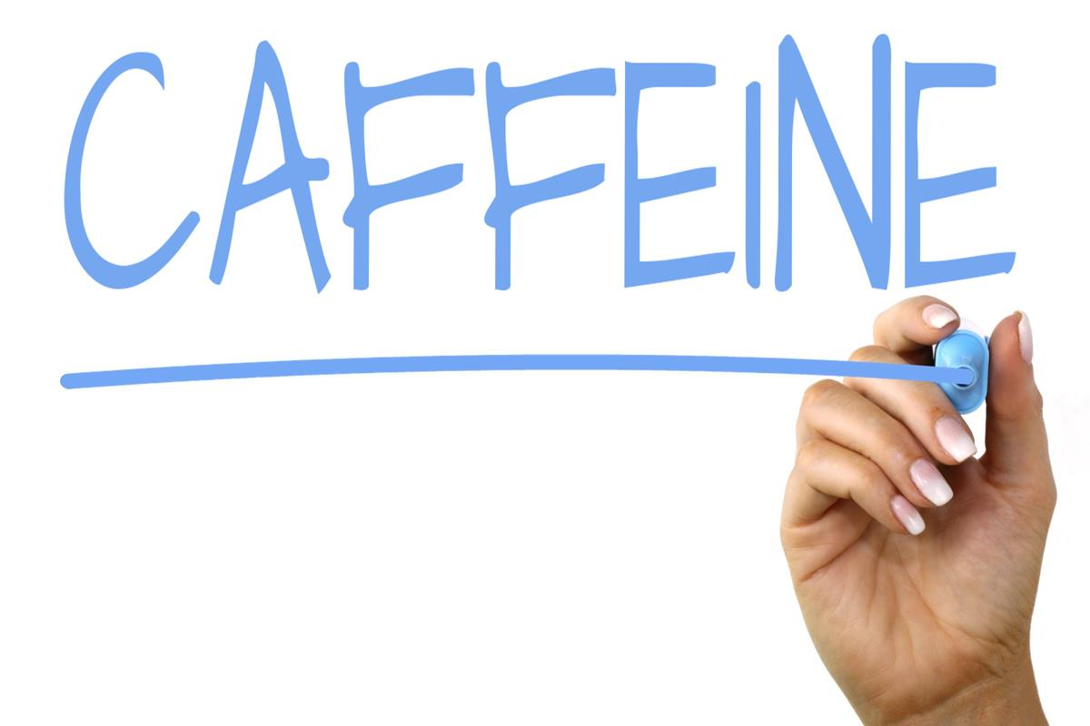
Lorazepam Food Interactions
Alcohol
Can depress the CNS further
Caffeine
Teas, coffee, cola drinks, & chocolate
Counteracts the relaxing and anti anxiety effects
Notes:
https://www.wellrx.com/ativan/lifestyle-interactions/

Slide 3
Educational Interventions
Lipid soluble
Do not drive, operate any machinery, or anything where patient needs to be alert due to CNS depression
Moisturize the mouth with water because a dry mouth is a side effect
Teach patient the importance of not stopping the drug abruptly
If withdraw occur, teach patient signs of hypertension
Tobacco decrease the effectiveness
Contraindicated in pregnancy

