Slide 1
P.E.T.A : SeaWorld Edition- A Proposal for a New Website Design
Alyssa DiMarino
Lauren Healy
November 17, 2020

Slide 2
Agenda
Introduction and background of P.E.T.A and SeaWorld’s connection
Analysis and data of 2 websites: Savethedolphins and ProjectSeahorse on appearance, content, and rhetorical appeals
Our consulting teams’ conclusions from the analysis of the websites
Recommendations to improve our company’s (P.E.T.A) website
Summary of our points
Our Consulting Teams’ contact info

Slide 3
Introduction
Background
Both organizations advocate for the better treatment and health for marine life.
We understand that animal abuse of any type should not be tolerated.
This report is very important for the goal of making SeaWorld realize the damage they are doing to their marine life. living.
https://www.facebook.com/watch/?v=1481375785366706
mistreatment of animals
P.E.T.A= People for the Ethical Treatment of animals.
Website shows SeaWorld abuse
Conducted research on Savethedolphins and Projectseahorse that advocate for the correct treatment of marine life.

Slide 4
Analysis & Data- Appearance
http://savedolphins.eii.org/campaigns/dwp/
The website savethedolphins.eei.org supports P.E.T.A. in their mission to stop all abuse of marine life across the world.
Website appearance was appealing and calming for the viewers of the website
Use of images/videos
Gives viewers opportunities to make a difference
The font portrays the website in an effective way
Easy to navigate
http://www.projectseahorse.org/home
Advocates for marine life educating the public
Website appearance was appealing and complimenting for the audience
Use of images/videos
Consistent text/font throughout
Easy to navigate

Slide 5
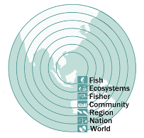
Analysis & Data- Content
http://savedolphins.eii.org/campaigns/dwp/
Content is informative
Provides articles with detailed information
Educational opportunities for everyone
Reliable and credible information
Non-bias information
http://www.projectseahorse.org/home
Content heavy
Reliable
Interdisciplinary approach
Research- based
Education opportunities

Slide 6
Analysis & Data- Rhetorical Appeals
http://savedolphins.eii.org/campaigns/dwp/
Ethos is shown throughout this website when they discuss how the President of the U.S. is involved in saving mammals.
Pathos is shown on this website with pictures and videos of marine life being tortured by workers at SeaWorld.
Logos is found on this website through the use of facts about orcas being held in captivity and the harmful treatment.
http://www.projectseahorse.org/home
Ethos
Dr. Amanda Vincent
The University of British Columbia’s Oceans and Fisheries
Zoological Society of London
Ph.D research team
awards/achievements published
Pathos
Pictures on marine life endangerment
Donation page
Logos
Statistics
Success rates
Tables and figures

Slide 7
Conclusions
P.E.T.A SeaWorld category website needs changes to reach the public eye for public awareness.
End animal abuse and cruelty in SeaWorld parks.
Make website easier to navigate
Adjust content of website to have more reliable information
Include organizations in our website
Make credibility more known to the public
Changing advertisements such as merchandise and apparel
To inform the public on SeaWorld and to not look like we are solely making a profit.
Update and modify the website= Better educated on SeaWorld and their lawsuits and abuse
Start making a difference=the public avoiding SeaWorld Parks.

Slide 8
Recommendations
#1:
P.E.T.A should embed more tabs for the different animals
#2:
Have more “sister” organizations embedded in our website
#3:
Avoid Advertisements on informative pages

Slide 9
Summary
SeaWorld Corporation, employees, and trainers are harming and compromising the well-being of their animals
P.E.T.A needs to improve their website to raise public awareness for SeaWorld marine life
SeaWorld needs an ocean side sanctuary for their animals to prevent abuse, neglect, and captivity

Slide 10
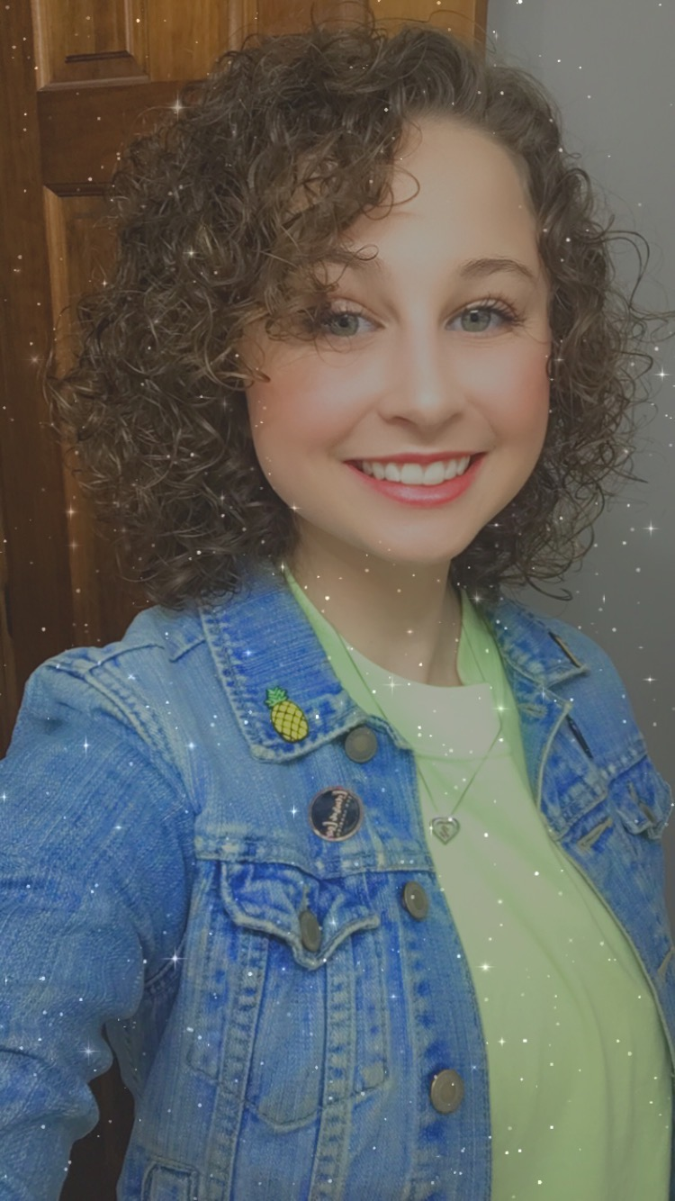
Thank you!
For any follow-up questions, comments, or concerns, please contact us at the following phone number or emails below. We look forward to hearing back from you!
Phone number: 123-456-7890
Alyssa DiMarino, Website Consultant
Lauren Healy, Website Consultant
alyssa.dimarino@live.longwood.edu
Lauren.healy@live.longwood.edu

Slide 11
References
Interdisciplinary Approach . https://images.squarespace- cdn.com/content/v1/55930a68e4b08369d02136a7/1437002410088- Q5DESNF9AP25839G6VUX/ke17ZwdGBToddI8pDm48kCLDVB1Oq9LDY26J7_qVD 1F7gQa3H78H3Y0txjaiv_0fDoOvxcdMmMKkDsyUqMSsMWxHk725yiiHCCLfrh8O1z 5QPOohDIaIeljMHgDF5CVlOqpeNLcJ80NK65_fV7S1UX2K2sPF_saC7IdfU47p7Y- nPc9Sioo8SX_rdDAwAHeFWZXVa6t3lOB28ooYNrPaSQ/image-asset.jpeg?format=750w.
International Marine Mammal Project. Campaigns: Dolphin + Whale Project. Campaigns | Dolphin + Whale Project | International Marine Mammal Project.http://savedolphins.eii.org/campaigns/dwp/.
PETA (People for the Ethical Treatment of Animals). (2020, March 11). SeaWorld Is a Hellhole for Animals. https://www.facebook.com/watch/?v=1481375785366706.
Seahorse, P. (2020). Project Seahorse Advancing Marine Conservation. Project Seahorse.https://www.projectseahorse.org/home.

