Slide 1
Lightning Strike Presentation
Taylor Yeager
Notes:
PICO: In male collegiate soccer players, should lateral ankle sprains be treated with solely soft tissue manipulation or soft tissue manipulation combined with rehabilitation exercises to ultimately decrease pain and increase mobility?

Slide 2
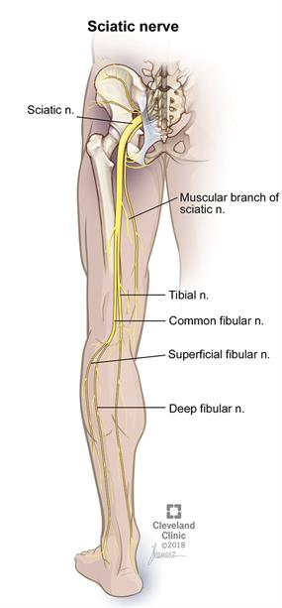
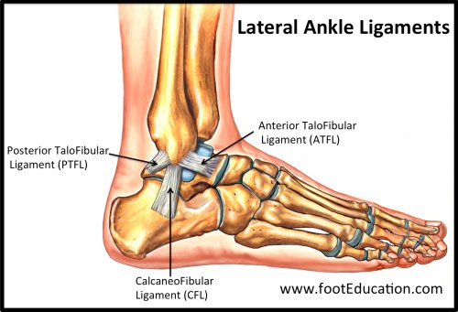
Notes:
Lateral=inversion
Most common injury → CAI and recurrent ankle sprains
Lateral ligaments: ATF, PTF, CF (where they are)
Musculature protects against rearfoot supination and plantarflexion
Innervation contributes to proprioception

Slide 3
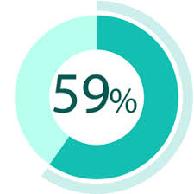
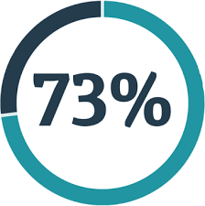
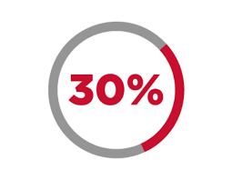
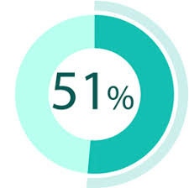
Notes:
Running, jumping, turning w/ high stress on joints
1/10,000 people each day
73% have recurrent ankle sprains → 59% have symptoms that prohibit RTP
Unilateral prevalence rate: 51.8%
Chronic pain/swelling/popping in 30.2%
Instability is most common issue

Slide 4
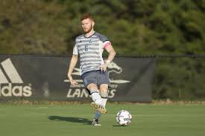
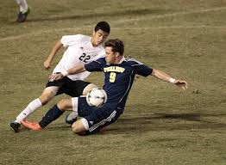
Notes:
In games is 4 times higher than in practice
Rates lower in D3 schools
Preseason more common → season game → postseason
3 MOI: player contact, other contact, no contact
16% from slide tackles (reduce slide tackles in games)

Slide 5
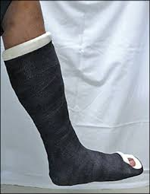
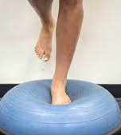
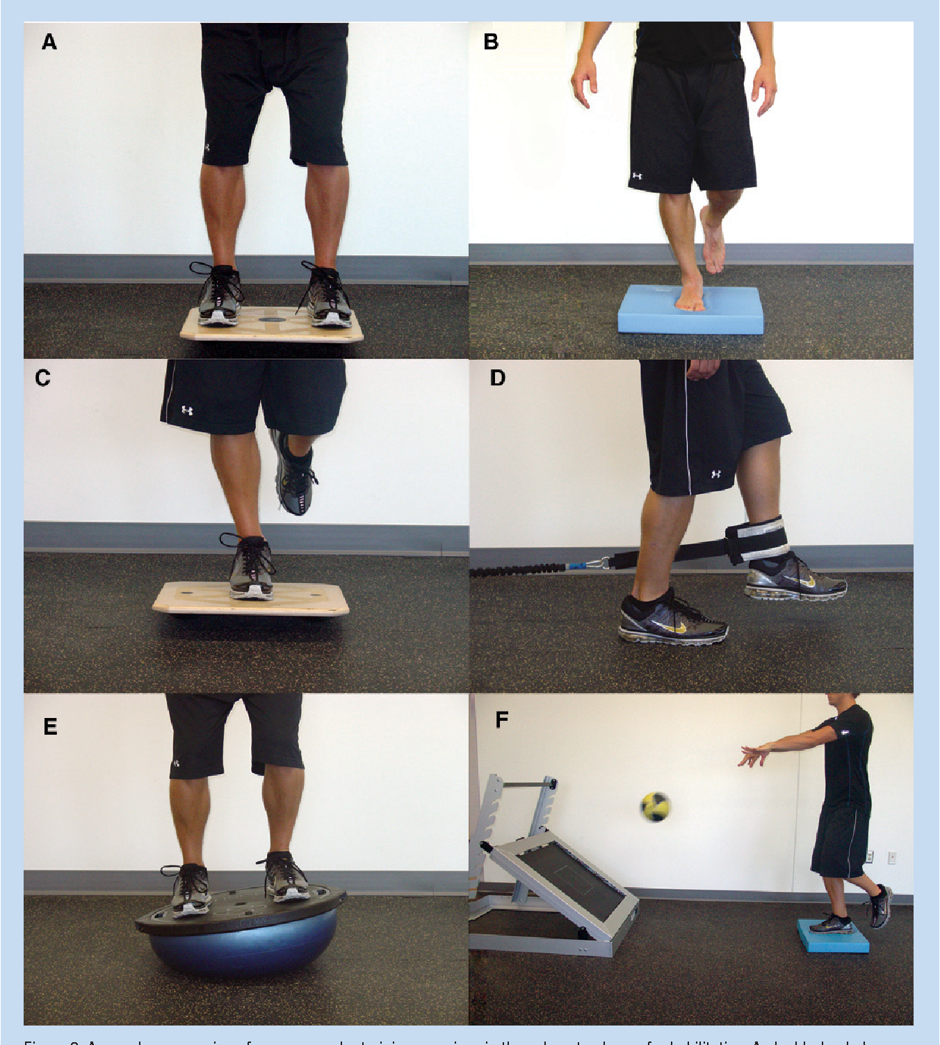
Notes:
No surgery=more instability, but conservative treatment recommended
Below the knee walking cast=quicker recovery time
Proprioceptive training replaces surgical options in prevention
Rehab w/in 1 week=inc function
Balance board training reduces ankle sprains

Slide 6
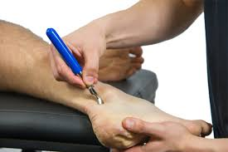
Notes:
Graston applied to ligaments, fascia, tendons, muscle bellies on anterior/posterior/lateral lower leg for ankle – must make indentations
FAAM, ADL, DAAM Sport – scores improved with both
Pain levels drop & ROM increases with either approach
SEBT scores inc with either option
Balance training alone improves stability, adding GISTM improves ROM

Slide 7
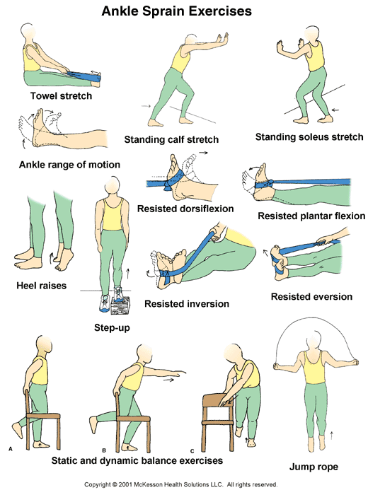
+
Notes:
Clearly there are obvious benefits to both Graston and rehabilitative exercises. Graston on its own has the benefit of breaking up the soft tissue in order to help the ankle regain its range of motion. This is crucial to the rehabilitation process. However, with the addition of rehabilitative exercises, alongside Graston, the patient can also increase strength and proprioceptive ability of the ankle. So, to answer my PICO question, I think the most beneficial way to decrease pain and increase mobility is to use a combination of these treatments in order for the patient to have a successful recovery.

Slide 8
References
Hertel J. Functional anatomy, pathomechanics, and pathophysiology of lateral ankle instability. J Athl Train. 2002 Oct-Dec;37(4):364-375.
Yeung MS, Chan K, So CH, Yuan WY. An epidemiological survey on ankle sprain. Br J Sp Med. 1994;28(2):112-116.
Agel J, Evans TA, Dick R, Putukian M, Marchall SW. Descriptive epidemiology of collegiate men's soccer injuries: national collegiate athletic association injury surveillance system, 1988–1989 through 2002–2003. J Athl Train. 2007 Apr-Jun;42(2):270-277.
Petersen W, Rembitzki IV, Koppenburg AG, et al. Treatment of acute ankle ligament injuries: a systematic review. Arch Orthop Trauma Surg. 2013 Aug;133(8):1129-1141.
Schmierer B. Graston soft tissue mobilization and dynamic balance training effects on pain and dynamic postural control of young athletes with chronic ankle instability. Critically Appraised Topics. 2014;10:1-5.

