Slide 1
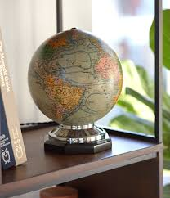
“Contemporary Citizen” Proposals

Slide 2
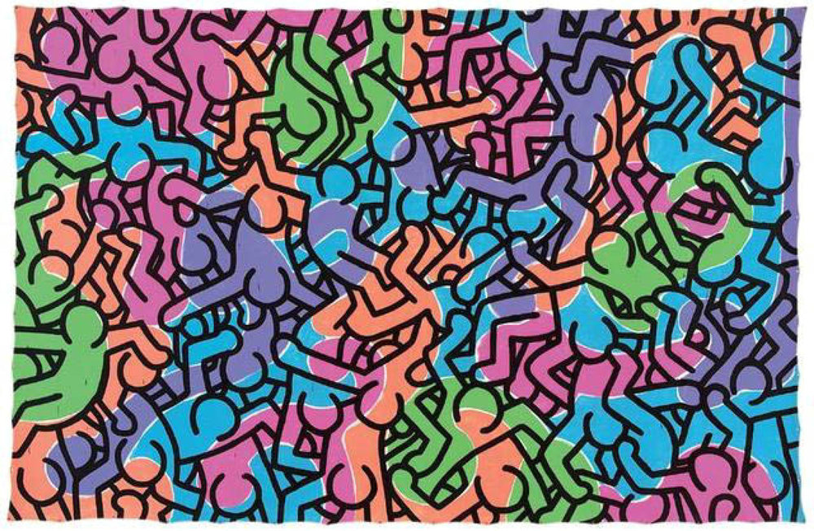
Keith Haring: Untitled (People), 1985
Everyone is drawn the same
No matter the race, everyone is human
Everyone is intertwined
Lines melding together to make one form
Society is chaotic, but controlled
Nobody is only part of a single group, people mix into other groups sharing ideas, colors.

Slide 3
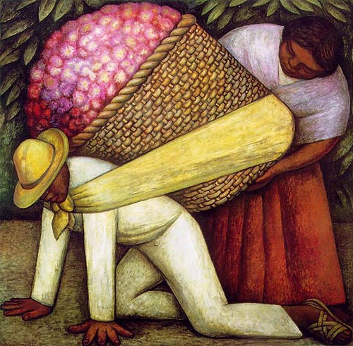
Diego Rivera: Cargador de Flores, 1935
“The Flower Carrier”
Working alone is not desirable.
Woman helping man lift the flowers.
Flowers can represent the world and man’s issues.
Perseverance is needed.
The man getting back up.
The man represent human struggle.

Slide 4
Both images represent society and meaning of being a “Contemporary Citizen”
One about the struggles, and the other about being part of the whole.

