Slide 1
United States Healthcare:
Key Qualities of our healthcare system
Arleigh Wood
July 16, 2020

Slide 2
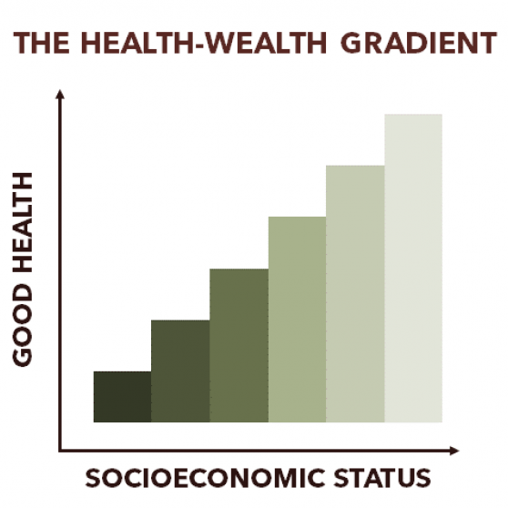
Service Provision
National and Private Healthcare
Physicians, nurses, medics, and many other healthcare professionals are deliverers
Over 6,000 hospitals in the United States (public and private owned) AHA, 2020
Wealth=Health
More money means better and quicker care
Virginia has 20% of African Americans in poverty with twice the mortality rates (VDH, 2008)
Private enterprises and administrators focus primarily on prioritization and budgets (Barnieh, et al. 2014)
Clinicians and insurance agencies make the final call (HHS, 2017)
Pay-For-Performance
Decrease malpractice and cost of services (Abduljawad & Al-Assaf, 2011)

Slide 3
Resource Generation
Inputs
Unintended consequences
Affordable Care Act (CBO, 2019)
20 million gained insurance
Competition for resources
Proposed Mix
Human Resources | Physical Capital | Consumable Goods
Medical School Nursing School Formal Training Programs | Investors Government Charitable Donations Insurance Infrastructure (Hospitals and Facilities) | Medication Medical Supplies & Equipment

Slide 4
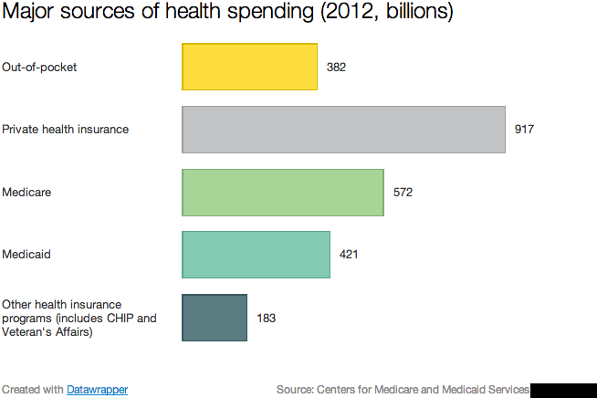
Funding
Paid for by government programs, personal funding, and private health insurance plans
Financing
Tax dollars (Medicaid)
Employee wages (Medicare)
Employer or Private Insurance
Personal (Copays, Outright payment)
(Kliff, 2014)

Slide 5
Stewardship
World Health Organization
Created a framework for health care quality
POTUS
Health Reform
Hospital Boards of Trustees or Visitors
VCU Board of Directors
Quality assurance, Safety, Timeliness, Efficiency
American Hospital Association
Meet demands, affordability, quality
Multiple Sub-Organizations
Department of Veteran Affairs
(Bhatt, 2018)

Slide 6
COVID-19
CDC, WHO, POTUS, Local governments combatting
3,416,428 total Cases
135,991 Deaths
Currently on a 3.5% Increase in occupied beds since July 10th

Slide 7
References Cited
Abduljawad, A., & Al-Assaf, A. F. (2011). Incentives for better performance in health care. Sultan Qaboos University medical journal, 11(2), 201–206.
American Hospital Association, 2020. Fast Facts on U.S. Hospitals, 2020. AHA. https://www.aha.org/statistics/fast-facts-us-hospitals
Barnieh, L., Donaldson, C., & Manns, B. (2014). Health care prioritization: a clinician's duty. Canadian journal of kidney health and disease, 1, 27.
Bhatt, J., & Bathija, P. (2018). Ensuring Access to Quality Health Care in Vulnerable Communities. Academic medicine : journal of the Association of American Medical Colleges, 93(9), 1271–1275. https://doi.org/10.1097/ACM.0000000000002254
Congressional Budget Office, 2019. Affordable Care Act. https://www.cbo.gov/topics/health-care/affordable-care-act
Kliff, S. (2014). Health-care Spending. Vox. https://www.vox.com/2014/4/30/18077016/health-care-spending
Virginia Department of Health, 2008. Virginia Health Equity Report 2008. VDHOffice of Minority Health. https://www.vdh.virginia.gov/content/uploads/sites/76/2016/06/health-equity-report-summary .pdf
U.S. Department of Health and Human Services. (2017). Reforming America’s Healthcare System Through Choice and Competition. https://www.hhs.gov/sites/default/files/Reforming-Americas-Healthcare-System-Through-Choice-and-Competition.pdf

