Slide 1
Don't Be Like The Masses
By: Seneca Peklo & Heather Waldo

Slide 2
Anthropologie
A Clothing and Lifestyle Store
Opened in 1992 in Wayne, Pennsylvania
Over 200 Stores
An URBN Brand by Dick Hayne
“Our customer is a creative-minded woman, who wants to look like herself, not the masses. She has a sense of adventure about what she wears, and although fashion is important to her, she is too busy enjoying life to be governed by the latest trends. To her, Anthropologie is a portal of discovery—a brush with what could be. A place for her to lose—and find—herself.”

Slide 3
Don’t be like the masses
Mission: Women to feel more individualistic and have a positive self image
Goal: Increase women’s sense of being a unique individual through social media campaign with Anthropologie
To increase acceptance of social media users towards a woman's sense of individuality through the use of a social media campaign measured through the use of a hashtag over a two month period.
To also increase positive attitudes within social media users in a woman's sense of individuality within the same social media campaign, hashtag and time period.

Slide 4
More specifics about Don’t be like the masses
Audience: Social media users
Messages:
Empowering women and promoting uniqueness
Being adventurous in fashion
Having pride in oneself for being different

Slide 5
Social problem: Self image
Society asks for women to fit a certain mold to be considered beautiful. This can hinder a woman's self confidence from a young age and hinder their individuality. Approximately 80% of reported women don't like the way they look.

Slide 6
Self image & Anthropologie
“We source and craft all of our products with care, ensuring that any treasure you find at Anthropologie is unique, just like you.” (Anthropologie, 2019)
Anthropologie prides themselves in the uniqueness and distinctiveness of their merchandise
This campaign is meant to promote women feeling unique, bold and confident in who they are, much like the mission of Anthropologie
Notes:
Anthropologie values uniqueness which fits perfectly into our campaign.
They encourage their consumers to be bold and unique which is the goal of the campaign.

Slide 7
Our strategy
Hashtag: #IAM
Social Media Platforms: Twitter, Instagram, Facebook
Utilization of shared and owned media on a weekly basis

Slide 8
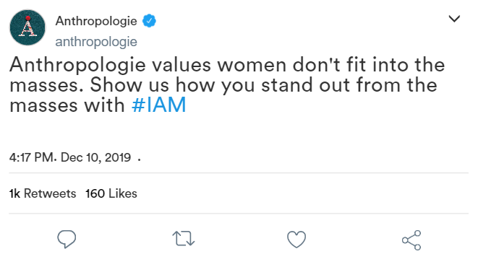
Sample
Posts

Slide 9
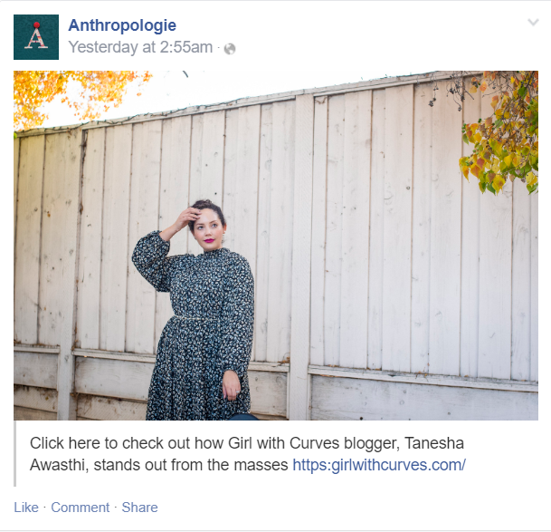

Slide 10
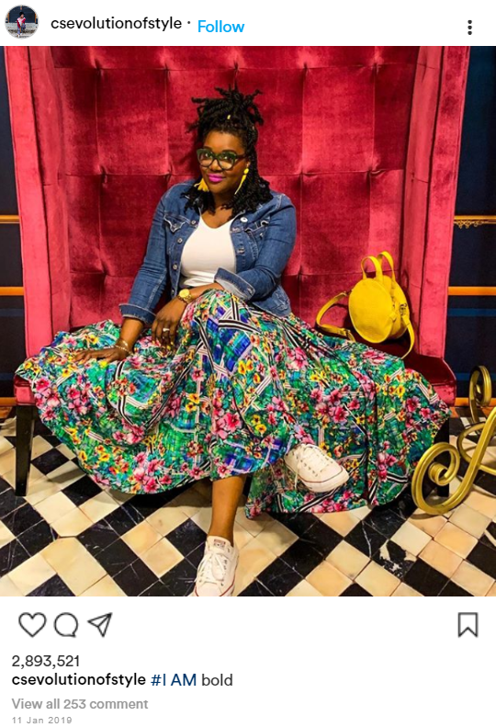
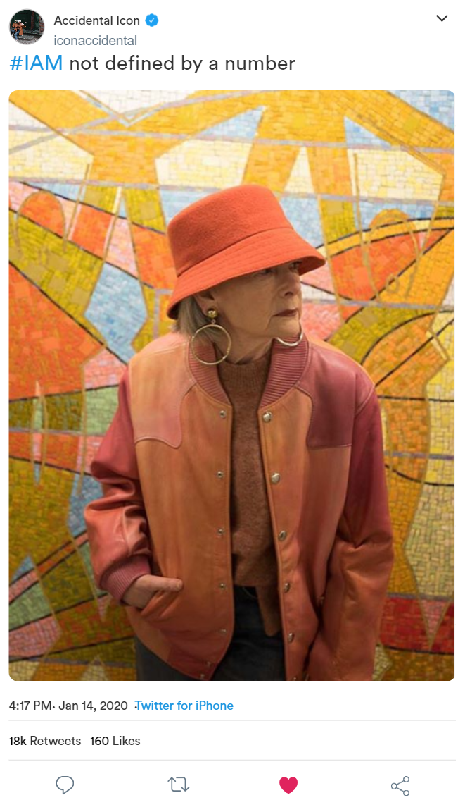

Slide 11
References
Anthropologie. (2019). About us. Retrieved from: https://www.anthropologie.com/?mrkgcl=694&mrkgadid=586468124&utm_medium=paid_search&utm_source=Google&utm_content=anthropologie_-_Exact&utm_term=anthropologie&utm_campaign=US_-_Brand_-_Top_Traffic&creative=341654748467&device=c&matchtype=e&network=g&gclsrc=aw.ds&&gclid=Cj0KCQiAz53vBRCpARIsAPPsz8UVZZ-oAVXBQ-nRKyi7YOIk9brqpB9USFE-y3_cTCxG5BwTZJ-8SFcaAk4-EALw_wcB
https://www.refinery29.com/en-us/2016/04/107683/female-body-image-statistics-2016
https://www.macmh.org/wp-content/uploads/2014/05/18_Gallivan_Teens-social-media-body-image-presentation-H-Gallivan-Spring-2014.pdf
https://www.csevolutionofstyle.com/2019/02/lack-of-diversity-in-the-fashion-blogging-industry.html

