Slide 1
Body Adornment: Final Exam Proposal
Kyra Valovick

Slide 2
My Wearable Definition
Something that can be worn; a piece of clothing, jewelry, headwear, footwear, etc.
I propose to create:
A set of traditional vaquero attire – boots and spurs, chaparajos, a sombrero, and a sarape

Slide 3
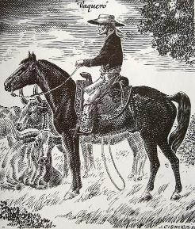
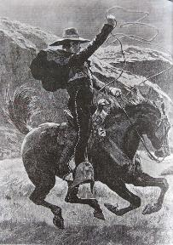
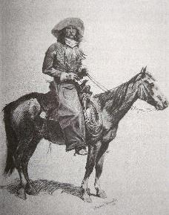
Historical Research
Notes:
Vaqueros:
Overalls: chaparajos: protected legs from sharp thicket and undergrowth
Bandana: around neck: over ears in cold, over nose and mouth in dust
Hat: sombrero: wide-brimmed, giant, guarded sun

Slide 4
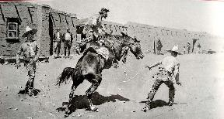
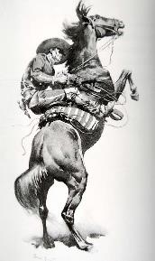
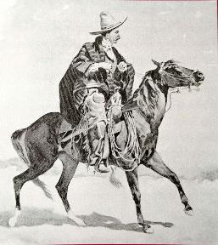
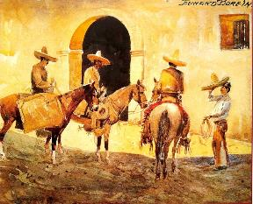
Historical Research
Notes:
Sarape: poncho: thrown over shoulder like shawl, carried on back of saddle – protection from rain, warm for cold, bed at night, haze cattle for roundups
Mecates: horsehair ropes for reins/halters/ropes – hair came from breeding mares

Slide 5
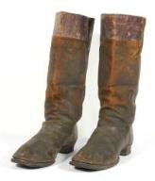
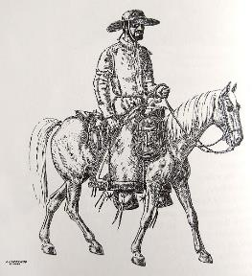
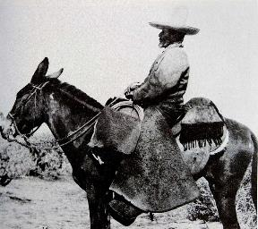
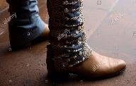
Historical Research
Notes:
Charro shoe: “low-heeled, thin-soled, and very pointed at the toe, resembling, in every respect but the toe, the old-style congress shoe. It is usually of russet leather of very soft texture.”
Compared to the high-heeled, tall boots of the American cowboys

Slide 6
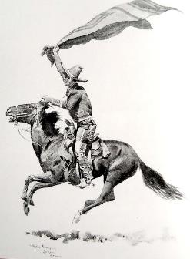
Historical Research
Notes:
Machismo: super masculine superiority – refused to ride mares, only stallions
Taming horses...
Starved them, ran them around
Stallions tied, haltered, blindfolded, saddled, ran him out on a rope for about an hour
Blindfolded (no kicking or biting) got on, sometimes tied, rode a couple hours – 5-6 days of this
Tamer could earn $20/month – special skills could get them $30/month ($300-$450 today)

Slide 7
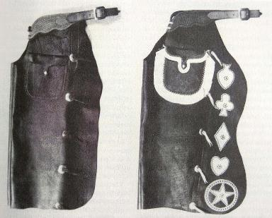
Historical Research
Notes:
Chaps: chaperejos, chaparreras: pronounced like shaps – cover front and sides of legs, fastened w/thongs/buckles behind legs
Protected against hard brush/thorns/cacti; protected against cold/snow/rain/biting animals
Chivarras: goatskin
Angoras: goatskin with hair left on outside for extra warmth (not good in rain)
Armitas/Chigaderos: chinks: shortened to just below knee – good in warmer weather, less hot

Slide 8
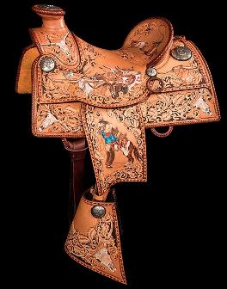
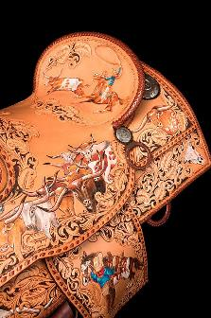
Contemporary Research
Notes:
Lisa and Loren Skyhorse are a saddle-making couple.
Make crazy cool saddles; more like art than saddles – highly decorated, including conchos
Spanish version with hooded stirrups, or tapaderos, “to keep cactus spines out of their boots
Cowboys carried their saddles from horse to horse, changing horses all the time, but never their saddles
Both beautiful looking and riding
Most expensive sold: $75,000
“The Buckaroos” – details honor cowboy artist Charlie Russell (American artist of the American Old West. He created more than 2,000 paintings of cowboys, Native Americans, and landscapes set in the western United States and in Alberta, Canada, in addition to bronze sculptures); sterling silver conchos hand engraved

Slide 9
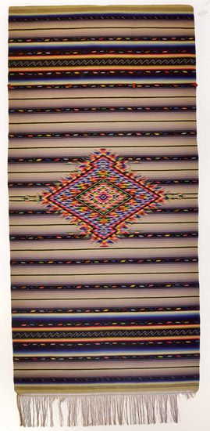
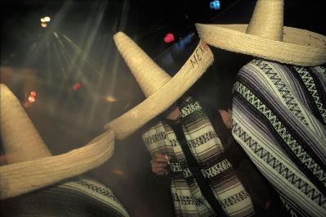
Contemporary Research
Notes:
The image on the left is of sombreros worn in today’s culture. One example of the contemporary usage of the sombrero is the Charro Days celebrated in Brownsville, Texas, where everyone dresses in the traditional Mexican cowboy clothes.
The image on the right is a sarape, which is typically worn by men to show off. They are made with different motifs and desinings, and they were traditionally dyed with cochineal beetles from the nopal cactus.
Sombrero
1938: first Charro Days – year after Great Depression; trying to uplift Brownsville, Texas (border to Mexico)
To celebrate rich cultural heritage
Dress like traditional Charro (Mexican cowboy clothes) – Charro (broader term for Mexican cowboy); Vaquero (narrower term for just the ones who broke horses and herded cattle)
Sarape
Rain jacket, cloak, shawl/scarf, blanket – rolled behind a saddle, it provided a striking ornament
Sarapes let men to play the peacock – women didn’t wear them
Flowers, animals, motifs from classical architecture, portraits, often combined in odd ways with traditional patterns
Cochineal: extremely costly red dye, produced by pulverizing cochineal bugs, a parasite of the nopal cactus
Used to be hand-woven

Slide 10
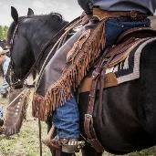
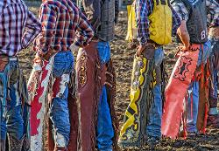
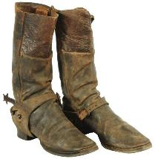
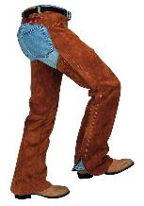
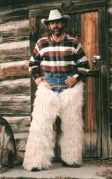
Contemporary Research
Notes:
The images on the left are chaps used today. Chinks end just below the knees, and are traditional for vaqueros. Batwing Chaps are longer and open in the back. They became popular when more work was done on foot; they are now used in rodeos. Shotgun Chaps provide the most protection with a zipper up the back of the leg. They are now used for Western Pleasure Events. Woolies are made with the hair of different animals to provide extra warmth; they’re not as popular now.
Boots were traditionally made for men who were in saddles all day, so they were not comfortable to walk around in. In today’s culture, they have become a fashion accessory.
Chaps
Chinks: just below knees – vaqueros in California and Southwest
Batwing Chaps: longer; open in the back – popular when more work was done by foot – now used in rodeos
Shotgun Chaps: most protection; zip up back of leg – most popular in 1870s; working cowboys in Texas – now for Western Pleasure
Woolies: made with fleece, hair-on cow, buffalo; moisture resistant – provided extra warmth in late 1880s; not so popular now
Boots
Traditionally mad for men who were in saddles all day – not terribly comfortable or practical for walking around a lot in
Early 20th century, became a fashion accessory – western life was mythologized in movies

Slide 11
Proposed Project Statement
In the early to mid-1500s, the Mexican cowboys – vaqueros – were around the Mexico/Texas border, herding cattle and taming horses. This wearable piece has four different parts that each exemplify who the vaqueros were. The sombrero, an iconic piece, kept the sun out of their faces in their long days in the saddle. Their sarape was used for many different purposes, including herding cattle. They were also dyed with brilliant reds from beetles that lived in the nopal cactus. Chinks, a shorter type of chaperejos, protected their legs from the spines of the cacti. Finally, the charro boots and spurs, that differed slightly from the American cowboys’, are also highly iconic. Through the use of casting with brown cotton pulp, and the repeated concho inspired pattern, this piece demonstrates the often forgotten Mexican cowboys – the vaqueros.

Slide 12
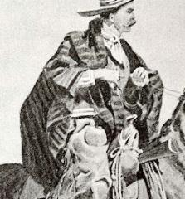
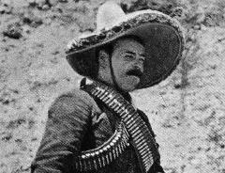
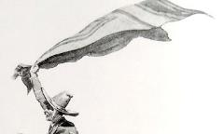
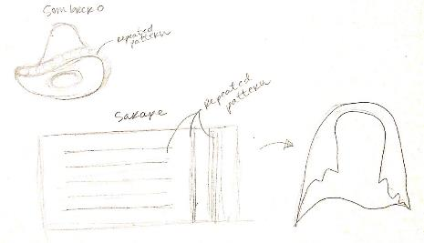
Research

Slide 13
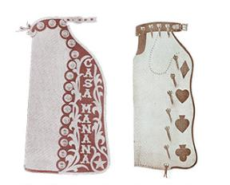
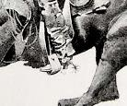
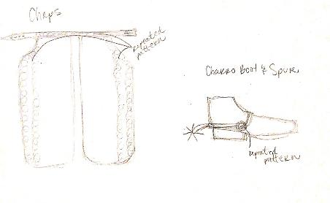
Research

Slide 14
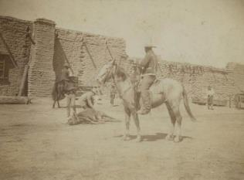
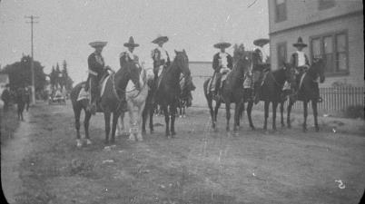
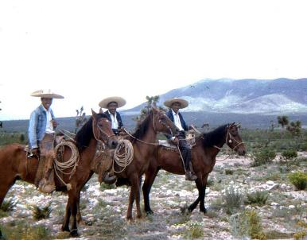
Research
Notes:
The Bullock Texas State History Museum
Vaqueros were the true first cowboys, not the American ones we think of
Not set out to be icon – laborers
Most were Native American/Spanish; American Indian; African American
Like independent contractors – not tied to one ranch --- owned horses, saddles, ropes
Very well-known for their skills in herding and driving cattle/wild horses; stopping and starting real fast; knew about social structure of cattle herds

Slide 15
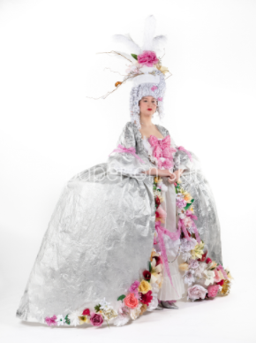
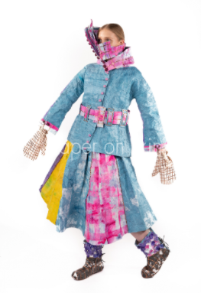
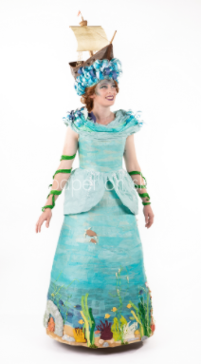
Research
Notes:
These are some contemporary papermaking artists. Design Eye Creative put together this exhibition titled Paper on Skin, where artists were challenged to create wearable garments that were made from at least 80% of paper.
JOAN STAMMERS - 'LET THEM EAT CAKE‘
MARION KENNEDY - 'FATHOMS‘
MALI KLEIN - 'FOGGY LADY‘
Design Eye Creative paper on skin
connects Burnie’s papermaking heritage to a community of Australian and international artists
embrace the challenge of designing a wearable garment made from at least 80% paper.
2020 saw finalists from seven countries represented.
Grant Wells Photo
filmed version was also released

Slide 16
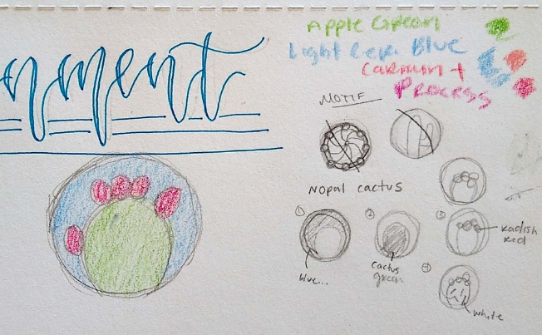
Repeated Motif/Pattern
Notes:
Inspired by repeated concho design
Nopal Cactus
Chaps to protect from spines
Cochineal beetles from inside to provide red dye for sarape

Slide 17
Exaggeration: (scale, size—proportion, shape)
I will incorporate size by creating all my pieces life-sized.
I will incorporate shape through the use of my repeated pattern. I will also use different sizes for my pattern.

Slide 18
Process: Fibers
Cotton: approx. 2-3 gallon bags
Acrylic Paint: stenciling patterns
Adhering: stitching and gluing

Slide 19
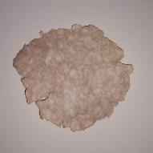
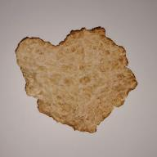
Process: Cast element
Sombrero: bowl and stuffing wrapped in wax paper; wax paper shaped with various items
Sarape: hanger w/stuffing, covered in wax paper
Chaps: shaped wax paper
Boots: stuffing lined w/wax paper, glue sole to shoe
Spurs: cast each piece separately, attach after dry

Slide 20
Work Schedule
Sunday | Monday | Tuesday | Wednesday | Thursday | Friday | Saturday
 | 11.9 | 11.10 | 11.11 | 11.12 | 11.13 Book Research | 11.14
11.15 | 11.16 PPT: Historical Research; sketches done | 11.17 | 11.18 | 11.19 | 11.20 | 11.21
11.22 | 11.23 DUE Complete PowerPoint | 11.24 Home | 11.25 | 11.26 Thanksgiving | 11.27 Start work on casting pieces: Sarape | 11.28 Spur Pieces: 4 Buttons, 4 Straps, 2 Rowels, 2 Stems, 2 Heels

Slide 21
Work Schedule
Sunday | Monday | Tuesday | Wednesday | Thursday | Friday | Saturday
11.29 Boot Soles, boots | 11.30 Chinks | 12.1 Hat | 12.2 | 12.3 Finished casting; start sewing & repeated pattern | 12.4 | 12.5
12.6 | 12.7 DUE Complete Paper Work Done

Slide 22
Bibliography/Sources
Adams, H. (2011, October 19). Latin America’s wrap for all seasons. Smithsonian Magazine. https://www.smithsonianmag.com/arts-culture/latin-americas-wrap-for-all-seasons-112403979/.
Design Eye Creative. (2020). Paper on skin. Australia.
Freedman, R. (2001). In the days of the vaqueros: America’s first true cowboys. Clarion Books.
Gulliford, A. (2018, March 15). Leather as art: The work of Lisa and Loren Skyhorse. The Journal. https://the-journal.com/articles/88066.

Slide 23
Bibliography/sources
Prose, F. (2016, September 19). The trouble with sombreros. The New York Review. https://www.nybooks.com/daily/2016/09/19/the-trouble-with-sombreros-shriver-cultural-appropriation/.
Putfark, E. (2017, February 13). Types of chaps. American Cowboy. https://www.americancowboy.com/people/types-chaps-28214.
Sandler, M. W. (2001). Vaqueros: America’s first cowmen. Henry Holt and Company.
Slatta, R. W. (1990). Cowboys of the Americas. Yale University.

Slide 24
Bibliography/sources
Slatta, R. W. (1994). The cowboy encyclopedia. ABC-CLIO.
Smith, D. (2020, November 17). Cowboy boots. Encyclopedia. https://www.encyclopedia.com/manufacturing/news-wires-white-papers-and-books/cowboy-boots
Ortiz, M. A. (2018). The history of charro days. Charro Days Fiesta. https://www.charrodaysfiesta.com/history.html.
Vaqueros: Teaching the world to rope and ride. (n.d.) The Bullock Texas State History Museum.

