Slide 1
Skin Cancer
Ryleigh Turner, Dana Joss, Sienna McIntyre

Slide 2
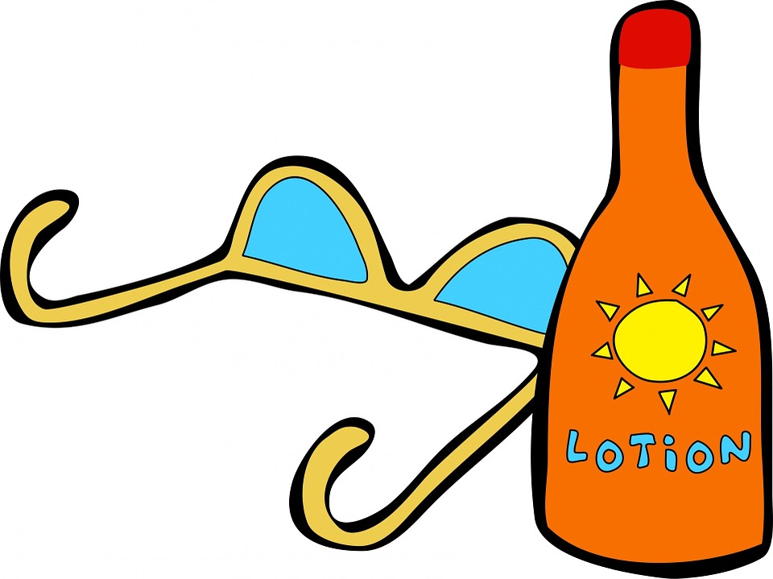
Overview
Ryleigh: Description/Definition
Dana: Personal Experience
Sienna: Demonstration and Why Sunscreen is Important

Slide 3
Risk Factors/Skin Color
(Orthaber, 2017)

Slide 4
Melanoma in My FAmily

Slide 5
Statistics: Melanoma
Accounts for 1% of skin cancers
Leading cause of skin cancer related death
7,230 expected to die in 2019
28 Deaths for every 100 diagnoses
Most dangerous type of skin cancer
Rates of men dying from melanoma have doubled in the last 3 decades
American Cancer Society, 2019.
British Journal of Nursing, 2003.
Practice Nurse, 2010.

Slide 6
STatistics, Cont.
People with fair skin are at higher risk
Warning signs include moles that are asymmetrical, growing, changing color or becoming itchy
Mahdi Taha, 2016.
Croucher, 2015.

Slide 7
American Cancer Society
Three Types of Cancer:
Localized
Regional
Distant
American Cancer Society, 2019.

Slide 8
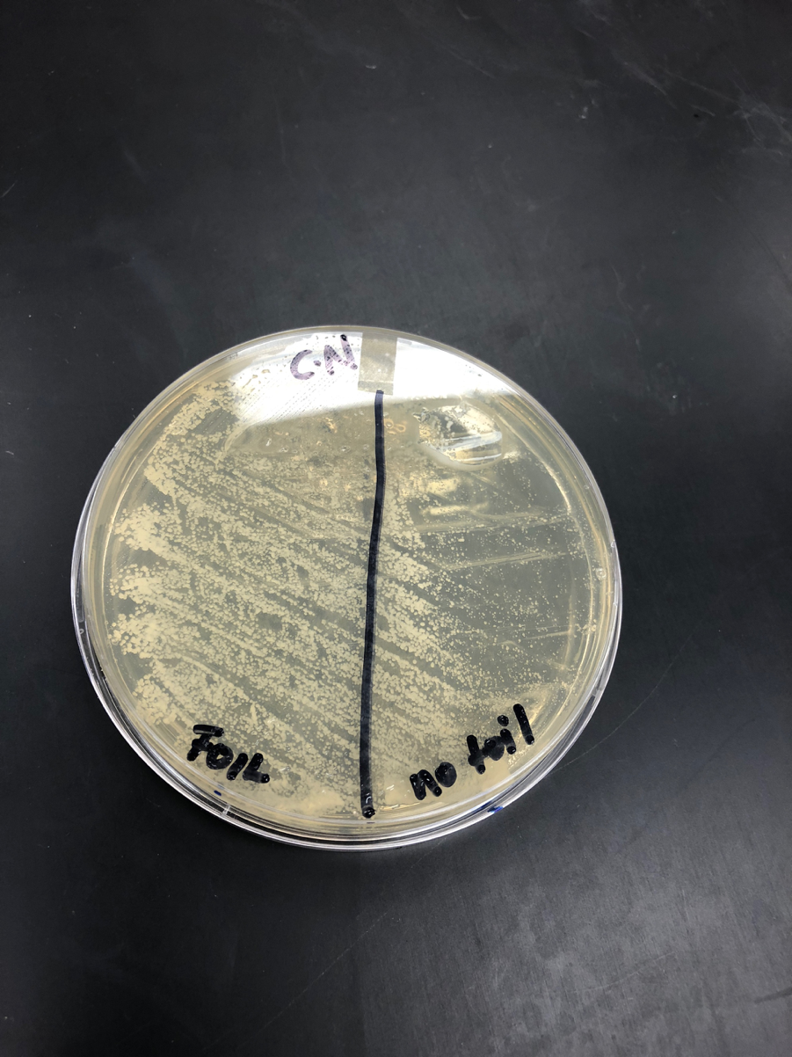
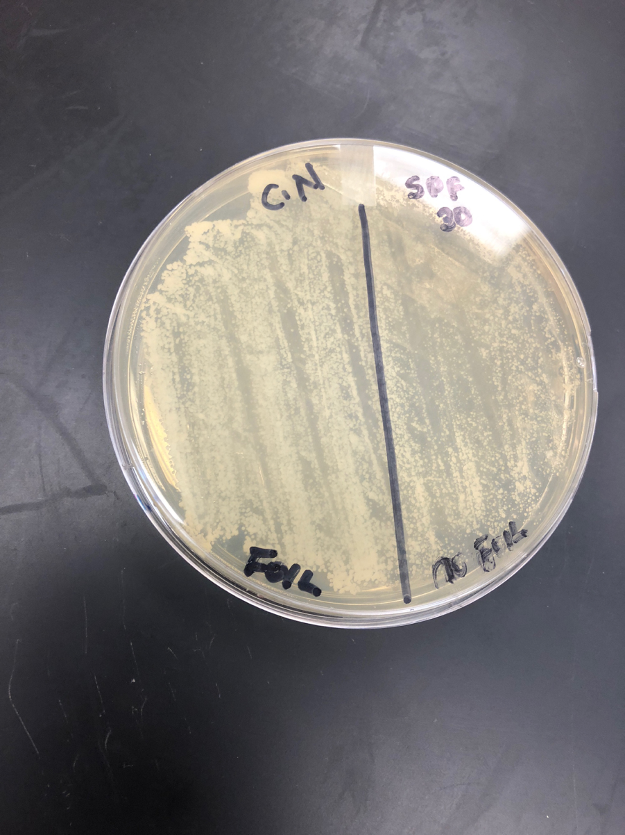
Preventative Measures
Wear Sunscreen!

Slide 9
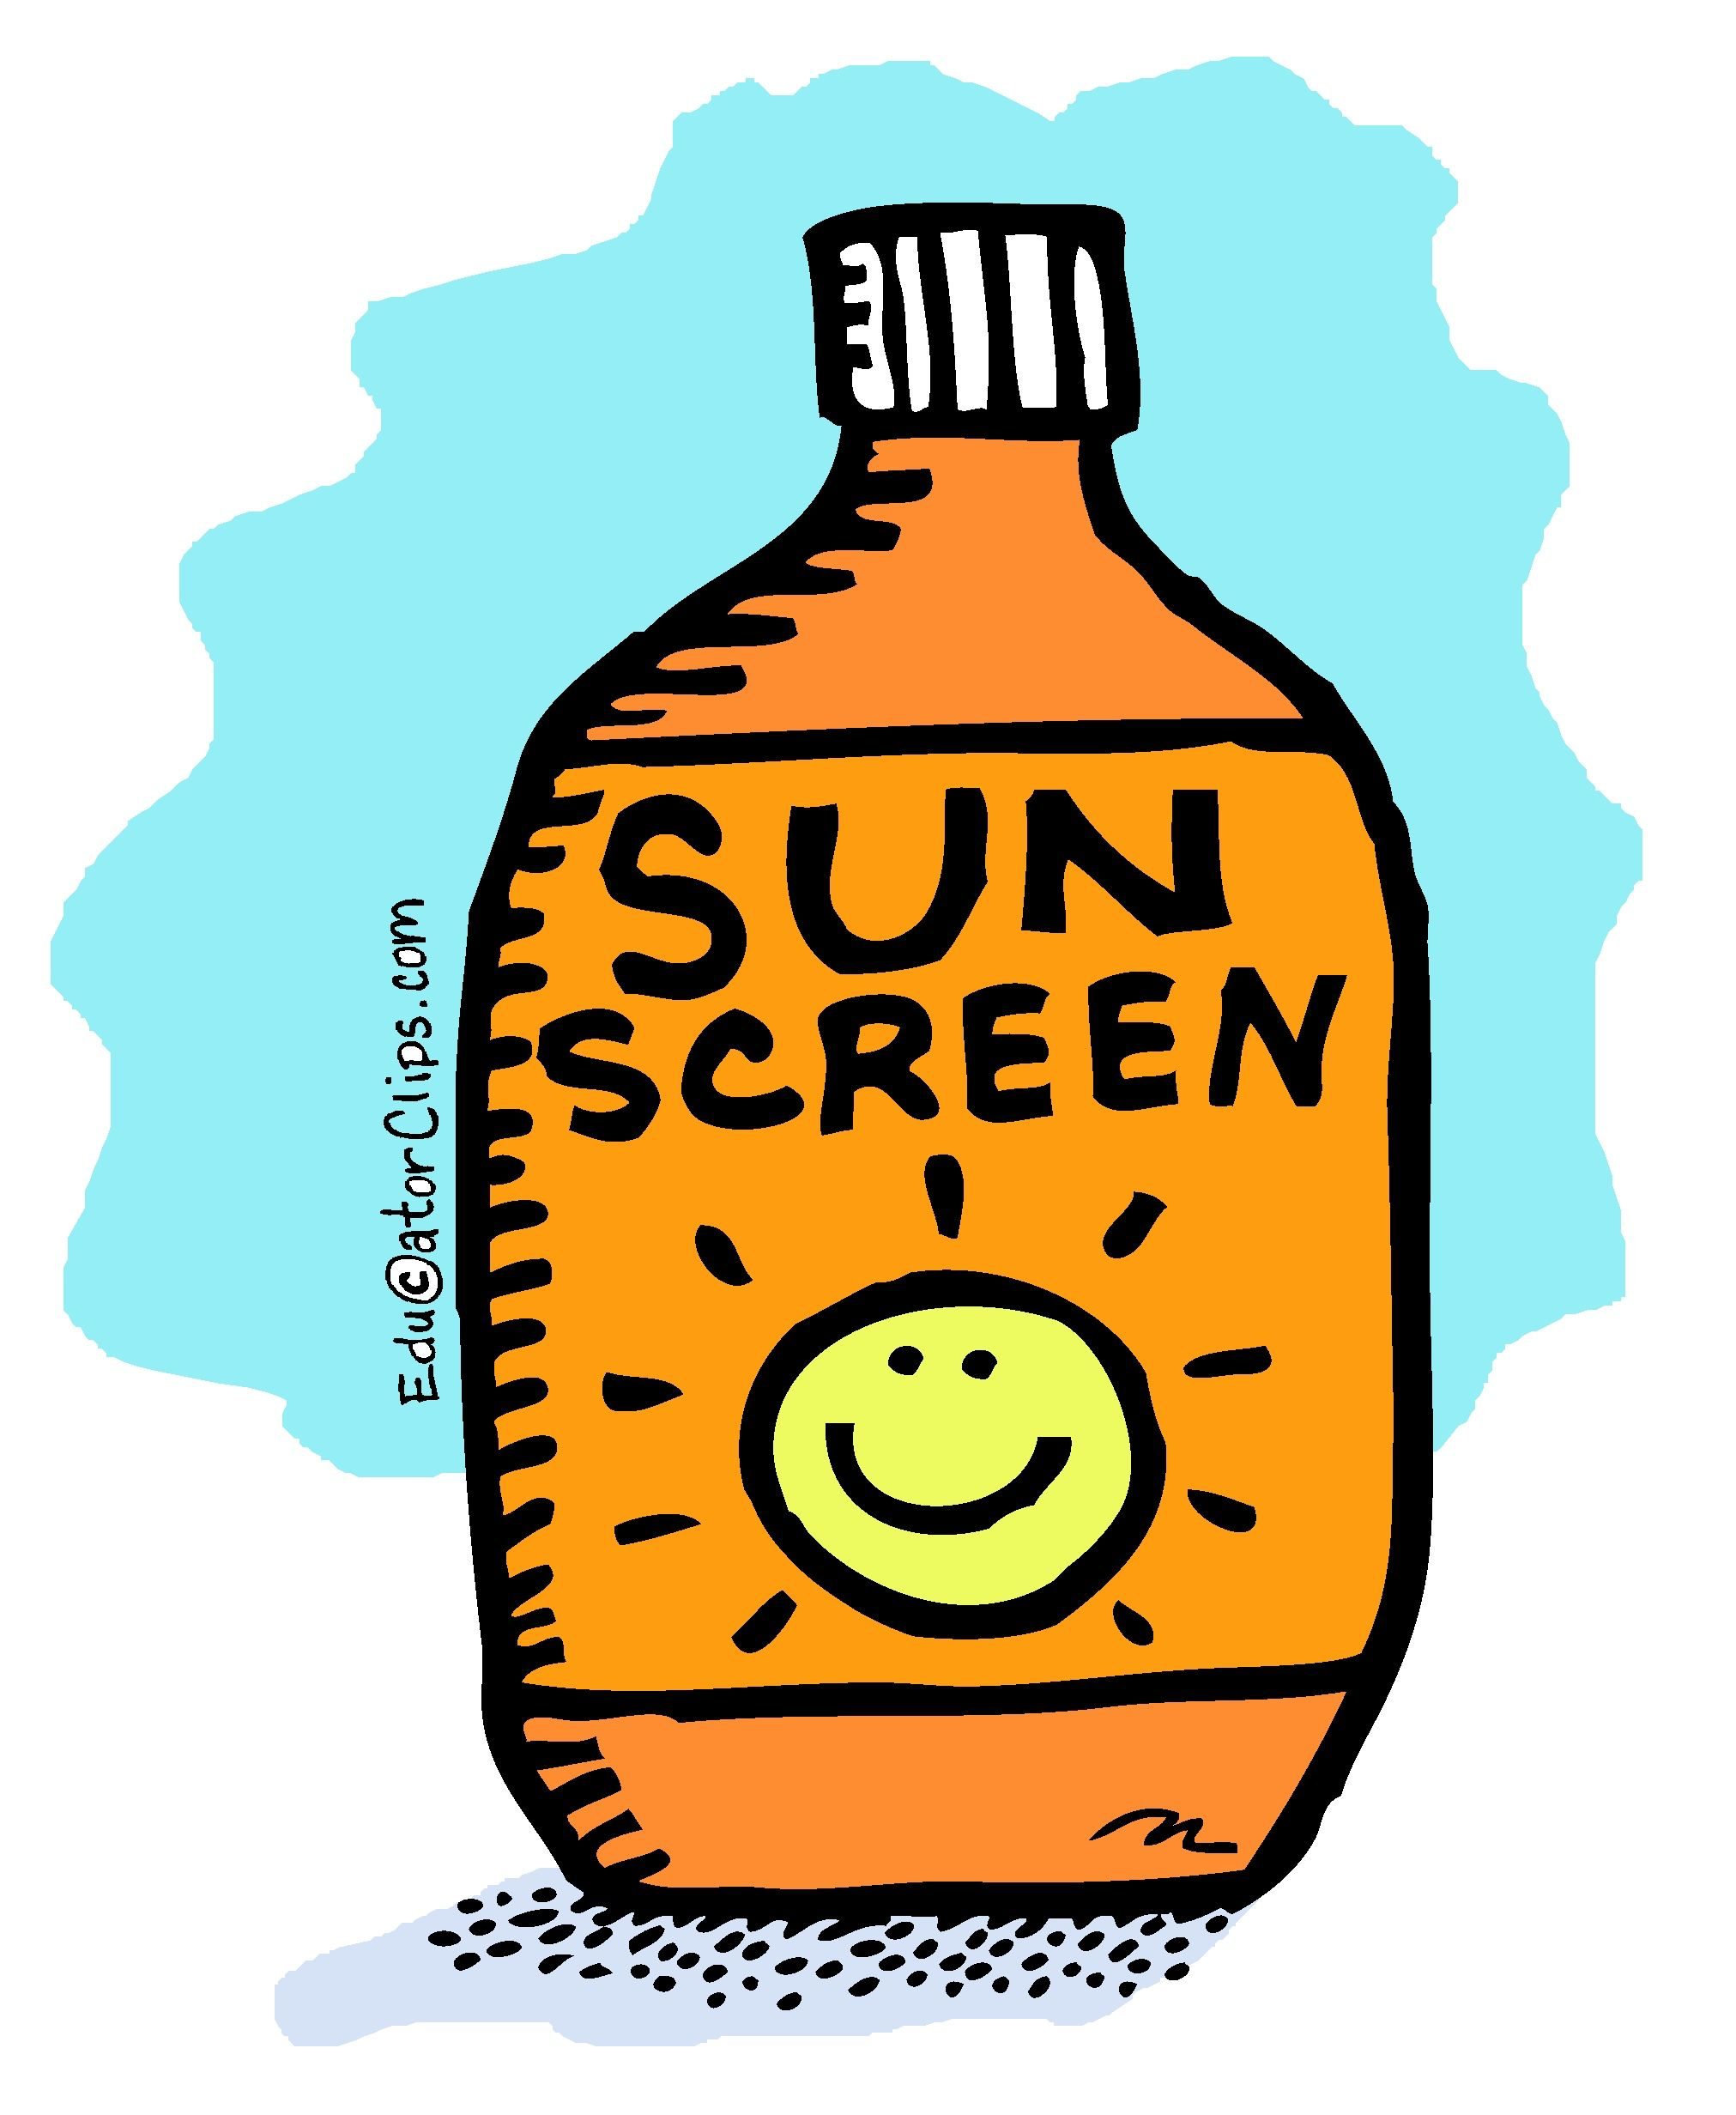
Sunscreen application
Step One:
Assess your risk
Skin Color
Genetic Predispositions
Past Sunburns
Geography
Step Two:
Decide which kind is for you
Face stick
Face rub in
Spray
Lotion
Step Three:
Apply!
Untwist the top or snap it open
If spray kind, RUB IT IN
Get all of your cracks and crevices
(Yang et al.,2018),(Lewis,2007),(Haymarket Media 2019),(Rooth,2019)

Slide 10
Why wear sunscreen?
By the age of 70, 1 in 5 Americans will have developed skin cancer
Damage occurs over a lifetime, protect yourself now!
No sunscreen = melanoma risk
(Top 5 Reasons, n.d.)

Slide 11
References
Croucher, S. (2015, June 1). Skin cancer: Breakthrough study shows how to halt progress of advanced malignant melanoma. International
Business Times: United Kingdom Edition (UK). Available from NewsBank:
https://infoweb-newsbank-com.proxy.longwood.edu/apps/news/document-view?p=WORLDNEWS&docref=news/155B2249DA282AC0.
Haymarket Media (2019) How to prevent skin cancer (fact sheet). Oncology Nurse Advisor (USA).
Hart, J. (2019, February 25). SC law would set age limit for tanning beds. WJBF News Channel
6. Retrieved from WJBF.com
Lewis, K.K. (2007) Stay safe in the sun. Natural Health, (37)6. DOI: 10679588
Mahdi Taha, D. (2016, June 15). Tips to reduce your risk of skin cancer this summer. Highlands News-Sun (Sebring, FL), p. 1. Available from NewsBank.

Slide 12
References
Media, H. (2019, March 25). How to Prevent Skin Cancer (Fact Sheet). Oncology Nurse Advisor (USA). Available from NewsBank:
https://infoweb-newsbank-com.proxy.longwood.edu/apps/news/document-view?p=WORLDNEWS&docref=news/17269BB4EF3236E0.
Men’s skin cancer death rates double in 30 years. (2010). Practice Nurse, 39(11), 6. Retrieved from http://search.ebscohost.com.proxy.longwood.edu/login.aspx?direct=true&db=a9h&AN=51884762&site=ehost-live&scope=site
Skin cancer deaths are on the rise. (2003). British Journal of Nursing, 12(13), 775. Retrieved from http://search.ebscohost.com.proxy.longwood.edu/login.aspx?direct=true&db=a9h&AN=10289449&site=ehost-live&scope=site
Top 5 Important Reasons You Should Always Wear Sunscreen. (n.d.). Retrieved from https://www.ehe.health/blog/always-wear-sunscreen
Rooth, M. (2019). Facing the facts. Geelong Today, 12.
Yang, E.J., Beck, K.M., Maarouf, M., & Shi, V.Y. (2018). Truths and myths in sunscreen labeling. Cosmetic Commentary, (17)6, 1288-1292. https://doi.org/10.1111/jocd.12743

