Slide 1
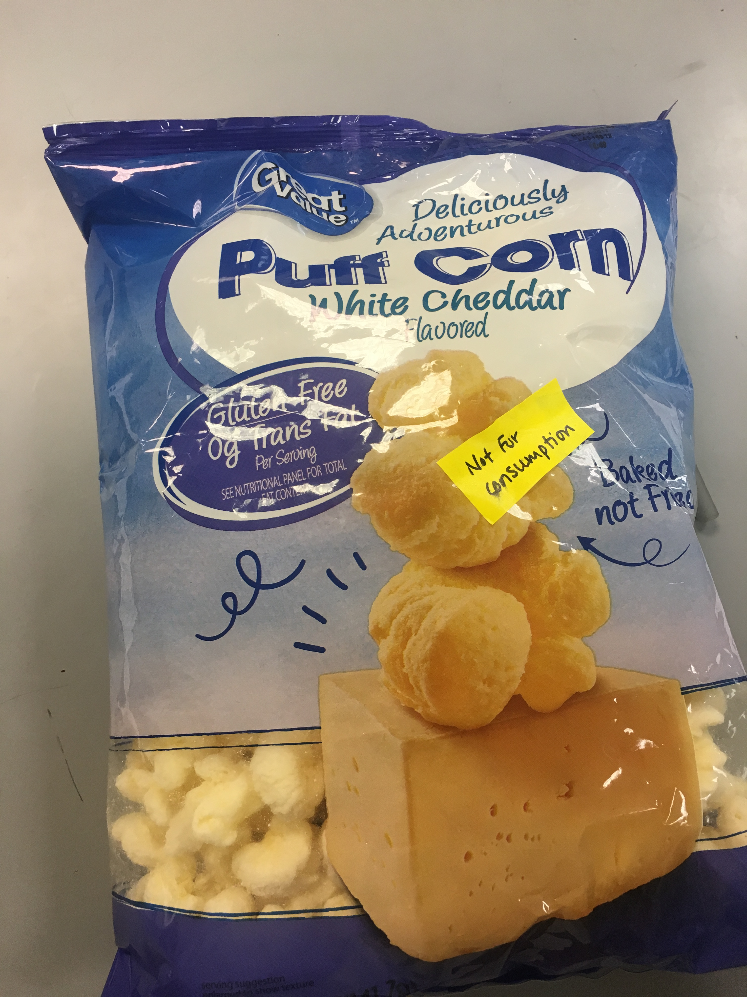
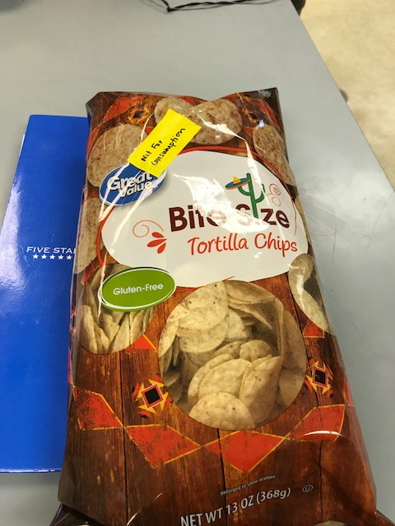
GMO Presence in Foods
Brandon Jones & Cammy Toddy
Data
Background
BIOL 101-50
Genetically Modified Organisms (GMOs) are present in many common foods that many people are not aware of
GMOs can be defined as living organisms with genetic material that has been artificially manipulated in a laboratory by genetic engineering (“What is GMO?”, 2016)
Journal of the Royal Society of Medicine studied the safety of genetically modified plants and their effect on human health
Researchers found that genetically modified plants carry more mutations than their untransformed counterparts
Led researchers to have suspicions that plants and crops may be produced with lower levels of nutrients and higher levels of toxins they found that genetically modified crops are highly regulated by the government (Key, 2013)
Longwood University
Figure 4 represents gel electrophoresis
First lane is the ruler and indicates the number of base pairs starting from 1,000 going to 750, 500, 200, and 100
Anything that falls below 100 base pairs is relevant
Shaded in well represents the presence of DNA in either our control or tested food
Methods
Extraction of DNA from Food Samples
Weigh 0.5-2g of food product
Add 5ml of water then grind with mortar and pestle
Place in screwcap tube of “non-GMO” InstaGene matrix
Place tube in centrifuge
PCR Reactions
label and insert 4 tubes with 20 ul of PMM and 4 with 20 ul of GMM
Electrophoresis
Use 3% agarose gel to separate bands so they can be seen
Observe results and draw conclusions
Figure 2. Food 2, Bite Size Tortilla Chips
Figure 4. Gel Electrophoresis results
Figure 1. Food 1, Puff Corn
Specific Aim
Purpose: test the presence of GMOs in everyday food products
Initial Hypothesis: was the greater the amount of known GMO ingredients such as corn and soy, the more likely the product was to contain GMOs
Conclusions
There appeared to be a negative correlation of GMOs between the DNA of the corn puffs and tortilla chips mixed with either plant master mix or GMO master mix
The results showed that both foods did not contain GMOs
The hypothesis was incorrect because the ingredients listed in the food products are typically linked to GMOs, but in this case, they did not show signs of GMOs
Through the evidence in the gel electrophoresis image, there seemed to be more DNA present in food 1 than in food 2 because lane 4 was more heavily shaded than lane 6.
Citations
Keenan, Chris. (2013, June 19). Top 10 Most Common GMO Foods. Cornucopia Institute,
Retrieved from https://www.cornucopia.org/2013/06/top-10-most-common-gmo-foods/
Key, S., Ma, J. K.-C., & Drake, P. M. (2008). Genetically modified plants and human
health. Journal of the Royal Society of Medicine, 101(6), 290–298.
https://www.ncbi.nlm.nih.gov/pmc/articles/PMC2408621/
What is GMO?. Non GMO Project, (2016). Retrieved from
https://www.nongmoproject.org/gmo-facts/what-is-gmo/

