Slide 1
Impacts of Social Media K-12
Tim Pellerin and Melanie Womble

Slide 2
Learning Targets
I can recognize positive and negative impacts of social media
I can identify different applications that parents and educators should know about
I can collaborate and brainstorm different ways educators can help students develop a positive digital footprint

Slide 3
Icebreaker- Wordle
https://www.polleverywhere.com/free_text_polls/EFhVuhDPRN3MNbpxUG3WF
Notes:
Melanie

Slide 4
EVEN IF YOU AREN'T ACTIVE ON SOCIAL MEDIA YOU NEED TO HAVE A FUNDAMENTAL UNDERSTANDING OF WHAT YOUR STUDENTS ARE ENGAGING WITH ON SOCIAL MEDIA.
Ruling Our Experiences, 2019

Slide 5
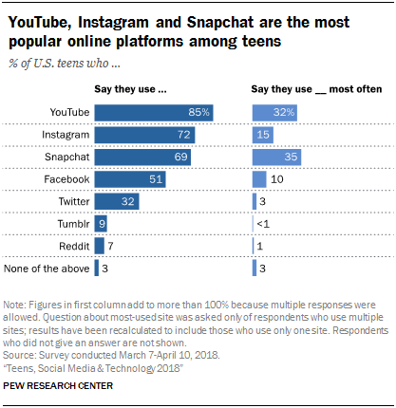

Slide 6
Social Media Usage
Humans possess a fundamental drive to compare themselves with others. This serves many different functions such as fulfilling affiliation needs (Schachter, 1959), evaluating the self (Festinger, 1954), making decisions (Camerer & Lovallo, 1999), being inspired (Lockwood & Kunda, 1997) and regulating emotions and well-being (Taylor & Brown, 1988).
https://newyorkbehavioralhealth.com/social-media-use-and-self-esteem

Slide 7
Trends
Negative impact on self-esteem
Self-esteem can be conceptualized as both a mostly stable trait that develops over time as well as a fluid state that is responsive to daily events and contexts (Heatherton & Polivy, 1991). As a result of chronic or occasional exposure to upward comparisons on social media sites, there could be a negative impact on people’s self-evaluation and self-esteem. Everyday chronic social media use may affect trait self-esteem negatively, while state self-esteem can also be affected by incidental use. In fact, research shows that people who use Facebook frequently report higher depression rates and decreased well-being (Feinstein et al., 2013).
https://newyorkbehavioralhealth.com/social-media-use-and-self-esteem
Notes:
Traditionally, social comparisons (in offline contexts) include in-person interactions with others (family members, coworkers, etc.). However, as people use social networking sites more and more, the majority of their comparative information is positive (upward). This is due to the fact that social networking sites provide the perfect platform for meticulous self-presentation by allowing users to select content on their profiles, post pictures, and represent themselves in ideal ways (Rosenberg & Egbert, 2011).

Slide 8
Trends continued...
Lack of social skills Unable to concentrate
Decrease of sleep Lack of Physical Activity
Increased Anxiety and Depression
Cyberbullying
Social Isolation - (FOMO)
http://www.bbc.com/future/story/20180110-the-vital-time-you-really-shouldnt-be-on-social-media
https://www.techprevue.com/negative-social-media-adolescents/

Slide 9
How social media is impacting student achievement?
Time management
Students struggle with understanding how SM fits into their academic planning
Ability to study effectively
Cognitively students can not separate when or when not to use SM
Social Interactions
Those brought in school that disrupt the educational process
“It has become their best friend”
They turn to social media for “Instant Acceptance”
Lack of Parental Involvement
Personal Communication skills/Interpersonal skills
how to communicate with adults(Teachers)
How do they feel when they come into your class based on SM?
Notes:
Teens spend on average 9 hours a day consuming media
24% of teens go online almost constantly

Slide 10
High School Perspective
Impacts grades, distraction
Students are unable to shut off or remove themselves from a conflict (cyberbullying continues even when school is out), allows students to be anonymous.*
Social media is attached to self-esteem*
Disrupts sleep*
Lack of self-control*
Improper English*
The false belief that if it is online it must be true, creates false reality*
Students post their thoughts and feelings - (Suicidal ideation)*
Using SM to post taped fights* or threats of fights*
Social media does allow students to stay connected
Networking
Platform for social causes
Notes:
We understand the main idea behind why SM was created however we need to “Educate students that SM is not the real world”.

Slide 11
What the students have to say about SM
https://www.commonsensemedia.org/videos/social-media-social-life-teens-reveal-their-experiences

Slide 12
Apps that could be potentially dangerous for our students
Tik Tok IMVU Snapchat Whisper
YouTube Houseparty Instagram Vsco
Telloymn Tinder Look kik.
Bigo Live Voxer Tumblr ask.fm
https://www.familyeducation.com/mobile-apps/a-complete-guide-to-potentially-dangerous-apps-all-parents-should-be-aware-of

Slide 13
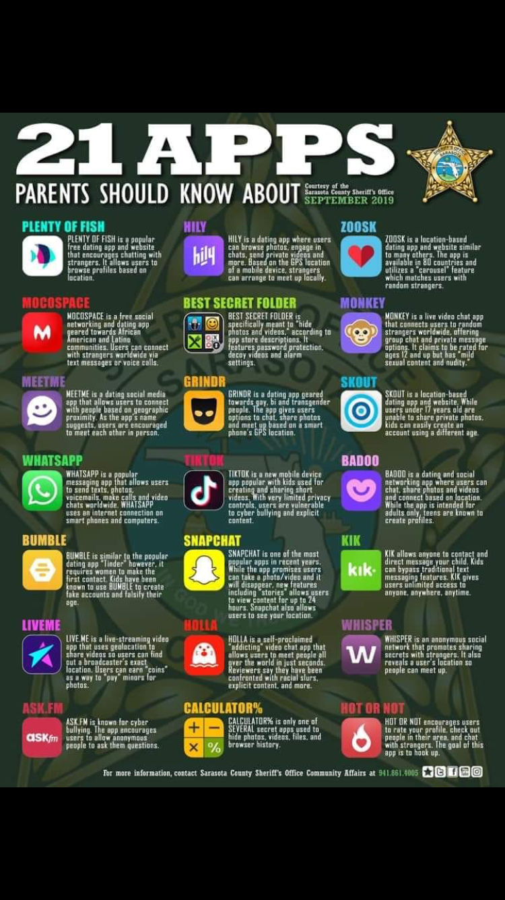

Slide 14
Ways SM Can Positively Affect Students
Empowered to show family members how to utilize technology
Create a positive digital footprint- Linkedin etc.
Provides parents an opportunity for open communication
Learn essential job skills
Allows students to stay in touch with family/friends
Study groups
Form of expression and a way to spread kindness
https://smartsocial.com/positive-impact-of-social-media/
https://smartsocial.com/positive-impact-of-social-media/

Slide 15
How to Encourage Positive Social Media Use
Be a role model- Utilize social media in a positive way
-quotes, positive figures, colleges, careers etc.
Use social media in the classroom- Teach them the skills
-Twitter for research or Blogs to show work in the classroom
-Seesaw
Encourage parental involvement

Slide 16
What can we do as Educators?
Break into groups and brainstorm ideas on the chart paper.
Discussion

