Slide 1
School Improvement Plan
PEDU-671-P13
Amanda Yoder & Tim Pellerin

Slide 2
Vision Statement
VBCPS Vision Statement
Every student is achieving at his or her maximum potential in an engaging, inspiring and challenging learning environment.
Notes:
Tim
Kempsville Middle does not have a Vision Statement so we decided to look at the VBCPS Vision Statement which states: Every student is achieving at his or her maximum potential in an engaging, inspiring and challenging learning environment.
It aligns with our 3 goals with the emphasis on (Every Student, Achieving at his or her maximum potential). When evaluating this vision statement it does not address the global, life-long learners and preparing students beyond high school.

Slide 3
Needs Assessment
Notes:
Amanda
This school year we are fully accredited based on data from the 2017-2018 school year. Using the state accreditation report, we will focus on Students with Disabilities (SWD) and African Americans in both literacy and numeracy. We will utilize targeted supports inspired by our school data from state accreditation report, benchmark data, SDBQ, progress monitoring, and academic support meetings. Our school will continue to work with central office instructional specialists especially OPEC to focus on student-centered efforts with SDI, scaffolding, learning walks, and SWD folder with student descriptors. We will continue to support all our students by providing personalized and student-centered supports with more student agency and advocacy.

Slide 4
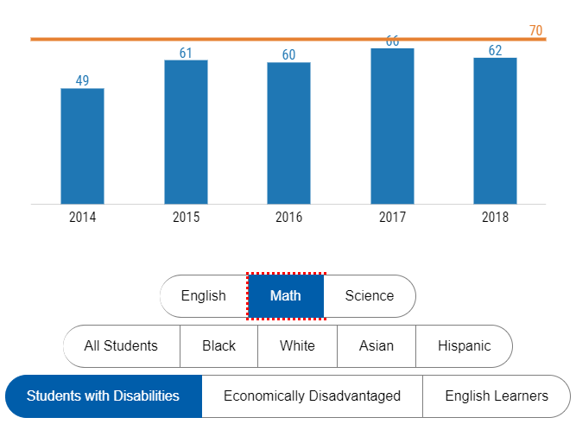
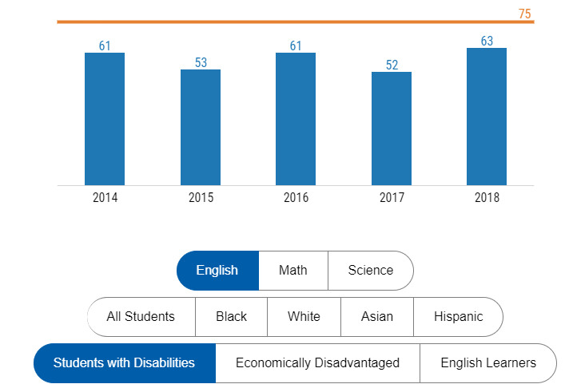
Needs Assessment
Math SWD
English SWD
Notes:
Tim
The data shows that we are below the benchmarks in Math and English for SWD’s. These are focus areas for our PCI with action steps to ensure the gaps are addressed.

Slide 5
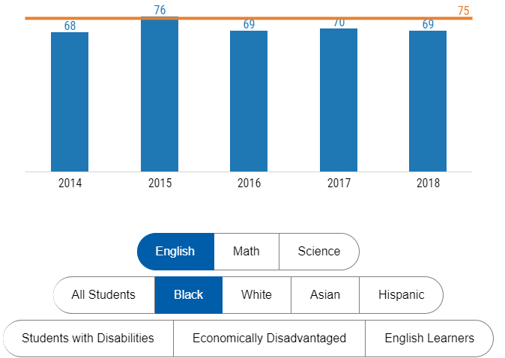
Needs Assessment
English AA
Notes:
Tim
Our AA population has seen some improvement in 2015 and a slight dip for the next 3 years.

Slide 6
SMART Goals for Improvement
By the end of the 2018-2019 school year, Kempsville Middle School will increase the English SOL-pass rate for Students with Disabilities from 54.81 to 59.33 or higher
By the end of the 2018-2019 school year, Kempsville Middle School will increase the Math SOL-pass rate for students with disabilities from 50.68 to 55.61
By the end of the 2018-2019 school year, Kempsville Middle School will increase the English SOL-pass rate for African American students from 66.02 to 69.42 or higher
Notes:
Amanda
Our central office administration is keen on ensuring our goals are truly obtainable, so while we’d love to see all student groups at 100%, our goals have small, achievable increases.

Slide 7
Goal 1- English SWD
Action Steps
Instructional Audit
Professional Learning Communities (PLC)- to include disaggregating data and alignment of learning plans/assessments
Grade Level Meetings focused on Writing to Learn
Data Chats
Academic Support
Tutoring and Remediation
IEP Goals- ensure alignment with deficits in data
Conduct ongoing PD related to Student achievement for SWD’s
Notes:
Amanda
Overall: 83.73 to 85.40. The school’s emphasis will be on writing.

Slide 8
Goal 1
Action Steps continued
Tech-based programs to include Achieve 3000, E-Science, and IXL (English)
Observations
Learning Walks
Review of Learning Plans
Content Vocabulary
Peer Observations
Notes:
Amanda

Slide 9
Goal 2 - Math SWD
Action Steps
Instructional Audits
Professional Learning Communities (PLC)
Grade Level Meetings focused on Writing to Learn
Data Chats
Academic Support
Tutoring and Remediation
Observations
Learning Walks
Review of Learning Plans
IEP Goals- ensure alignment with deficits in data
Notes:
Tim
Data chats are done during PD and is similar to speed dating where the administrators go from content area to content area in the cafeteria to discuss the data that the teachers are disaggregating from the assessments provided in the presentation and packets at their tables.

Slide 10
Goal 3 - English AA
Action Steps:
Instructional Audits
Professional Learning Communities
Grade Level Meetings to include Writing to Learn
Data Chats
Ongoing PD on relationship building & Diversity training
Academic Support
Tutoring and Remediation
Tech-based programs to include Achieve 3000, E-Science, IXL(Math)
Observations, Learning Walks, Review of Learning Plans
ARDT Funding and personnel
Notes:
Tim
Building relationships with students is a primary focus and we believe more training on relationship building and diversity is highly important.

Slide 11
Communication to Stakeholders
All goals and plans are communicated to teachers, staff, parents, and community members.
Regular dialogue opportunities to inform and update include:
Faculty/Staff Meetings
ILT Meetings
Parent Newsletters
PTA sessions
School Planning Council- Admin, Teachers, Students, Parents, Community
School Website
Notes:
Amanda

Slide 12
SCHOOL IMPROVEMENT PLAN

Slide 13
Resource Management
Action Step | Cost | Quantity
Tutors | $19,034 (Separate Budget) | 634 hours
Tutoring Snacks | $800
Collaboration Day- Subs | $ 10,450 | Requested 138, Got approval for 110 (Diff. pot from DT)
Math Coach | $0 | Counts as a staff allocation-approved by Downtown
Faculty Meetings | $500 | $25 per staff/per year
Total | $30,784
Notes:
Amanda
Tutor rates: Non-certified: $24/hr. / Certified (Teachers): $30/hr.
Funds are tracked using the 2018-19 Tutor Track Sheet
Funds used for certified and non-certified tutors
Principal requests collaboration days and that money is approved by the Executive Director and is a separate allotment 2017 (requested 64 positions) we increased it to 138 for 18/19
During School Day:
Tutors are paid by an outside agency called University Tutors
After School Day:
Tutors are paid by Remediation Funds

Slide 14
Data Monitoring
Benchmark Assessments-Pre, Mid, & Post Division Assessments
Reading Inventory Scores
TenMarks
Achieve3000
IXL Data (English & Math)
Data Chats
Learning Walks
Instructional Audits
Notes:
Tim

Slide 15
References
VDOE School Quality Profile
http://schoolquality.virginia.gov/schools/kempsville-middle
VBCPS Part-Time/Temporary Hourly Rates
file:///C:/Users/tjpeller/AppData/Local/Microsoft/Windows/INetCache/Content.Outlook/UUO5HW2X/PartTimeTemporaryRates.pdf

