Slide 1
PBL 1 Tiered Systematic approach to address excessive absences
Timothy J. Pellerin
Amanda Yoder

Slide 2
Notes:
Who is affected? 1 in 10 kids from Kindergarten to first grade are chronically absent, 2 in 10 (low Income), 2.5 in 10 (homeless), 4 in 10 (Transient)
Why it Matters? If they don’t come to school they miss out on fundamental reading and math skills.
What can families do? Get school start times, build routines, don’t permit missing school, schedule timely appointments.

Slide 3
Looking at the data
The attendance rate for XYZ Middle school was 96.4% in the
2017-2018sy
That is a 1.6% drop from the previous year due to there being 48 students who had excessive absences, excluding 5 for medical reasons therefore we need to put some tier1, tier 2 & tier 3 supports in place to address the absenteeism concerns from the division.
Notes:
The data to support why there is a need to have tiered level supports for attendance.

Slide 4
Excessive absences
Definition
All excused and unexcused absences will be included in computing excessive absences except as follows:
School-sponsored/related activities
Authorized visits of students with school personnel
Recognized religious holidays
In the high schools, students having more than twelve (12) absences from a class (excused or unexcused) within a given semester will be considered as having excessive absences. This guideline will also apply to credit courses taken at the middle school level.
In high schools with alternate day schedules (i.e. block scheduling), students having more than six (6) class absences from a class (excused or unexcused) within a given semester will be considered as having excessive absences. This guideline will also apply to credit courses at the middle school level.
In elementary and middle schools, students having more than twenty-four (24) absences for the year will be considered as having excessive absences.
Notes:
Policy states that 24 absences are excessive however we look at (2/3rds of 24) which is 16 as the target number before they get to 24. The problem with this is even excused absences are considered excessive.

Slide 5
Excessive absences(cont.)
Resulting Actions
When a student's absences equal two-thirds of the number for excessive absences, the school will notify the parent in writing of the number of absences and will be responsible for working with the student and the parent in developing a plan of corrective action as appropriate. Such intervention may include, but is not limited to, the following: parent conference; scheduled contact with parent; referral to the guidance counselor or school social worker; loss of privileges and/or restricted participation in school activities; referral to alternative learning program; and recommendation to the administration for other consequences.
When a student's absences are excessive, the teacher will notify the principal. The principal or his designee will advise the parent by United States mail of the appropriate following action:
In the elementary and middle schools (grades K-8), students having excessive absences will participate in a corrective action plan with intervention strategies to improve attendance. At the end of the year, on the authority of the principal, the student could be denied promotion as appropriate.
In high schools, students having excessive absences within a given semester will receive a failing grade (63/N) for that semester or the actual class grade, whichever is lower. At the middle school level, this guideline will also apply to credit courses.

Slide 6
Current supports
each Unexcused absence- the principal, or his/her designee, will make a reasonable effort to notify the parent of the pupil's absence and to obtain an explanation for the absence.
5th absence- Make a reasonable effort to ensure that direct contact is made with the parent/guardian by the principal or his/her designee, to obtain an explanation for the absences, and to explain to the parent/guardian the consequences of non-attendance.
6th unexcused absence- Within ten school days, the principal, or his/her designee, shall schedule a conference with the Student Support Team (SST),
7th unexcused absence- The principal, or his/her designee, shall refer the student to Juvenile Intake for an interview.
Notes:
Current supports in place for the 5th, 6th, and 7th absence. As we can see the current supports say ”the principal” or his/her designee, will make a REASONABLE effort. I find that left things open to interpretation because who decides what reasonable is?

Slide 7
Protocol for tracking student attendance
STAFF TITLE | STAFF RESPONSIBILITIES
Teachers | First parent contact, attend and participate in SRT meetings providing details regarding students’ academic progress as well as academic interventions that would benefit students.
School Counselor(s) | Check weekly report and schedule appropriate meetings when students reach 3, 5, or 7 full day absences. Create Tier 1, Tier 2, & Tier 3 interventions for students.
Student Support Specialist | When notified by the school counselor(s) will assist with meeting with students, create an attendance expectations contract.
School Social Worker | Communicate with admin/Counselors about students with 8 or more absences, conduct home visits and move towards CHINS petitions when appropriate.
School Administrator | Communicate with counselors and social worker about students with 16 or more, explain attendance contracts with parents/guardians, assist SSW with CHINS petitions when appropriate.
School Nurse | Attend and participate in SRT meetings providing medical/health information for students as well as resources and supports that benefit students.
Attendance Secretary | Run and distribute weekly attendance report for admin/meetings, Parent contact with 3,5,7, day attendance letters sent home.
Notes:
Protocols are a system of rules that explain the correct conduct and procedures to be followed in formal situations. Having defined protocols in places ensures that everyone has a responsibility when tracking attendance. This type of system details the steps to be taken by each member on the attendance team. We need to find out why our students are absent, hold the parents responsible by showing them that we care about their children and providing a safe environment for students to learn. There needs to be some accountability with recordkeeping.

Slide 8
Plan to implement the supports
Tier 1- Attendance secretary gives weekly report to Admin team, Letters sent home, Teacher contact, teacher meet with student one on one, Counselors meet with students/parent contact
Tier 2- Counselors Parent conferences, Individual counseling, Small groups, Student Support Specialist, SSW, Admin contact, Counseling lessons, ISS counseling
Tier 3- Admin, SRT, Attendance contract/Corrective Action Plan, CHINS
Notes:
Tier 1, Tier 2 and Tier 3 Supports and things to be done at each level. The roles overlap in each tier and therefore it becomes a collaborative effort. With any tiered level intervention it is designed to provide support at various levels increasing in intensity. The focuses is on addressing problems early with students who show signs of academic weakness, attendance concerns and/or behavioral concerns.

Slide 9
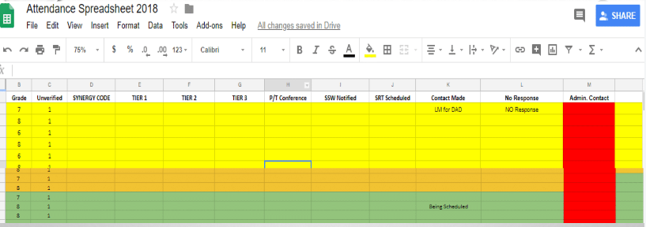
VDOE has implemented a new attendance tracking requirement to be recorded for schools to develop
plans, conferences and court referrals as defined below:
1= 5 or more unexcused absences and an attendance plan was developed
2= 5 or more unexcused absences but an attendance plan was not developed due to the outreach to the parent was unsuccessful
3= 5 or more unexcused absences but an attendance plan was not developed due to parent refusal
4= 5 or more unexcused absences but an attendance plan was not developed due to the student no longer being enrolled.
Notes:
Sample spreadsheet shared with all members of the team to update as contact is made or meetings have been held. We can use this method as a real time data tracking tool to monitor the efforts being made to reduce the number of excessive absences. Document, document, document! We will look at the total unverified, and the attendance secretary will enter the synergy code designated by the VDOE of (1, 2, 3, 4) identifying 5 or more absences and if an attendance plan has been implemented and it the parent was a part of, refused or the child is no longer enrolled. Identify the tier supports used, conferences and SSW contacts. VDOE has codes for attendance conferences (at 6 unexcused) and also Court referrals (at 7 unexcused).

Slide 10
Student Involvement
Provide opportunities through:
Clubs
Leadership opportunities- Beach Girls Rock(BGR), AAMS
Committees- SCA, Student Advisory committee
Mentorship Program
Volunteers – Helpers for school sponsored activities
Notes:
Ways that the school can encourage the importance of coming to school and get students involved to feel a sense of belonging. We need to empower our students through leadership opportunities, giving them a reason to want to come to school, to be a part of something. This is a way to strengthening their commitment to education, community and democracy.

