Slide 1
The Effect of Different Leaf Species on Earthworm Growth
Erin Axeman, Jevaun Thaxton, Angelina Sherba, Nicole Barclay

Slide 2
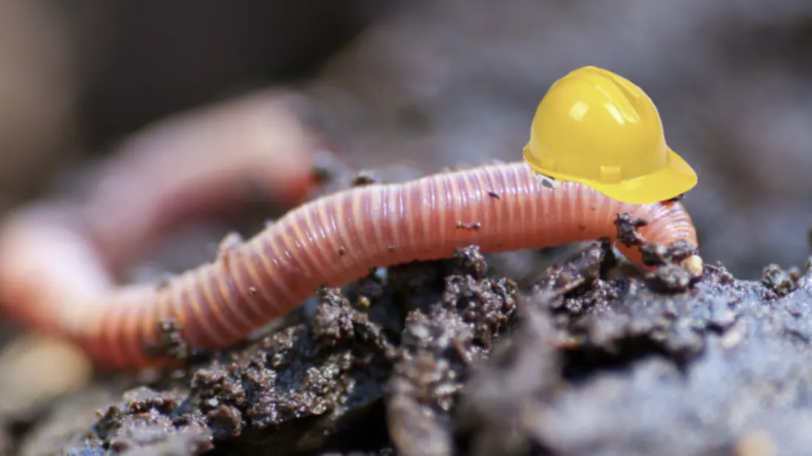
Introduction
Earthworms are soil dwelling invertebrates
Many factors affect earthworm distribution in soil (Schelfhout, S., et al. 2017)
Organic matter in soil may alter earthworm behavior (Suarez, E.R., et al. 2006)

Slide 3
Introduction
Earthworms can create new habitat conditions
Earthworms aid the break down organic matter (Traw, B.M. and Gift, N. 2010)
Earthworms can increase microbial biomass (Bray, N., et al. 2019)

Slide 4
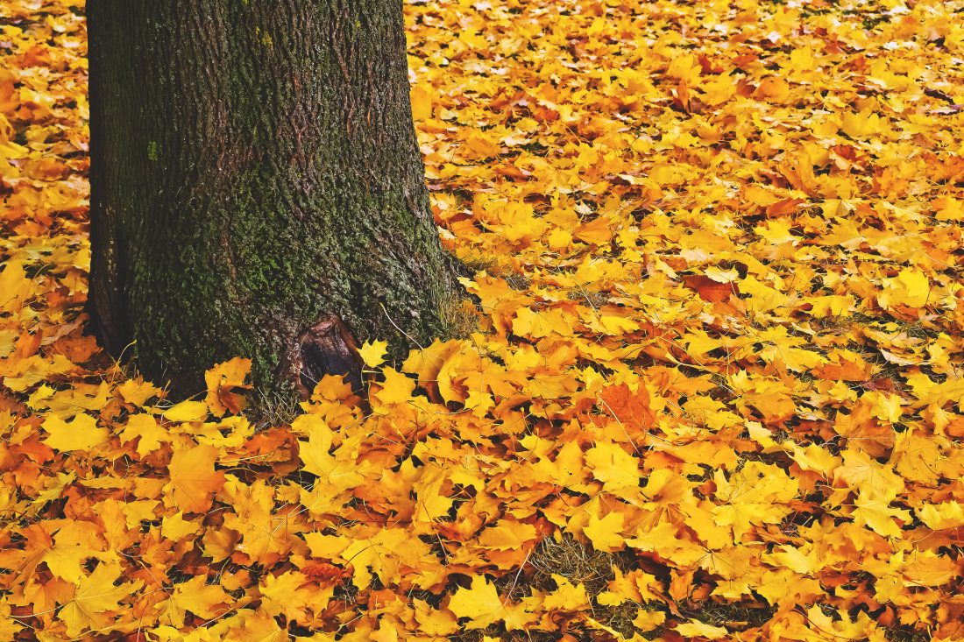
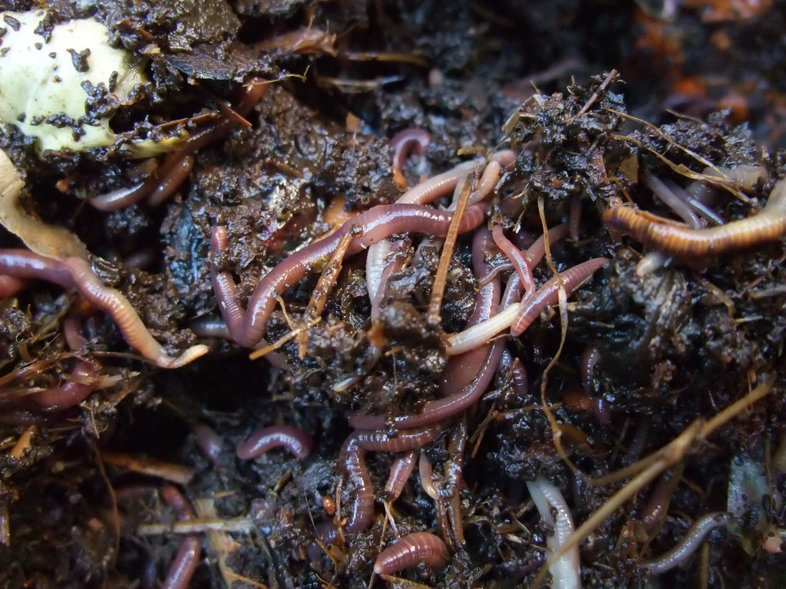
Introduction
Different tree species can change soil fertility with the leaf litter they produce [1]
Trees with higher litter create higher activity of earthworms [1]

Slide 5
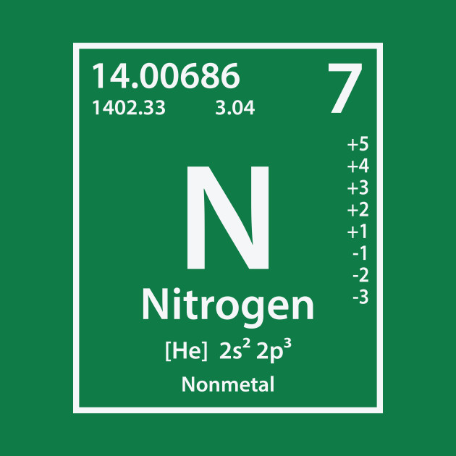
Hypothesis
Alternate: Leaves with more nitrogen and carbon content will cause the earthworms to grow larger than leaves that contain less nitrogen and carbon
Null: Different leaf species will have no effect on earthworm growth

Slide 6
Methods
Step One
Step Two
Step Three
Twelve containers were filled with potting soil (three blackjack, three red maple, three mix, and three no leaves)
Twenty-four worms were weighed and recorded
Two worms were put into each container
Worms were bought
Leaves were collected around Longwood campus
Worms were weighed and recorded once a week for four weeks
Soil was watered every other week

Slide 7
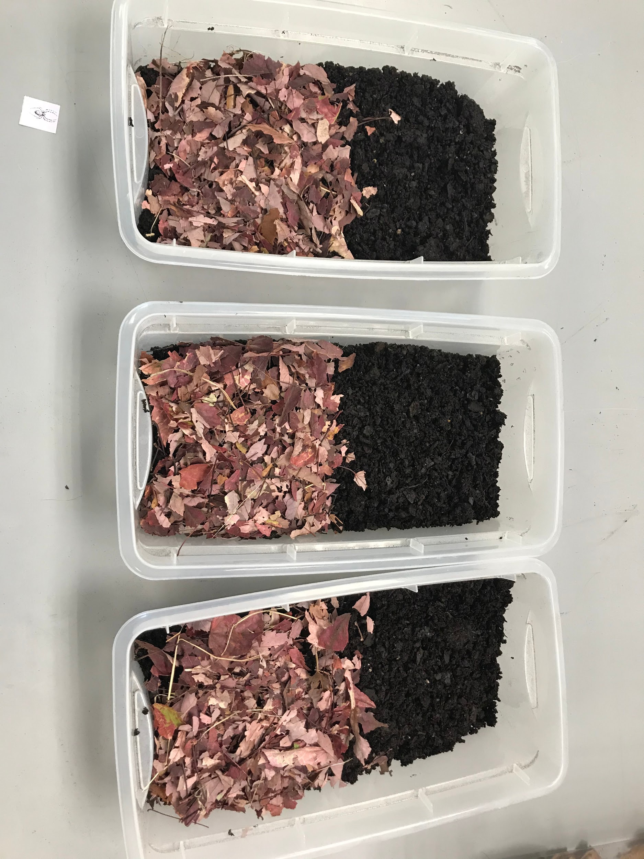
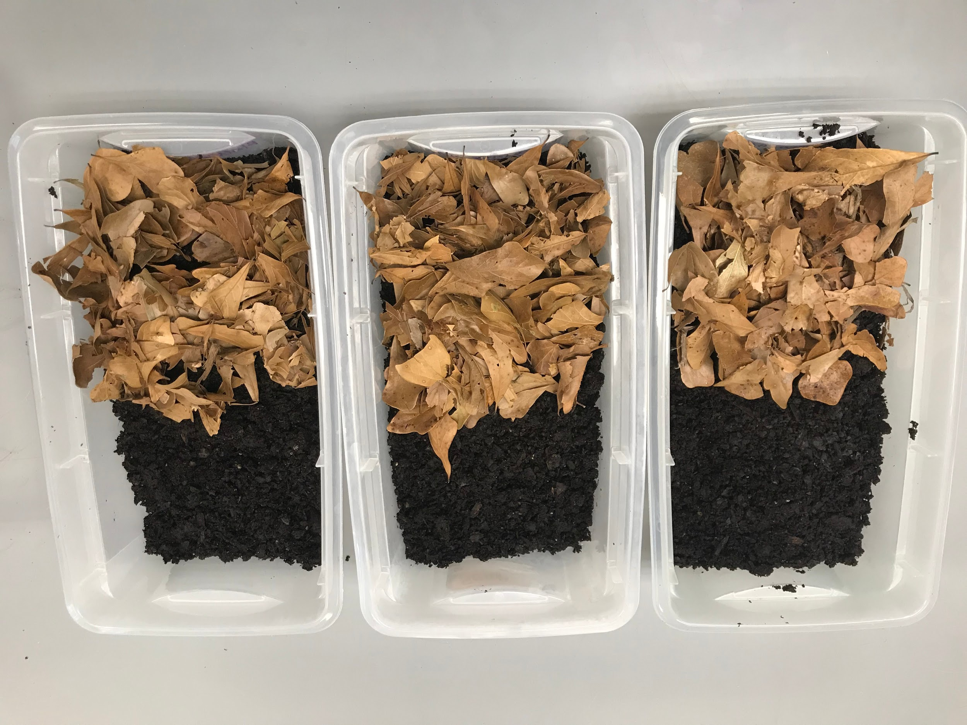
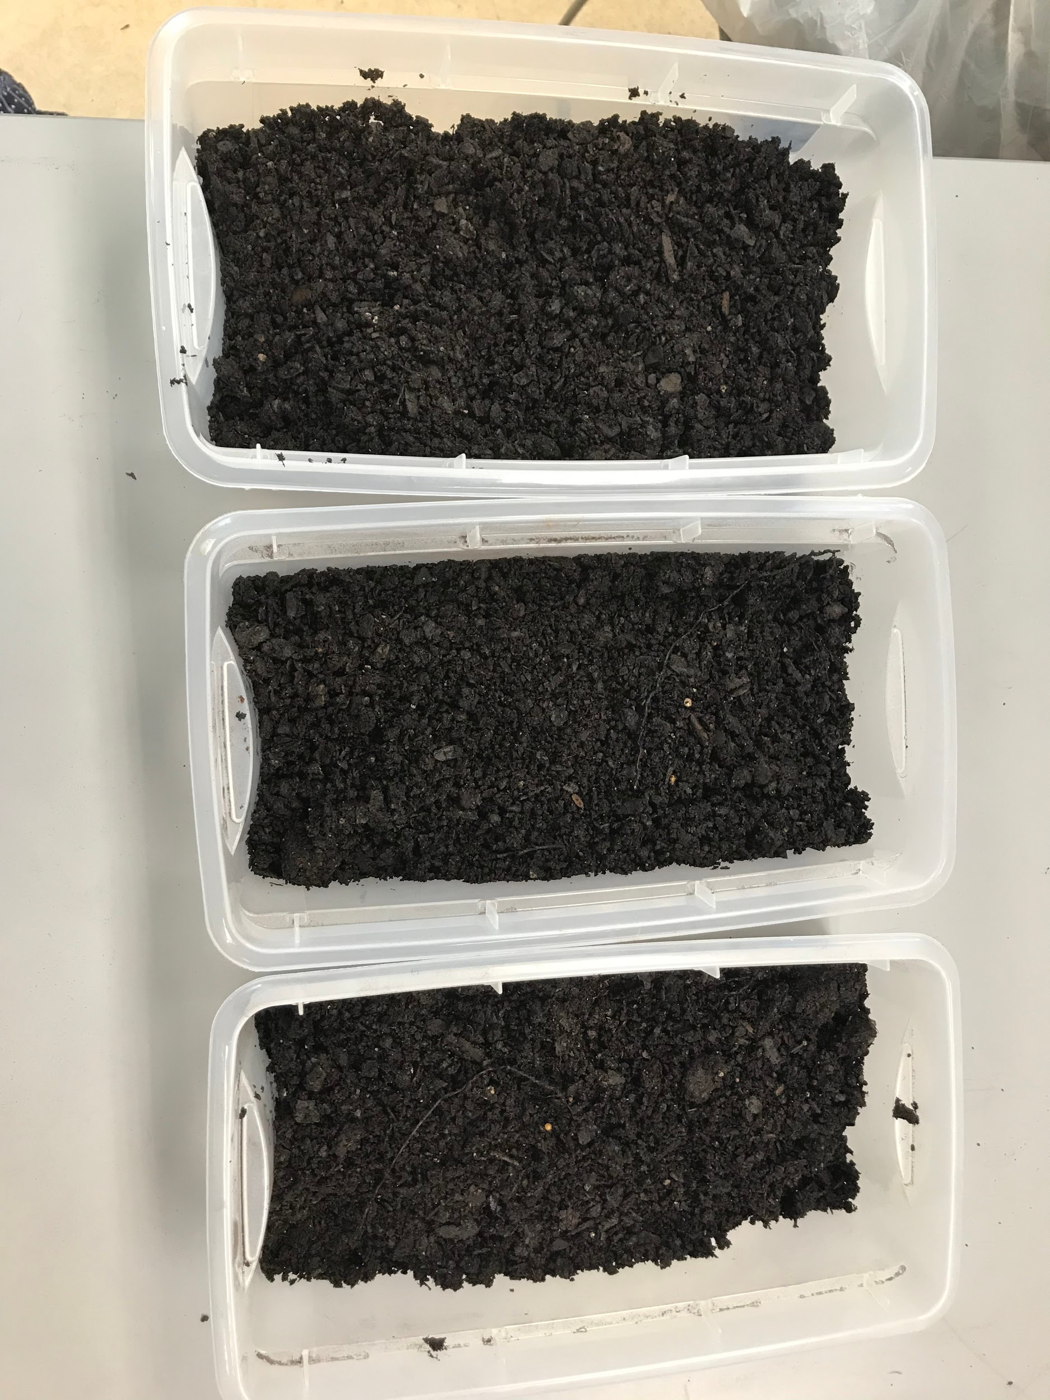
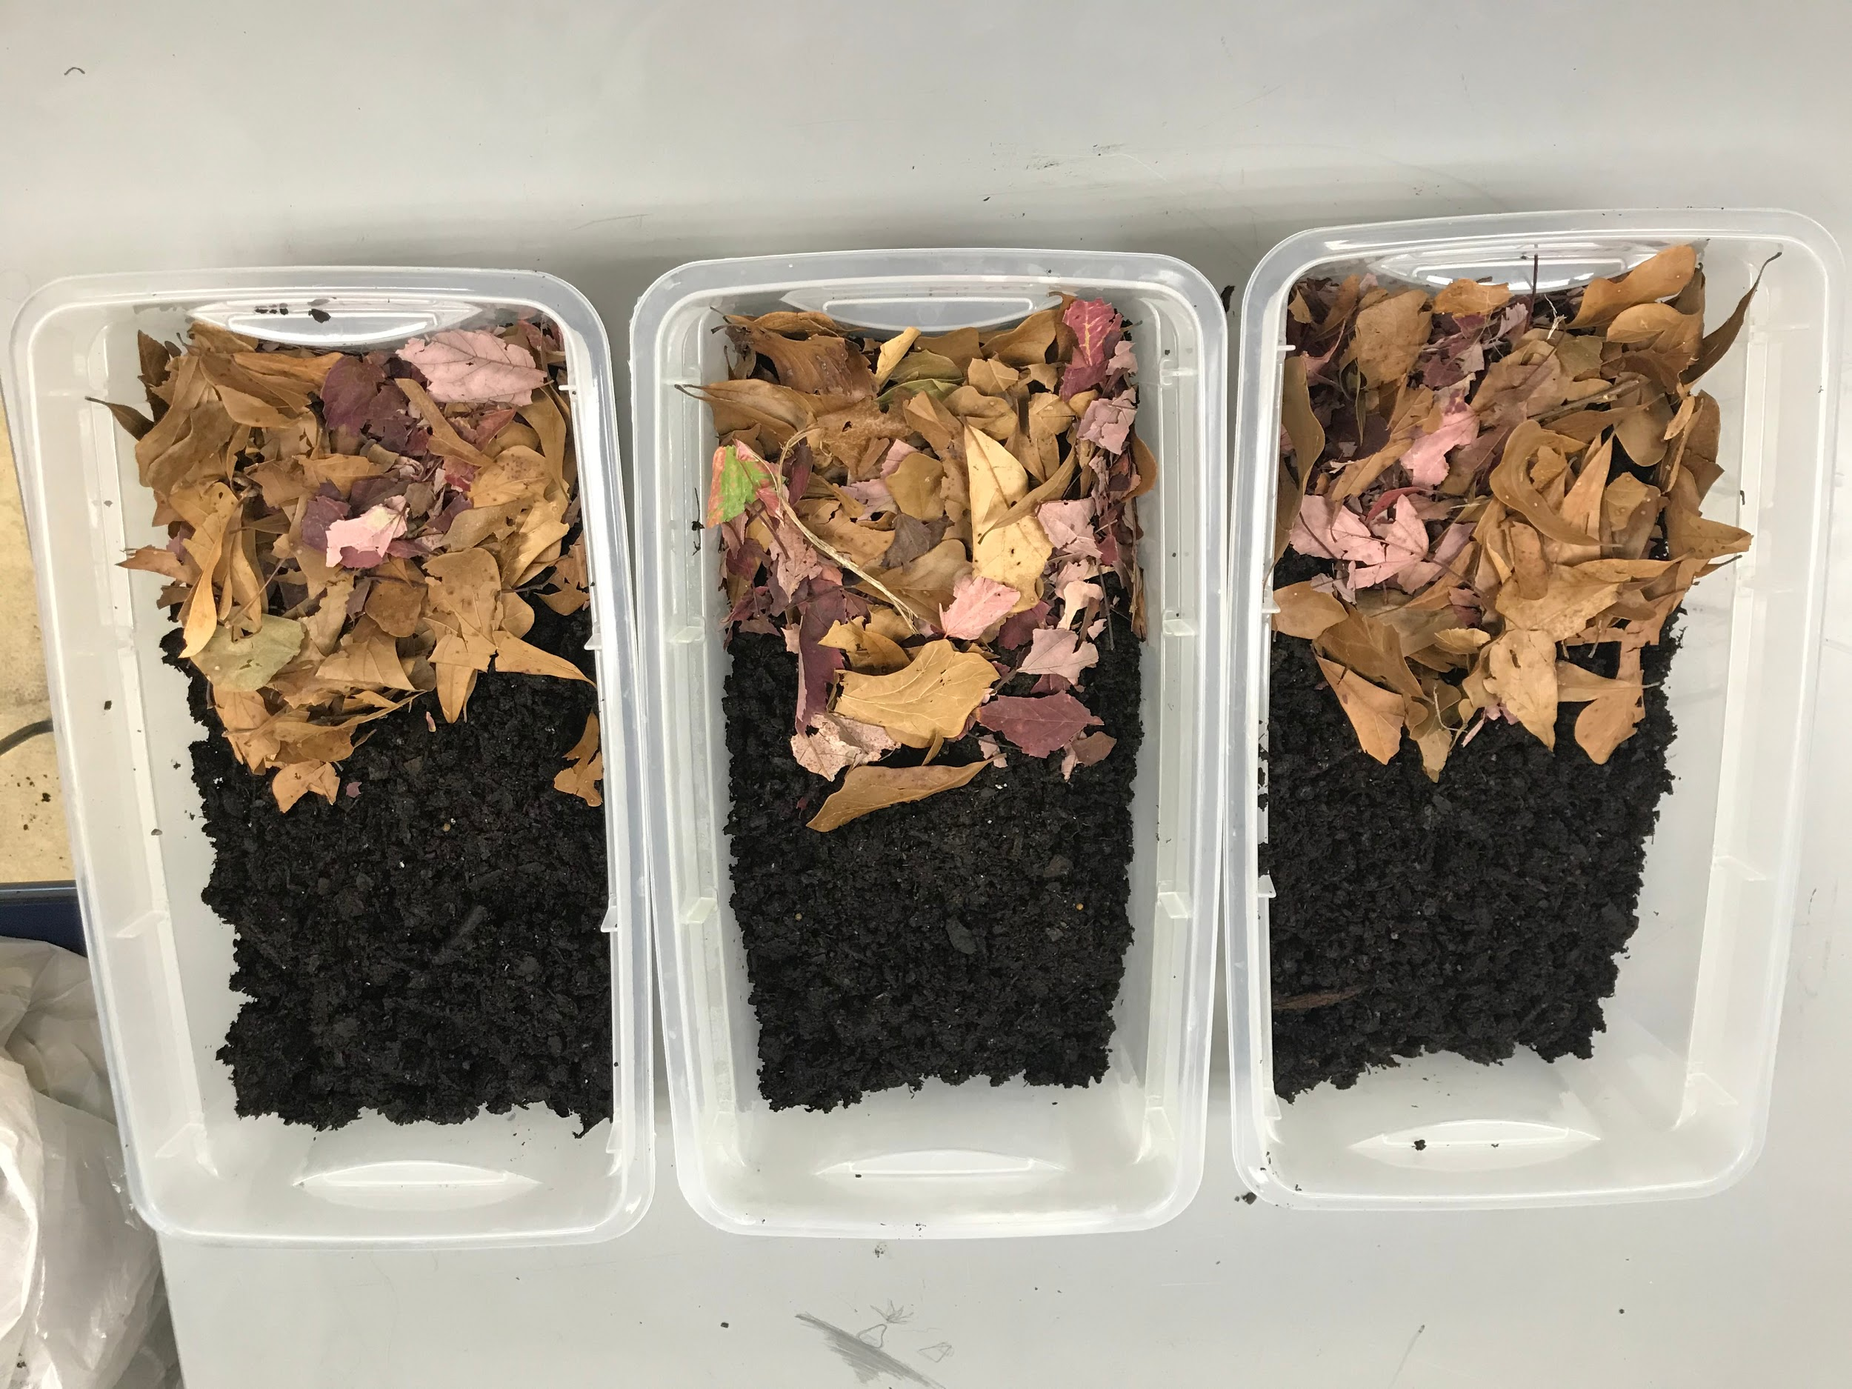

Slide 8
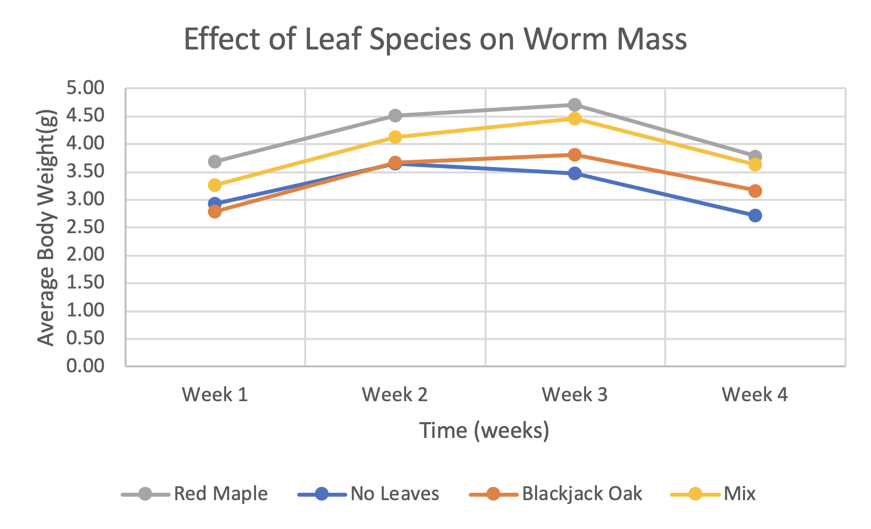
Results

Slide 9
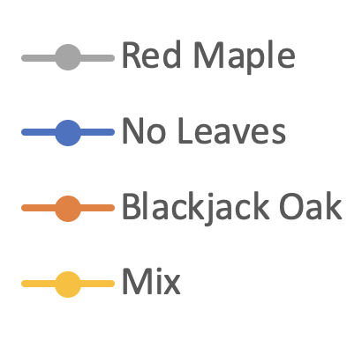
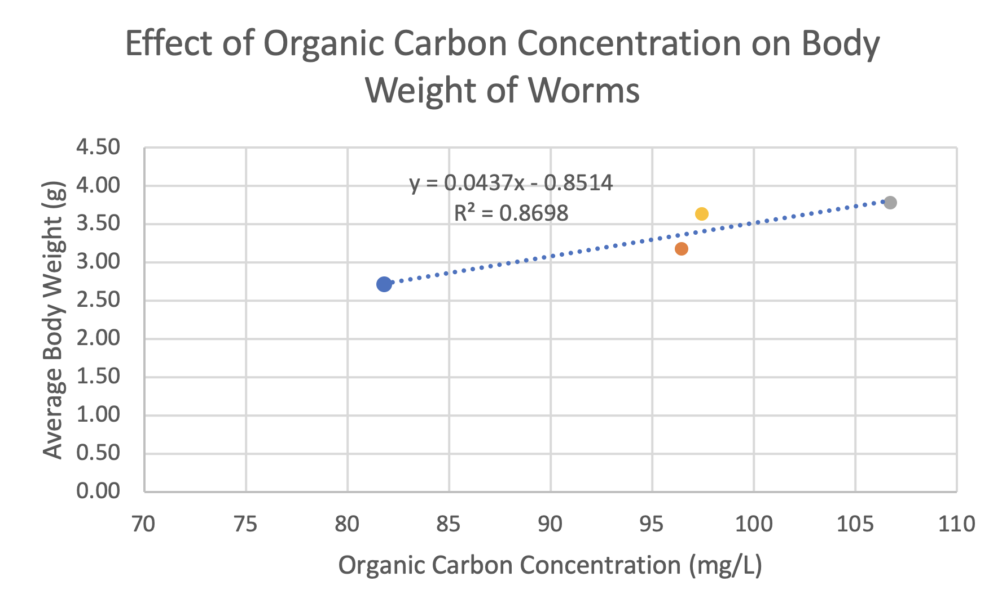
Results (continued)
Notes:
Not statistically significant

Slide 10
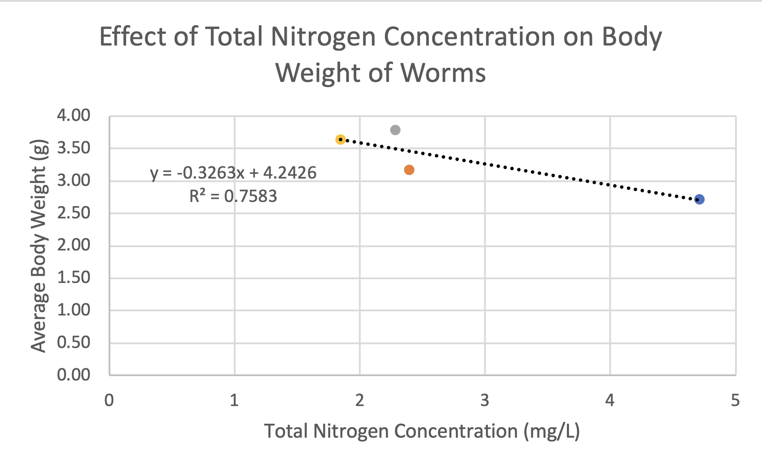
Results (continued)
Notes:
Not statistically significant

Slide 11
Discussion
Different tree species contain different concentrations of nutrients
The worms found under the leaves had a significant difference in worm size
The type of leaf species did not have a significant difference in worm size
Our prediction was not supported because the mixed treatment did not have the greatest concentration of organic carbon or nitrogen

Slide 12
Conclusion
The mixed leaves did not have the most amount of carbon and nitrogen
Position of the worms played a significant role in earthworm growth
Type of leaf species did not play a significant role in earthworm growth

Slide 13
Improvement
Labelling individual worms
Elimination of other organisms in the soil
Measuring organic carbon and nitrogen at the beginning of and throughout the experiment as well
Consistent watering

