Slide 1
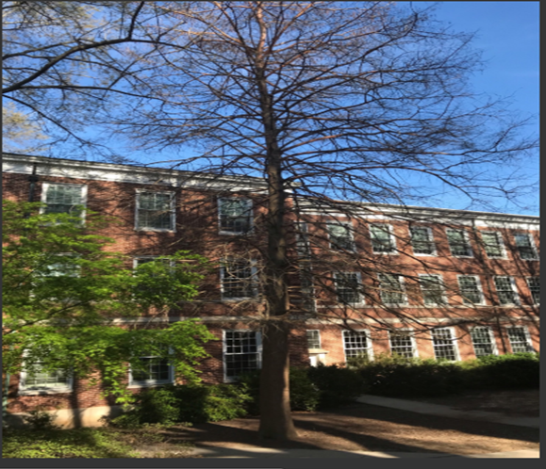
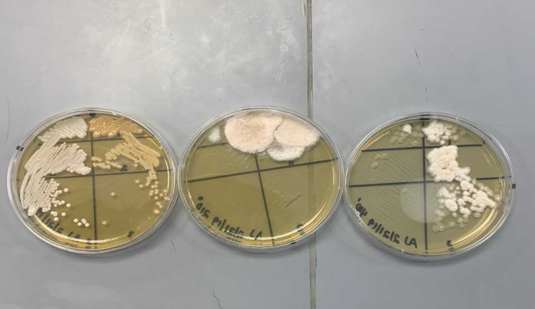
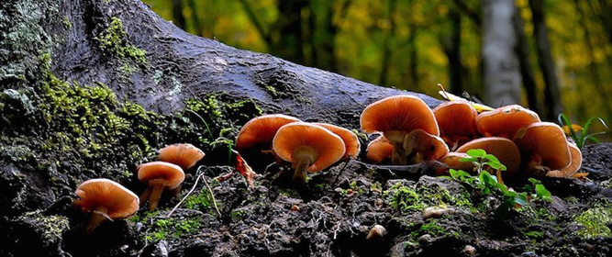
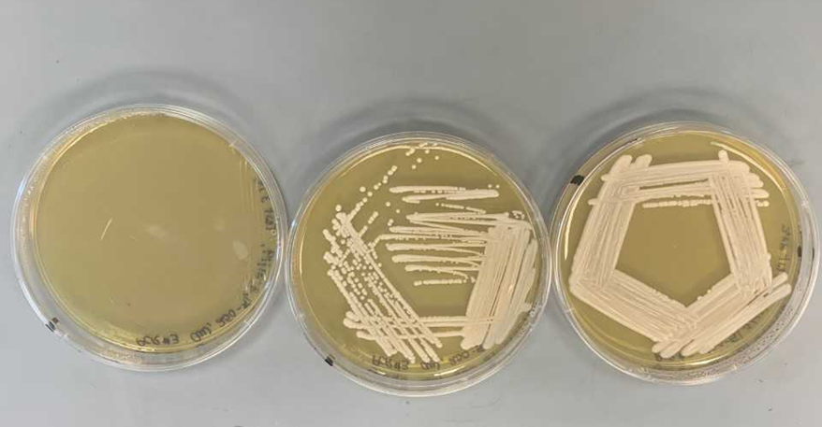
Isolation of Yeast from a cedar tree at Longwood University Arjhane’ White and JevaunThaxton
Figure 1. Isolated yeast colonies from original agar plates. The three images are in increasing order of dilution from left to right.
Background
Fungi form mutualistic relationships with plants
Yeast is a eukaryotic fungus
It inhabits diverse places all the way from animal fur to rain puddles
It can be harvested from natural surfaces (ex. tree bark)
Hypothesis
Yeast will prefer to inhabit the roots of the tree, due to there being more available nutrients.
Specific Aim
Determining what level e.i roots, low trunk, or high trunk do yeast prefer to grow on trees.
Methods
Take 2 inch cuttings from tree bark and dilute the samples at three different levels
Plate sample dilutions on agar plate and allow yeast to grow
Collect morphology of yeast colonies that appear on the plate.
Isolate colonies and run PCRs and biochemical test assays on new isolated samples.
Perform DNA sequencing and record top matches for yeast identification
Clustering Analysis
Citations
Wang, Shin et.al. ,2008. fungi in forest trees: are they mutualists, Fungal biology 75–89.Saccharomyces arboricolus sp. nov., a yeast species from tree bark, International Journal of Systematic and Evolutionary Microbiology, 58, 510–514.
• 2.Goddard, Matthew et. al. 2015. Saccharomyces cerevisiae: a nomadic yeast with no niche, FEMS Yeast Research, Volume 15, Issue 3.
•3.Rao, R.S.,2008. Isolation and characterization of ethanol‐producing yeasts from fruits and tree barks, Centre for Cellular and Molecular Biology 500 007.
•4. Thomas, N. S., 2007. Endophytic •1
Results
Conclusions
The yeast species Cystofilobasidium capitatum was isolated fron the cedart tree.
yeast prefer to grow at the base of trees.
Figure 3. Yeast colonies that grew after being introduced to three different conditions.
Notes:
The first agar plat(right) had its yeast introduced into an environment with a different temperature than its original agar plate. The second agar plate had its yeast colonies introduces into a .5 mol salt environment. The third agar plate had its yeast colonies introduce into a 1% starch environment.

