Slide 1
The Effects of Reminiscence Therapy on Dementia with Depression Symptoms
Rebecca Locey

Slide 2
Agency Summary
Imperial Plaza Senior Living includes Independent Living (IL), IL Plus which is just independent residents who need assistance with their medications, Assisted Living (AL), and Memory Care (MC) residential facility.
The agency does provide full dining options, transportation, and ability to hire companions for appointments or needs in their apartments as well as a doctor’s office, grocery store, and pharmacy onsite. AL & MC has 2 nurse practitioners who do room visits. Also has in house maintenance and activities for all levels of care. The agency also offers housekeeping for all rooms.
Serve older adults, which also include residents with mental health which includes those who have dementia/memory loss, Schizophrenia, Bi-Polar disorders and many more, residents with physical disabilities such as amputees, multiple sclerosis, visual impairments and many more, developmental disabilities like Down syndrome, ID and many more.
Imperial Plaza is located in Richmond, VA near the Bryant Park Interchange.

Slide 3
RT Services
The Therapeutic Recreation services provided at Imperial Plaza include exercise programs, cooking programs, community outings, music programs, holiday theme events, family events, arts and crafts, virtual travel, brain teasers, spiritual/religious programs, and Bingo
(Imperial Plaza, Monthly Calendar)

Slide 4
Populations Served
Primary disability groups served by this agency are participants with memory loss like dementia and Alzheimer’s disease. Also diabetes which usually has another diagnosis along with that. Physical disabilities like weakness/loss of mobility/balance which is not necessarily due to a specific disease process, also the loss of hearing and sight which is generally not the total loss but only a partial loss of hearing or sight. Mental health disabilities like Schizophrenia. They also have developmental disabilities like Down syndrome and multiple sclerosis.

Slide 5
Strengths and Areas of Improvement
Strengths- The strengths of Imperial Plaza RT program is the variety of programs offered each week and especially each month which address physical, cognitive, social, spiritual, and intellectual needs of the participants. Another strength is the range of disabilities they are able to serve in just one population, older adults. They also have the strength of being able to think on the fly and change things as they go to better fit a goal or outcome they chose for the activity.
Areas of Improvement - One major weakness in the agency is the lack of documentation on the programs and the participants. This makes it difficult to know for sure which programs are working and which are not for individuals and as a whole the disability or population.

Slide 6
Overview of RT Program
Following the individual initial assessments after admission which are also done with following up the questions with family to compare answers to ensure information is accurate, the CTRSs base their monthly programs on the interests as well as the wants and needs of the resident’s so they will be more involved and active and feel like they are more involved because their ideas are being used.
The Recreation Therapy staff gather together in a meeting before the start of a new month to discuss the monthly calendar and the leisure activities they want to do based on holidays and just the normal activities they use each month. But along with the group they also take into consideration the ideas of the resident’s which they get when the have resident council meetings and ask what programs they would like to see on the calendar.
Their programs include exercise, cooking, music, outings, health/beauty, travel, holiday themes, family events, and arts and crafts, bingo, brain teasers, virtual travel and religious/spiritual programs.
Participants are reassessed only if needed to be as request of a staff member or recreational therapist, but they can also be done annually based on changes in the resident’s behavior or treatment.
Imperial Plaza does not do documentation on their programs, they do like attendance sheets to see who was there, but there is not much documentation done on the process of the program or residents. It is not mandated at the agency. They only use directions for programs or recipes for cooking programs.

Slide 7
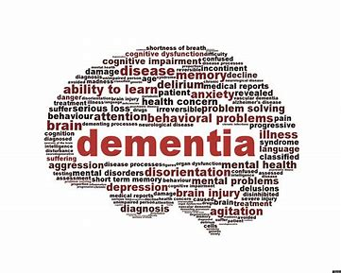
Identified Problem
Resident’s with dementia quite often have depression or a form of depressive symptoms that come from the changes in their life due to the disease. The depression causes changes in self- esteem which lowers, decline in the quality of life and behavioral changes. This is all also due to the memory loss which is associated with the disease.
In the last few years, the use of Reminiscence Therapy (RT) has been used to tackle these effects of dementia without the use of antipsychotics or other medications used to control these symptoms or lessen them. But the research says that medications are not as successful for they cause side effects of their own which can be dangerous to the resident’s.

Slide 8
PICO(T) Statement
The Older Adults with dementia participate in a one hour reminiscence therapy group session once a week for 8 weeks to reduce depression versus the residents who do not receive the reminiscence therapy intervention.

Slide 9
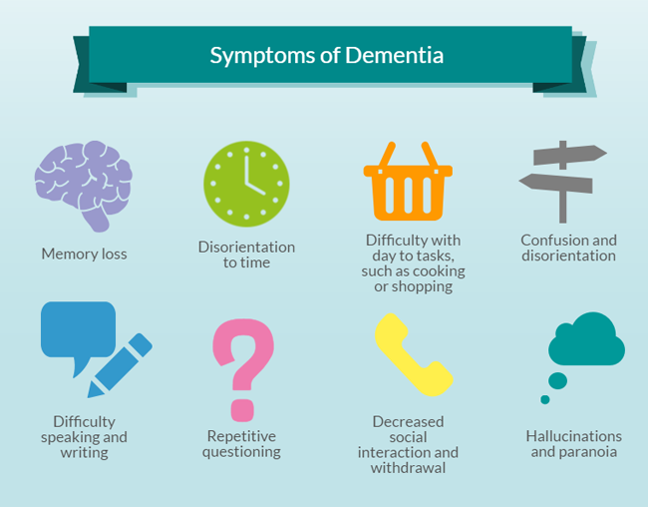
Key Findings- Literature
In studies I found, some said that at least 8 sessions would be a minimum for Reminiscence Therapy to be beneficial, but my studies also recommend that doubling the sessions to 16 could show more change and positive results so doing two programs a week or one program a week for 16 weeks would be something to look into.
Receiving RT can help in decreasing depression and depressive symptoms, behavioral changes, improve memory, increase socialization, improve self-esteem , lower irritability and increase the quality of life.
There are different forms of implementing RT (i.e. group, 1:1, or digital/virtual settings) depending on the wants and needs of the resident. In the instance of the different forms, group setting would benefit Imperial Plaza the most for the other programs are mostly done in group settings for it is not always enough time in the day to do 1:1 Reminiscence Therapy sessions and with this pandemic staff has also been short handed so it would benefit the staff as well to do a group setting.
In a couple of my studies, they recommended using a digital or virtual form of Reminiscence Therapy which is like a storybook done online. These forms were recommended as easier to maintain in a 1:1 setting more than other settings. This form would not be beneficial for Imperial Plaza for they do not have all the technology or means to implement this program virtually at the moment.

Slide 10
Key Findings- Expert
When speaking with Angela Mesa we went over the specifications of my literature summary. One of the main points Mrs. Mesa had after reading it initially was how I would successfully measure the depression to determine if the intervention met the outcome and what did majority of the articles due to measure the depression in their study to generate ideas. (Song, D., Shen, Q., Xu, T., & Sun, Q., 2014)
Another point she made was because most of the articles I found have more things that are being improved by the reminiscence therapy like memory, self-esteem, and quality of life, and she made the comment maybe I should incorporate those into my PICO(T) statement to give more to measure in the intervention. Park, K., Lee, S., Yang, J., Song, T., & Hong, G., 2019 & Chen, Y., Xiao, H., Yang, Y., & Lan, X., 2017)
My mentor also saw that two or three of my articles had to do with a digital form of reminiscence therapy and stated that they may not have the proper equipment or enough technology to be on a zoom call as well as participate in the digital intervention so to maybe stray from that this time until they are more equipped. (D’Cunha, N., Nguyen, D., Naumovski, N., McKune, A., Kellett, J., Georgousopoulou, E., . . . Isbel, S., 2019, Moon, S., & Park, K., 2020 & Subramaniam, P., & Woods, B., 2016)

Slide 11
Recommendations for Agency
Based on my research and my mentor’s expertise on the population and topic of dementia and depression, I suggest the agency implement the RT program in a group setting to benefit more residents and work with the activity schedule and short hand of staff. It also creates the socialization aspect that would be beneficial for the resident’s as well for they would be able to tell stories and hear stories from others which could jog more memories for the resident’s.
Reminiscence Therapy could be implemented in an Assisted Living setting, especially by incorporating different methods and uses of delivering the program like using prompts or props like personal items to the resident or residents in general from present or past memories . It could also be used by using pictures or items from years of their life to jog memories of events they experienced in their lifetime.
Sadly, there is a inconsistency with being able to hold programs like before due to the pandemic so advertising to the right population and scheduling a time that works for them would be beneficial to the success of the RT program. Once a week could be easier to schedule and just extend the program for 16 weeks so it doesn’t tire the resident’s out on the program to fast.

Slide 12
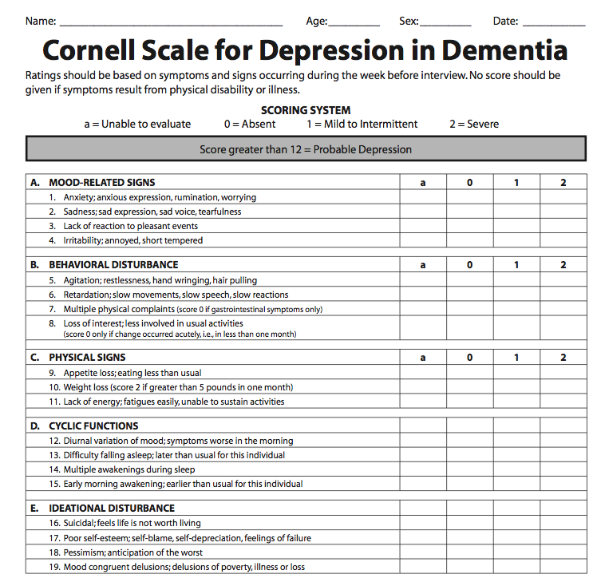
Recommendations for Evaluation
Residents should engage in a pre and post rating on the level of depression for the program as a means to observe the depression rate throughout the activity and have a basis.
The second way to evaluate depression is using the Cornell Scale for Depression in Dementia. I recommend using this before starting the program, halfway through the program, and at the end of the program. This scale is a 19 item scale, broken into five categories. Mood related signs, behavioral disturbance, physical signs, cyclic functions, and ideational disturbance. This will be a good tell throughout the program to see if it is successful in declining the depression or depressive symptoms,.
I would also evaluate the resident’s after the program each week, by answering just a couple questions. These questions will help determine if there is an improvement in their memory and mood which are two signs of dementia residents with depression.
Questions:
Were they actively engaged in the activity?
Were they able to follow directions throughout the activity?
Was there a change in their mood throughout the activity?

Slide 13
Questions?

Slide 14
References
Park, K., Lee, S., Yang, J., Song, T., & Hong, G. (2019, November). A systematic review and meta-analysis on the effect of reminiscence therapy for people with dementia. Retrieved June 28, 2020, from https://www.ncbi.nlm.nih.gov/pubmed/30712519
Song, D., Shen, Q., Xu, T., & Sun, Q. (2014, November 01). Effects of group reminiscence on elderly depression: A meta-analysis. Retrieved June 28, 2020, from https://www.sciencedirect.com/science/article/pii/S2352013214000945
Lök, N., Bademli, K., &Selçuk‐Tosun, A. (2018, September 24). The effect of reminiscence therapy on cognitive functions, depression, and quality of life in Alzheimer patients: Randomized controlled trial. Retrieved June 28, 2020, from https://onlinelibrary.wiley.com/doi/full/10.1002/gps.4980
Song, D., Shen, Q., Xu, T., & Sun, Q. (2014, November 01). Effects of group reminiscence on elderly depression: A meta-analysis. Retrieved June 28, 2020, from https://www.sciencedirect.com/science/article/pii/S2352013214000945
Cornell Scale for Depression in Dementia (CSDD). (n.d.). Retrieved July 13, 2020, from https://www.psychcongress.com/cornell-scale-depression-dementia-csdd

