Slide 1
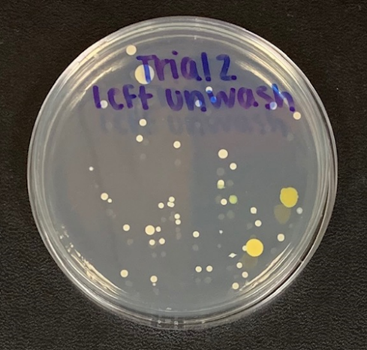
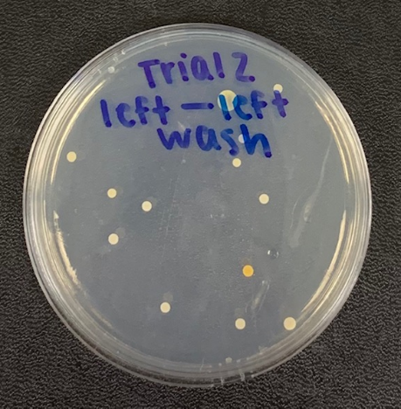
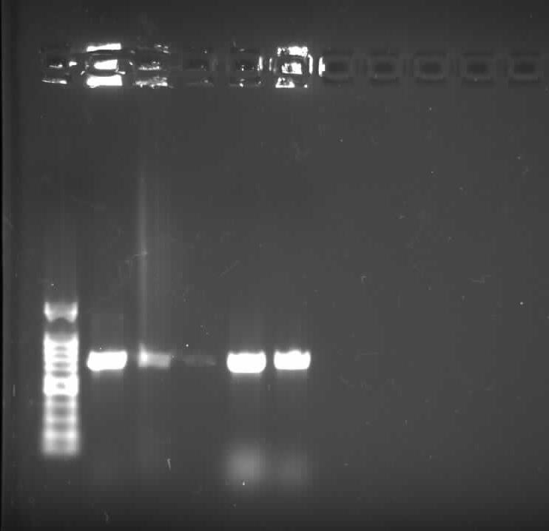
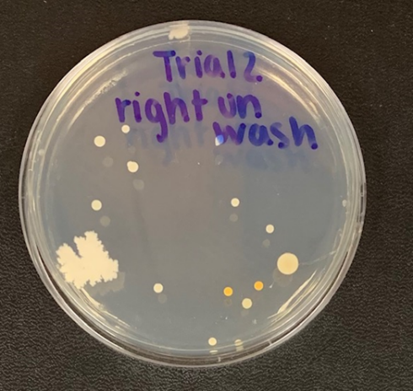
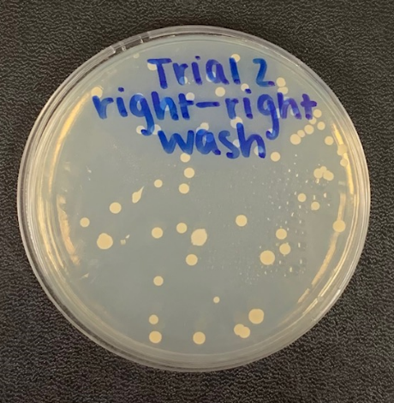
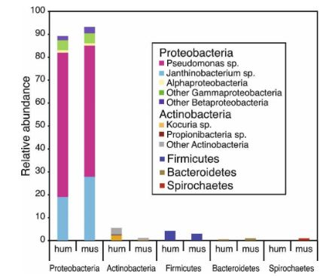
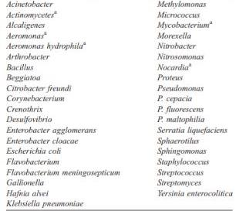
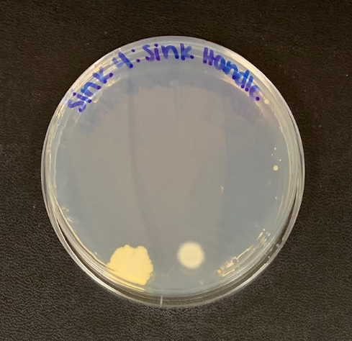
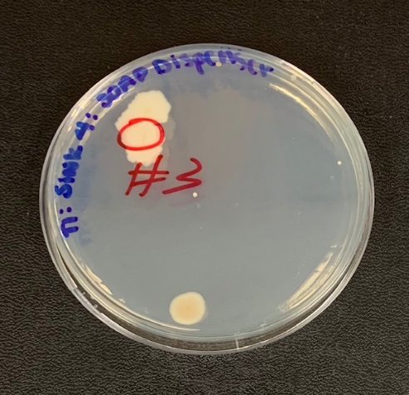
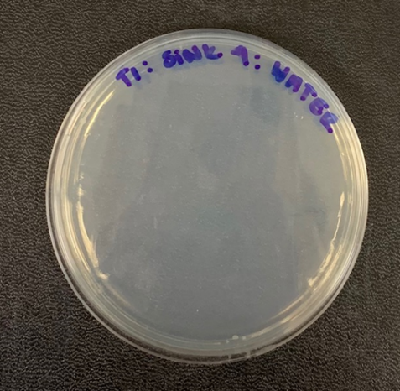
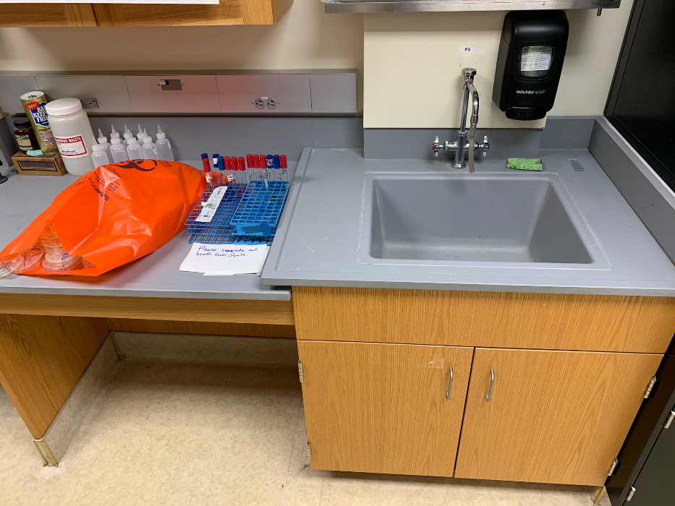
Investigation of Suspected Contamination in the Microbiology Lab: The Dirty Truth
Kaitlyn Marston, Meagan St. John, Tiffany Yun and Victoria Acosta
Course: BIOL 305 Microbiology Instructor: Denis Trubitsyn
Department of Biological & Environmental Sciences, Longwood University, Farmville, VA
Introduction
Results
The primary source of microbial contamination in rural water is found in fecal matter run off.¹
Point sources: storage facilities and feedlots.
Nonpoint sources: grazed pastures and rangelands.
Non-agricultural sources: failing septic systems and wildlife.
It has been previously researched that the most popular genus found on healthy mouse and human skin is Pseudomonas (Figure 1).²
Pseudomonas is also found in drinking water (Table 1).³
Bacteria commonly form biofilms, which promote biogeochemical cycling, occupy distinctive niches, and can cause disease.⁴
A
B
B
A
C
A
D
Table 1. Common genera found in drinking water. Genera are listed in no order of abundance.
Figure 2. Sample collecting for unwashed and washed was conducted on the same day with a sterile swab. A) Right hand unwashed. B) Right hand washed in sink 4. C) Right hand unwashed. D) Right hand washed in sink 3.
Figure 3. Agarose gel electrophoresis of PCR were amplified. Lanes four and five were utilized for this experiment. Lane one is used for size measurements of base pairs. Column 4 is the colony isolated from Fig. 2B and 5 is the colony isolated from Figure 3C.
A
B
C
Figure 1. Abundance of microbes on human and mouse skin. Hum is human; mus is mouse.
Figure 4. Inoculated plates to test for growth. A) Sink Handle at sink 4. B) Water tested at sink 4. C) Soap Dispenser tested at sink 4.
C
Hypothesis:
Due to prevalence of microbes in the lab, there will be contamination of hands after washing.
Conclusion
Methods
An increase of bacterial colonies were found on the test subject's hands after washing from sink 4​.
In sink 3, there was a slight decrease in bacterial colonies that were found on the hands after washing​.
​No bacterial colonies were found in the water​
Sink handle:​
dark yellow, irregular, serratus,​ raised​
Soap dispenser:​
light yellow, irregular, undulate,​ raised​
​
Preparation
Nutrient agar plates were inoculated by swabbing test subject's hands before and after washing in all four sinks
Focus
2 focus sinks were selected after examining number of colonies on plates from washed hands
Broader Implications: Stricter safety practices in the lab including sanitizing all lab surfaces and requirement of thorough handwashing. ​
Variable
Source of contamination was then explored:
Analysis
Gel electrophoresis was conducted on 16s rRNA
Faucet handle
Water from faucet
Soap dispenser
References Cited
1. Jamieson, R., R. Gordon, D. Joy, and Lee H. 2004. Assessing microbial pollution of rural surface waters: a review of current watershed scale modeling approaches. Agricultural Water Management, 70(1): pp.1-17.
2. Allen MJ et al. 2004. Heterotrophic plate count bacteria - what is their significance in drinking water? International Journal of Food Microbiology 92:265-274.
2. Grice EA et al. 2008. A diversity profile of the human skin microbiota. Genome Research: 1-8.
4. Nadell C, Drescher K, Foster KR. Spatial structure, cooperation and competition in biofilms. Nature Reviews Microbiology. 2016;14(9):589–600. doi:10.1038/nrmicro.2016.84

