Slide 1
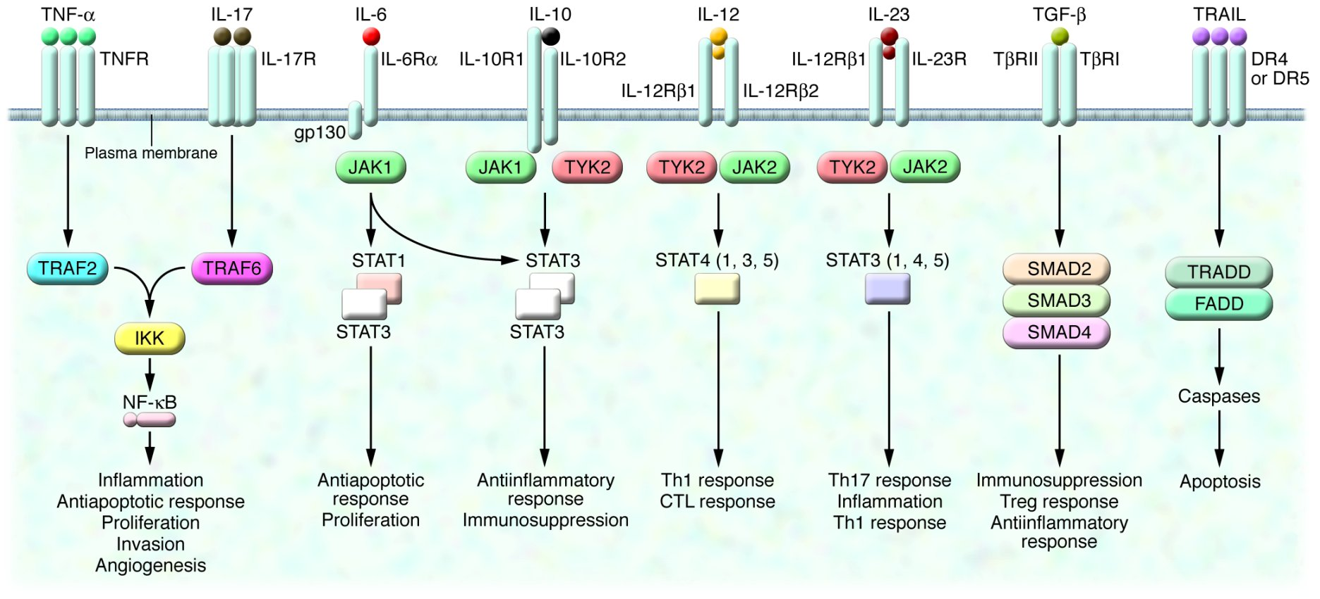
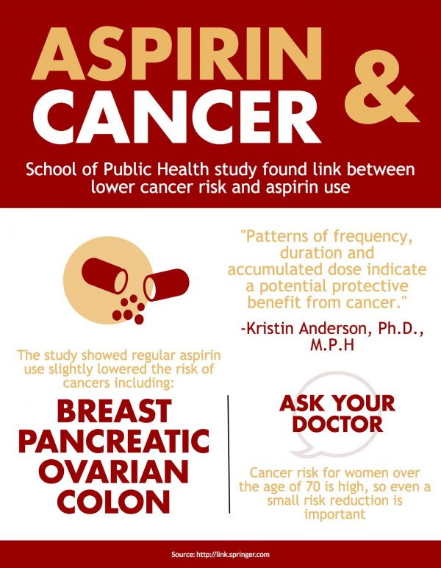
Prevention of Chronic Inflammation Induced Ovarian Cancer Using NSAIDs
Kaitlyn Marston, Angelica Romero, Meagan St. John, Hastings Williamson
BIOL 450 –The Biology of Cancer
Department of Biological and Environmental Sciences
Introduction
Results
Talcum powder particles induce ovarian cancer if the particles travel through the vagina, uterus, and fallopian tubes to the ovary³
Chronic inflammation is the normal response, causing DNA damage that leads to cancer⁴
Figure 3. NSAIDS decrease proliferation of ID8 cells. Averages are displayed with standard deviation. Significance of p<0.05 is displayed with asterisk.
Figure 1. Lawsuits filed from talcum powder induced ovarian cancer.¹
Proinflammatory cytokines (IL-6 and TNFα) are activated to regulate the immune response.
IL-6 plays a central role in neuronal reaction to nerve injury
TNFα may induce apoptosis, activate other inflammatory cytokines, and activate stress-activated protein kinases (SAPKs)⁵
Question: Can the use of NSAIDs reduce the levels of TNFα and IL-6 to act as a therapy for chronic inflammation induced ovarian cancer?
Hypothesis: NSAIDs will reduce the cytokine levels and pose as a therapeutic and preventative option for all chronic inflammation induced cancers.
Figure 4. NSAIDs do not cause cell death. Averages are displayed with standard deviation. Treatments do not show statistically significant from media.
Figure 5. NSAIDs cause a decrease in cells in G₁ and S phases. Averages are displayed with standard deviation. Significance of p<0.05 is displayed with asterisk.
Figure 6. NSAIDS reduce amount of TNFα secretion. Averages are displayed with standard deviation. Significance of p<0.05 is displayed with asterisk.
Figure 2. Cytokine signaling pathways induced by chronic inflammation.²
Methodology
Culture Cells
ID8 ovarian cancer cell line
Proliferation Assay
MTT assay in a 96-well plate, with triplicates of each treatment group
Apoptosis Assay
LDH assay in a 96-well plate, with triplicates of each treatment group
Cell Cycle Analysis
Cytokine Expression
Propidium iodide incorporated into DNA and analyzed with flow cytometry
ELISA was conducted to measure the amount of TNFα and IL-6 secretion
Treated with 200µM Ibuprofen, 5mM Aspirin, 1mM Acetaminophen, 200µM Naproxen
Figure 7. NSAIDs reduce amount of IL-6 secretion. Averages are displayed with standard deviation. Significance of p<0.05 is displayed with asterisk.
Conclusions
Conclusion: All anti-inflammatory drugs decreased cytokine, TNFα and IL-6, secretion and proliferation in an ovarian cancer cell line.
Aspirin may be the best NSAID to have an effect of tumor cells.
Questionnaire research verified chemo-preventative nature of the NSAID, Aspirin.⁶
Literature Cited
Talcum Powder Mesothelioma Lawsuits 2017. The Legal Herald. 2016
Lin W and Karin M. A cytokine-mediated link between innate immunity, inflammation, and cancer. J Clin Invest. 2007;117(5):1175-1183.
Talcum Powder and Cancer. 2017. American Cancer Society.
Chronic Inflammation. 2015. National Cancer Institute.
Zhang J, An J. Cytokines, Inflammation and Pain. 2007. International Anesthesiology Clinics. 45(2):27-37.
Vaughan et al. Aspirin use and the incidence of cancers in elderly women in the Iowa Women’s Health Study. 27(11);1395–1402.
Taniguchi K and Karin M. Seminars in Immunology. 2014;26(1):54-74.
Figure 8. Aspirin consumption facilitates prevention of inflammation induced ovarian cancer. ⁷
Future Directions:
Prescribe NSAIDs for prevention after gene testing of ovarian cancer
Tumorigenesis and metastasis therapies focusing on the interleukin family of cytokines⁷

