Slide 1
The use of CRISPR/Cas9 to investigate missense mutations of p300
Meagan St. John
PRISM Program
Department of Biological and Environmental Sciences
Longwood University

Slide 2
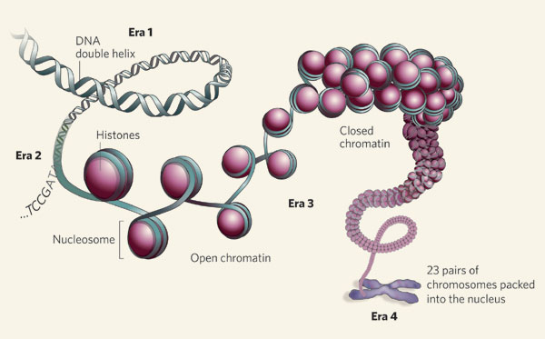
DNA is wrapped around histone proteins
DNA is wrapped around histone proteins to create a chromatin structure
Genes are expressed based on how tightly the DNA is wrapped around the histone
To unwind the DNA from the histone, it must be acetylated

Slide 3
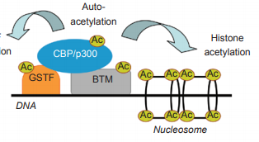
p300: A histone acetyltransferase
Turns on transcription by acetylating histones
p300 is required for normal development of the cardiovascular system, lungs, and small intestines
p300 is often considered a tumor suppressor
Even though p300 is mutated in many cancers, the effects of these mutations are not well characterized.

Slide 4
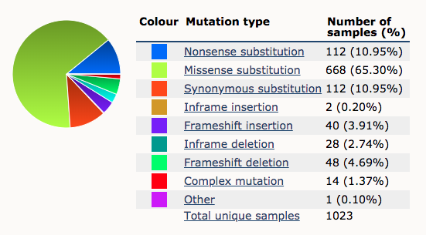
The majority of p300 mutations in cancers are missense mutations
Substitution mutations: Single nucleotide changes in the DNA
Missense mutations: Single amino acid changes in the protein
It is difficult to predict how these mutations affect the function of p300 in cells

Slide 5
How do missense mutations observed in human tumors alter the ability of p300 to activate gene expression?
Hypothesis: Missense mutations in p300 core domain will alter its ability to acetylate histones and activate transcription of genes.

Slide 6
The p300 core acetylates histones
KIX
BRD
HAT domain
KIX domain: Binds transcription factor proteins to induce transcription
p300 core:
Bromodomain: binds acetylated histone tails
HAT: histone acetylatransferase domain

Slide 7
Step 1: Identify cancer mutations in p300 core
N1126S
Y1131N
S1136P
R1137L
Y1201R
Y1414C
BRD
HAT Domain

Slide 8
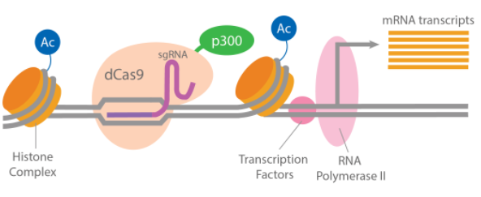
Step 2: Testing p300 core activity using deactivated Cas9

Slide 9
Step 3: Make mutations in p300 core and transfect cells
Experimental variable: mutations identified in p300
Mutations are near the active binding site (1399)
Create p300 mutants in dCas9^{p300Core} DNA
Transfect cells with normal or mutant dCas9^{p300Core} DNA and gRNA

Slide 10
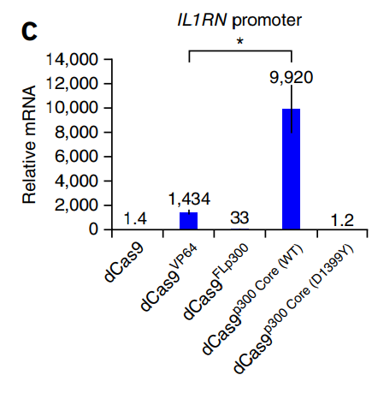
Step 4: Collect RNA and Perform RT-PCR
Collect RNA after transfection
Reverse transcribe RNA to DNA
Perform PCR to detect expression of IL1RN
Predicted results: Mutations in the p300 core domain will impair the ability of p300 to activate the expression of IL1RN.

Slide 11
Significance
The results will determine the different enzymatic functions of missense mutations in p300
Further studies can be performed with full length p300 mutants in cancer cells
Measure gene expression changes in cancer cells
The results will contribute to a greater understanding of how missense mutations alter protein function in cancer cells

Slide 12
Acknowledgements
Katlyn Myers
Dr. Erin Shanle
Dr. Amorette Barber
PRISM Program
Longwood University Department of Biological and Environmental Sciences

Slide 13
Literature Cited
Baylin SB & Schuebel KE. The epigenomic era opens. Nature. 2007. 448(7153):548-549.
CRISPR Cas9 Tools for Genomic Activation and Repression. ABM. 2017.
Hilton et al. Epigenome editing by a CRISPR-Cas9-based acetyltransferase activates genes from promoters and enhancers. Nature Biotechnology. 215. 33:510-517.
Karamouzis MV et al. Roles of CREB-binding protein (CBP)/p300 in respiratory epithelium tumorigenesis. Cell Research. 2007. 17:324-332.
Peixoto L & Abel T. The role of histone acetylation in memory formation and cognitive impairments. Neuropsychopharmacology Reviews. 2013. 38:62-76.
Shikama N et al. Essential function of p300 acetyltransferase activity in heart, lung and small intestine formation. The EMBO Journal . 2003. 22(19):5175-5185.
Verdin E & Ott M. 50 years of protein acetylation: from gene regulation to epigenetics, metabolism and beyond. Nature Reviews Molecular Cell Biology. 2014.15:703-708.
Vogelstein et al. Cancer Genome Landscapes. Science. 2013. 339:1546-1558.

