Slide 1
Short-term and Long-term Effects of Glucose on Cognitive Performance
Shanyia Chandler, Casey Gailey, Kayla Robinson, Meagan St. John

Slide 2
Overview
There has been growing evidence that raising blood glucose increases cognitive functioning. Influxes of glucose can causes hyperactivity due to the fact that it is the brain’s number one source of fuel.
Brain functioning, such as thinking, memory, and learning are directly proportional to glucose levels and how effectively the brain uses this fuel source.

Slide 3
What has been previously researched about this topic
An Introduction

Slide 4
Benton, David, and Deborah S. Owens. "Blood glucose and human memory." Psychopharmacology 113.1 (1993): 83-88.
The study hypothesized that, in young healthy adults, the influence of increasing blood glucose would enhance memory for word lists and a Wechsler story regardless of baseline blood glucose.
Experimental Design
All experiments were double blinded
Word List: A list of 15 words, each having 6 letters and 2 syllables
Spatial Memory Test: 16 colored pictures of objects

Slide 5
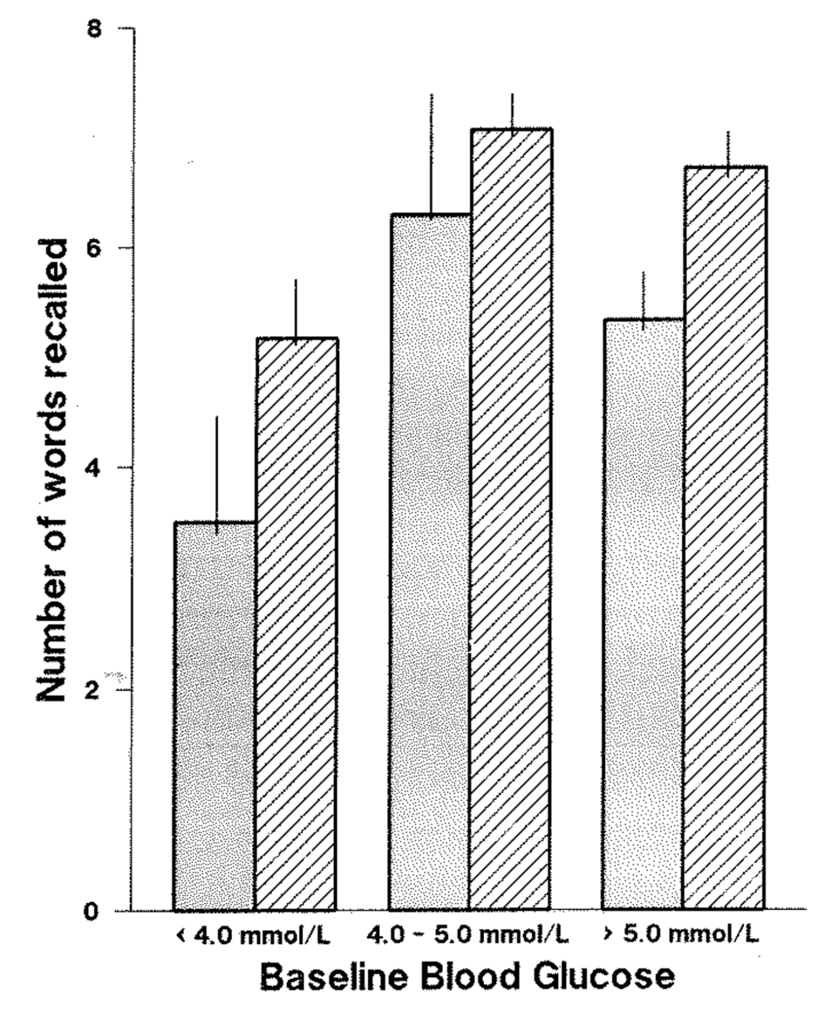
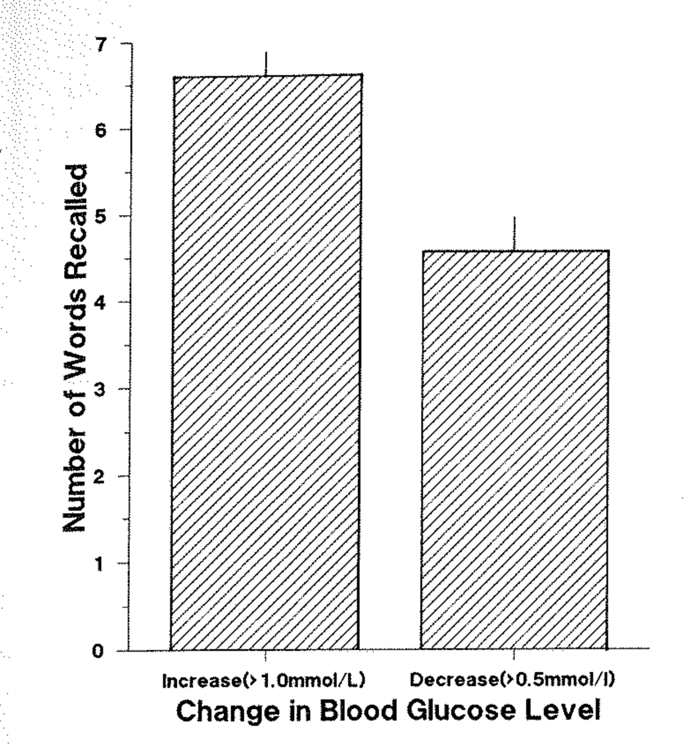
Results
The study found a significant correlation in blood glucose values and number of words recalled, but did not find a correlation between blood glucose and spatial memory.

Slide 6
Foster J, et. al., Glucose and Memory: fractionation of enhancement effects? Psychopharmacology. 1998; 137: 259-270.
Hypothesized: How does glucose effect short term and long term memory in multiple memory tests?
Experiment
Tested on 30 healthy females averaging 19.5 years old
3 possible treatments
Glucose
Saccharin
Water

Slide 7
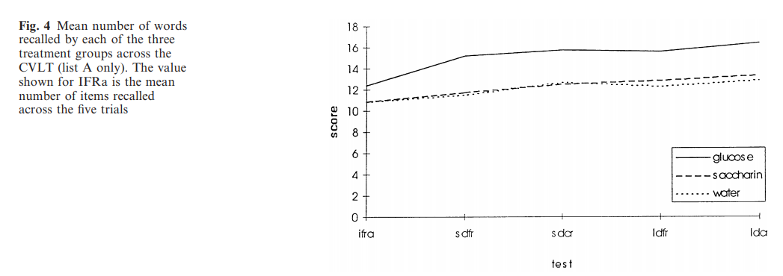
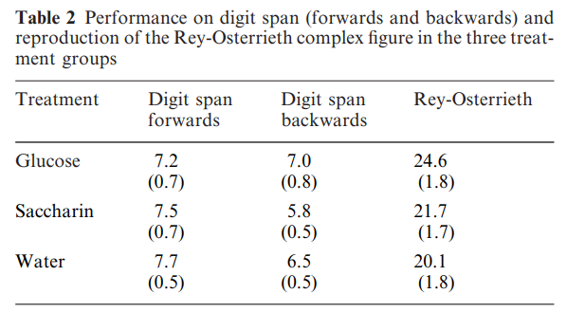
Results

Slide 8
Benton, David, Deborah S. Owens, and Pearl Y. Parker. "Blood glucose influences memory and attention in young adults." Neuropsychologia 32.5 (1994): 595-607.
Hypothesized: When there are higher levels of blood glucose, there will be a relatively greater ability to recall words at the beginning and end of a list.
Experiment:
Subjects listened to a tape recording of a list of 30 nouns, presented at the rate of one word per second.
There were two different drinks used in this experiment one was the actual glucose drink and the other was a placebo but both drinks were identical in taste and color.

Slide 9
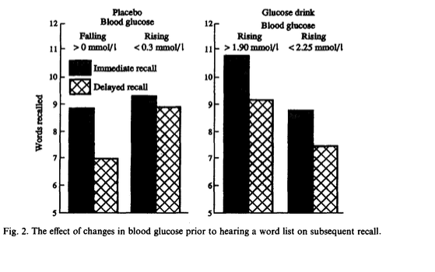
Results
When the results were examined there was a minor effect on the amount of words recalled between the subjects who had the glucose drink and the placebo.
Glucose drinkers made significantly more errors than the placebo drinkers. As the blood glucose levels increased they began to perform less efficiently.

Slide 10
Question/Hypothesis
What effect will glucose have on cognitive performance of short-term and long-term memory of various tests?
Numerical
Verbal
Visuospatial
Glucose will enhance performance of recollection of all types of cognitive tests in short-term memory

Slide 11
Methodology

Slide 12
Procedure
0 min
Baseline blood glucose measured
Treatment administered
15 min
Numerical Test
30 min
45 min
Verbal Test
50 min
30 second playing of word list
1 minute distracted work
2 minute numerical recollection
Half-time blood glucose measured
Visuospatial Test
30 seconds showing 4x4 image chart
1 minute distracted work
2 minute visuospatial recollection
30 second playing of verbal list
1 minute distracted work
2 minutes verbal recollection
Final blood glucose measured
360 min
Long-term blood glucose measured
1 minute numerical test recollection
1 minute visuospatial test recollection
1 minute verbal test recollection

Slide 13
Various cognitive tests
Glucose and basic cognitive test
Glucose drink
Glucose and higher cognitive test
Glucose drink
Sweetener and basic cognitive test
2 digit numbers
Basic tests
2 digit numbers
Simple image chart
2-syllable words
Higher tests
3 digit numbers
Complex image chart
3-syallable words
Placebo drink
Basic tests
Simple image chart
2-syllable words
Sweetener and higher cognitive test
Placebo drink
Higher tests
3 digit numbers
Complex image chart
3-syllable words

Slide 14
Results

Slide 15
The fluctuation of glucose levels over time when administered glucose

Slide 16
The fluctuation of glucose over time after administration of sucrose

Slide 17
The effects of glucose/sucrose administration on short-term recollection

Slide 18
The effects of glucose/sucrose administration on long-term recollection

Slide 19
Effects of cognitive tests on short-term memory

Slide 20
Effects of cognitive tests on long-term memory

Slide 21
Effects of cognitive tests on short-term vs. long-term memory

Slide 22
Discussion

Slide 23
Discussion

Slide 24
Discussion

Slide 25
Discussion

Slide 26
Works Cited
Benton, D. et al., Blood Glucose and Human Memory. Psychopharmacology. 1993; 113 (83-88).
Benton, D. et al., Blood Glucose Influences Memory and Attention in Young Adults. Neurophychologia. 1994; 32 (595-607).
Foster, J. et al., Glucose and Memory: fractionation of enhancement effects? Psychopharmacology. 1998; 137 (259-270).

Slide 27
Thank you Longwood University, Dr. Ludwar, and The Department of Biological and Environmental Sciences

