Slide 1
Olivia Kolenda. Meagan St. John, Debbie Pitt, Kylee Hise
The Effect of Time of Day on Species Richness and Number of Individuals of Each Species
Department of Biological and Environmental Science
Longwood University
Farmville, VA

Slide 2
Background
Wild birds follow a regular daily feeding activity.
Small birds present maximum activity of feeding during morning and evening.
Many factors may affect the time of caloric intake.

Slide 3
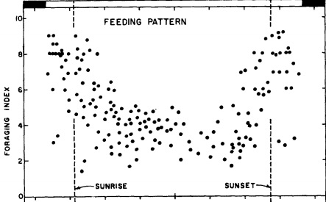
Feeding Pattern of White-Crowned Sparrows

Slide 4
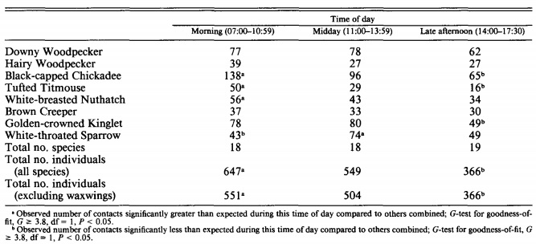
Total Number of Birds Based on Time of Day

Slide 5
Specific Aim
Does time of day affect the total number of birds?
Does time of day affect the species richness of birds?
To test this, we studied a specific bird feeder behind the EEC in Lancer Park.

Slide 6
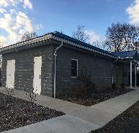
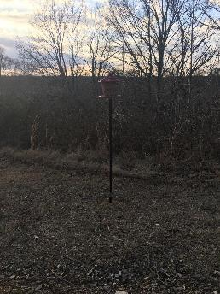
Study Area:
Longwood University Environmental Education Center (EEC) in Lancer Park located in Farmville, VA.
Perimeters: The birds within close perimeters of the bird feeder are the ones that will be counted.

Slide 7
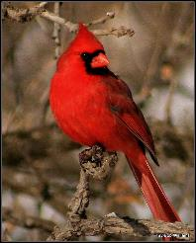
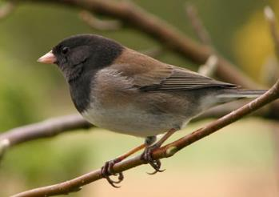
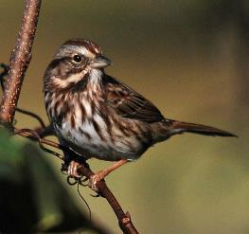
Species Likely to be Seen
Notes:
[[Northern cardinal]]
[[Dark-eyed junco]]
[[Song sparrow]]

Slide 8
Hypotheses
Ho1: There is no difference in the species diversity and richness of birds at one feeder bird feeder located at the Environmental Education Center at Longwood University based on different times of day (morning, noon, and afternoon).
Ho2: There is no difference in the number of individuals of each species of birds at one feeder located at the Environmental Education Center at Longwood University based on different times of day (morning, noon, and afternoon).

Slide 9
Type of Study
Observational study of point counts
Treatment variables:
Time of day
Temperature
Response variables:
Diversity in bird population at feeder
Number of birds in each species​
Notes:
Limitations: [[No control group, repeat of bird counting.​]]
Strength: [[Seeing the interactions between the birds, being able to count them, and being able to see the different species diversity]]

Slide 10
Additional Parameters: In Virginia
The average annual temperature is 13.5 degrees Celsius (56.3 degrees Fahrenheit).
The average high temperature for March is 15.1 degrees Celsius (59.18 degrees Fahrenheit).
The average low temperature for March is 0.2 degrees Celsius (32.36 degrees Fahrenheit).

Slide 11
Methodology
Collecting Samples
The medium-height bird feeder, second from the left, will be studied at the EEC.
For each time of day, data was recorded for 10 minutes
One tally mark was recorded for each bird seen, according to species
Only birds approaching the feeder were accounted for
If a bird fled the area and then returned, it was tallied again

Slide 12
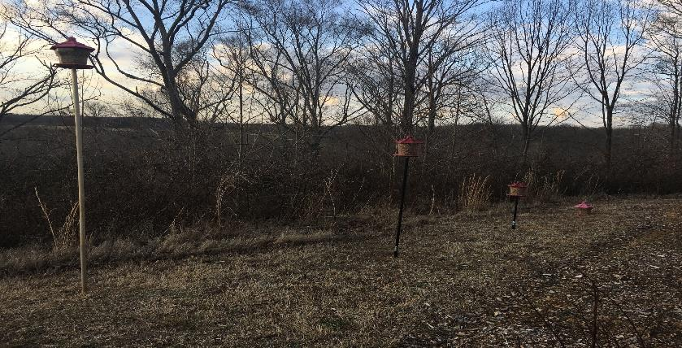

Slide 13
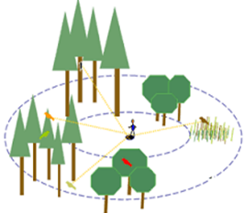
Methodology
Collecting Samples
Birds will be identified using the Merlin Bird ID app on mobile devices
Data will be statistically analyzed by ANOVA tests and Tukey Honestly Significant Differences tests
Point count is the method used for bird counting

Slide 14
Number of species of birds present based on three different times of the day.

Slide 15
Total number of birds present based on three different times of the day.
Notes:
Fix this graph

Slide 16
The effect of temperature on total number of birds present.

Slide 17
The average dominance presented by different bird species based on the time of day.

Slide 18
The heterogeneity presented by different bird species based on the time of day.

Slide 19
Literature Cited
Rollfinke, B., & Yahner, R. 1990. Effects of Time of Day and Season on Winter Bird Counts. The Condor. 92(1):215-219.
O'Leske, D., Robel, R., & Kemp, K. 1997. Fall Point Counts: Time of Day Affects Numbers and Species of Birds Counted. Transactions of the Kansas Academy of Science. 100(3/4):94-100.

Slide 20
THANK YOU!!!
Dr. Henk
Department of Biological Sciences
Longwood University

