Slide 1
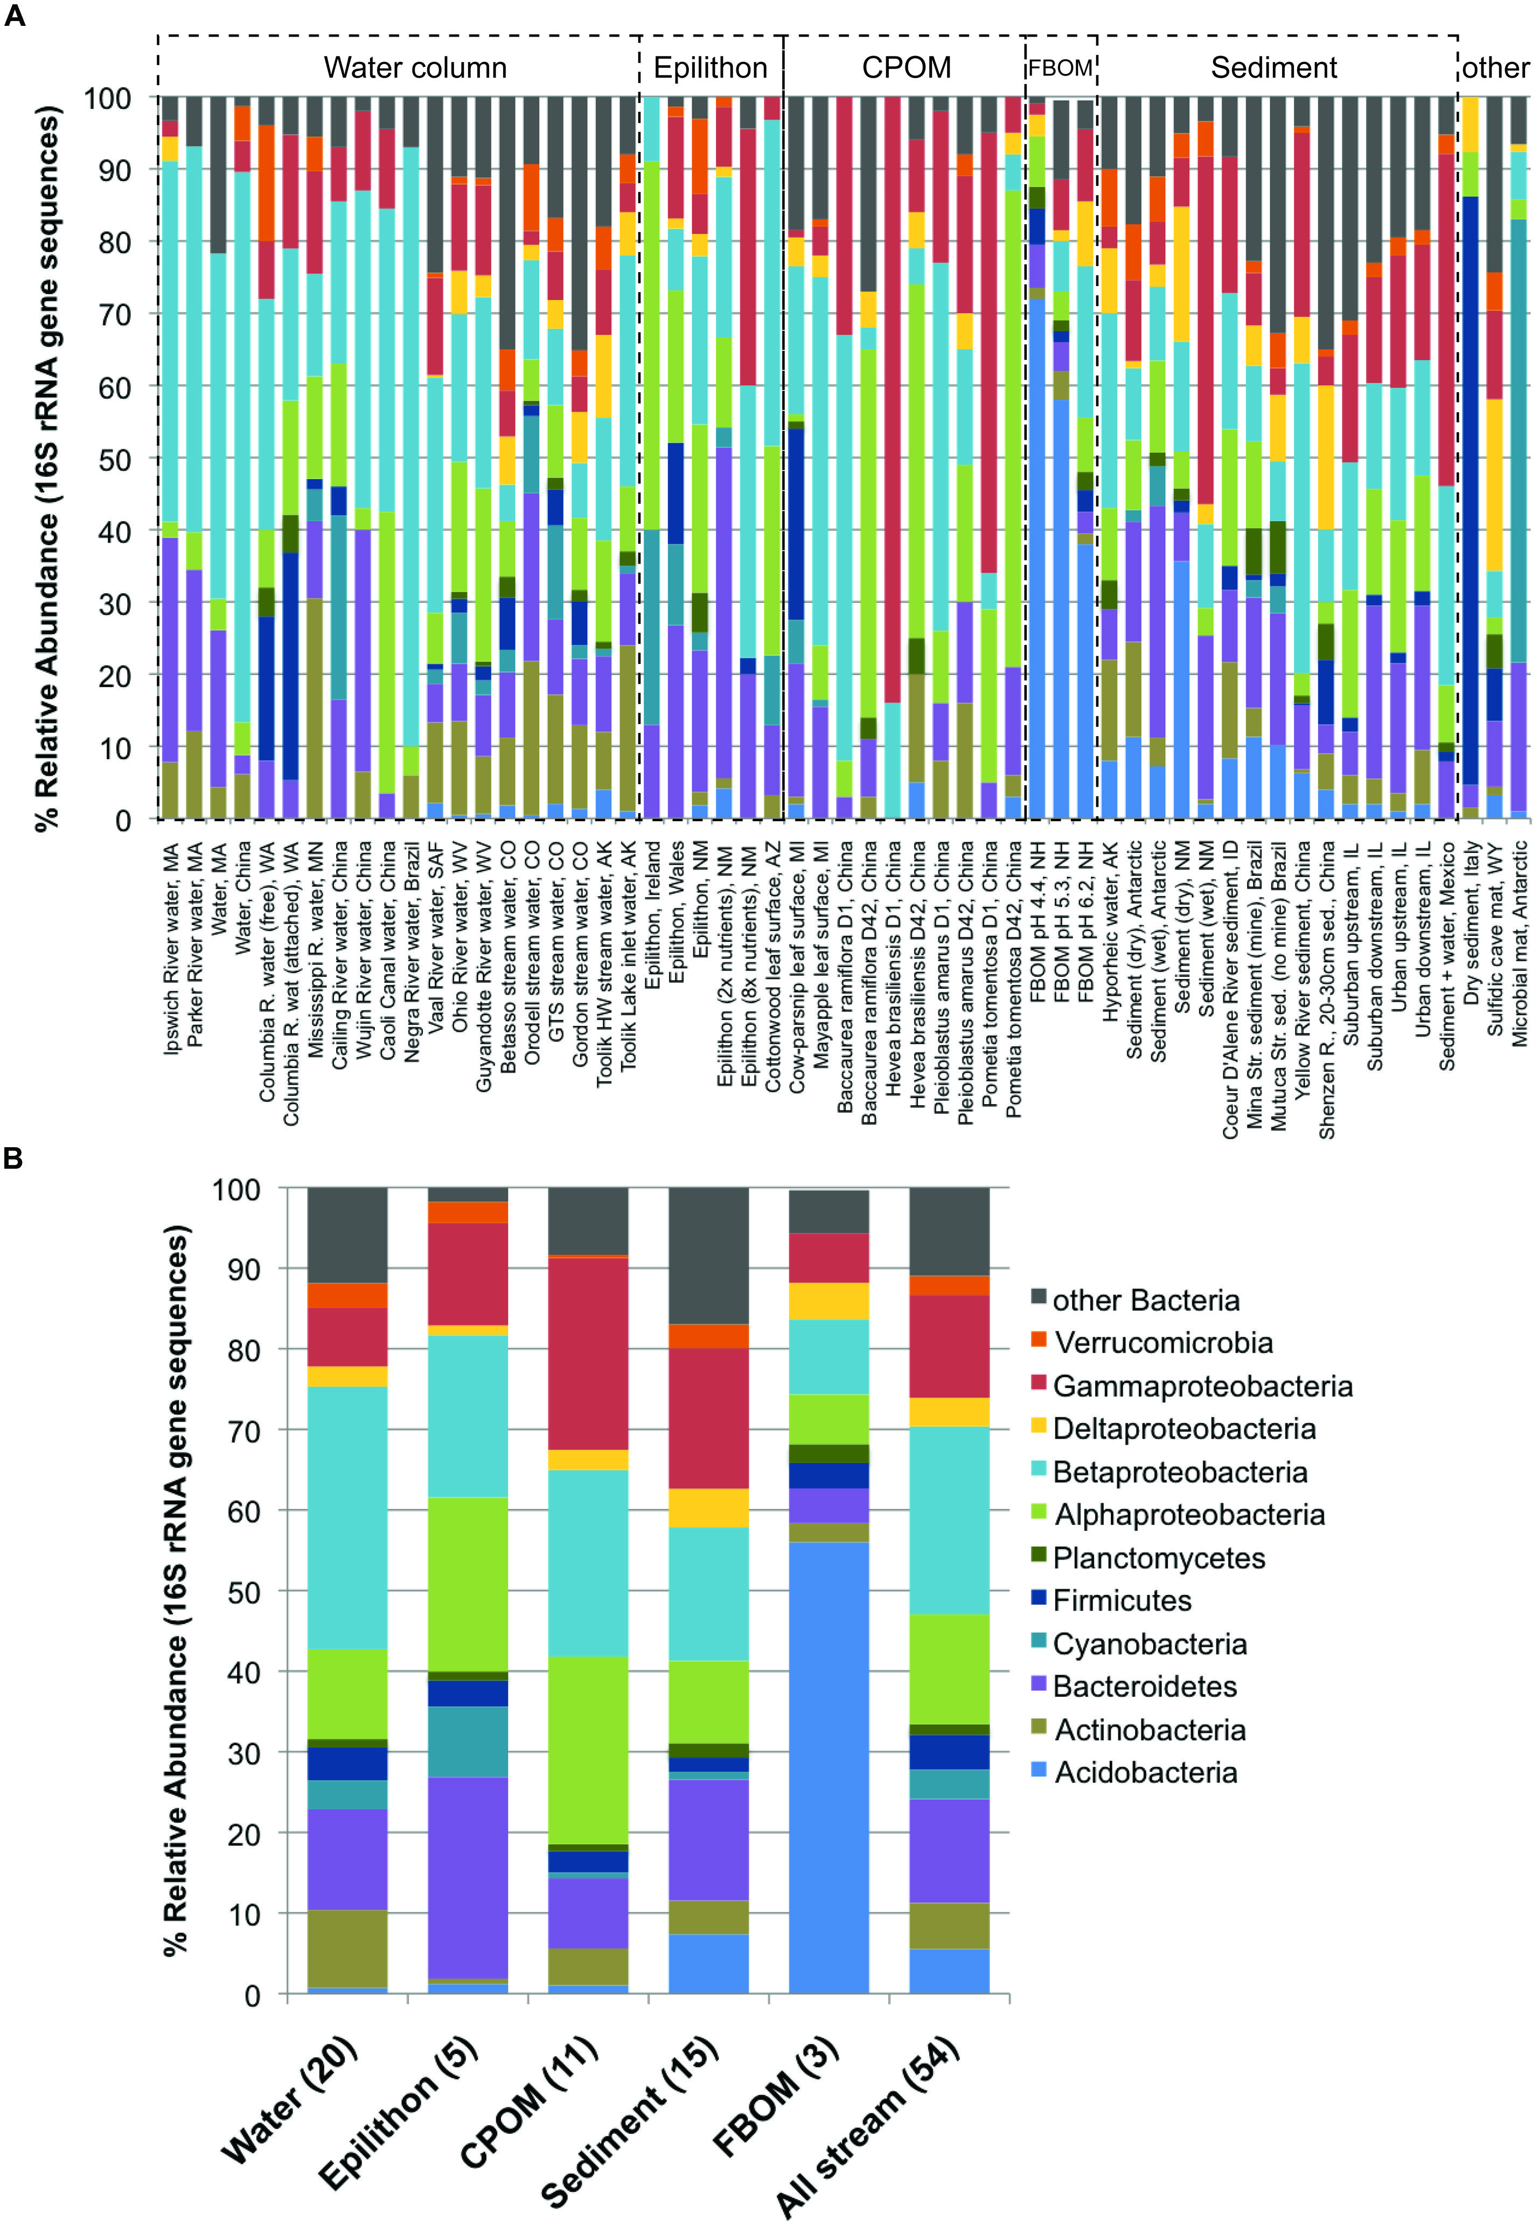
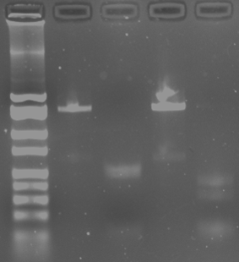
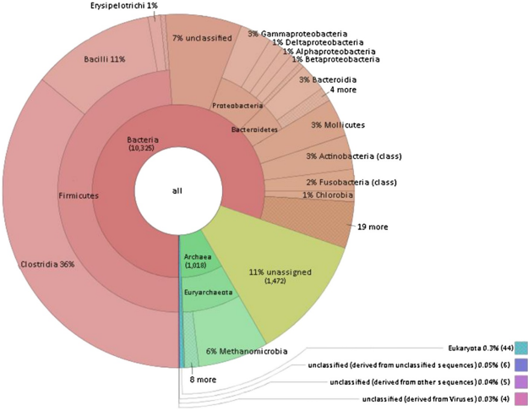
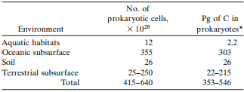
Microbial Diversity Comparison Between Water and Sediment
Christina Gonzalez and Meagan St. John
Department of Biological and Environmental Science, Longwood University
Background
Results
Microbial diversity is well understood to be a fundamental factor in aquatic ecosystem between microbes in the water and sediment of lotic environments.
Factors that are involved in influential variation on the ecosystem processes can result in affecting microbial diversity of the aquatic realm¹:
Hydrology
Contamination
Nutrient availability
Figure 4. Characteristics of colonies based on variations of form, elevation and margin per collection layer. In this figure the inner region of graph contains the percentage of colonies for the sediment layer and the outer region contains the water percentages.
Figure 5. Total percentage of bacteria per collection site based color classification. This graph contains three-color variations that were obtained per collection layer.
PCR Water
MspI Water
PCR Sediment
MspI Sediment
2000
1550
1000
750
500
400
300
200
100
50
Figure 1. Relative abundance of major bacterial phyla and subphyla based on 16S rRNA gene sequence. (A) all samples with habitats and locations on the x-axis and compartment type bracketed by dashed lines, (B) average community composition for each compartment ¹.
Figure 6. Gel electrophoresis base pairs amplified PCR products of MSP1 product. The base pair DNA ladder displays the size of the original sample DNA product and the restriction digest sample to measure the length of the DNA fragment.
Figure 7. The progression rate of bacteria growth was measured over a 48-hour duration period. Data was obtained after 24 hours and after 48 hours.
Figure 3. Number and biomass of prokaryotes in the world³ .
Bacteria identification | % Identity | # Of Gaps | # Of Differing Base Pairs | Gram Strain Identification
Pseudomonas brenneri strain CFML97-391 | 99 | 3 | 4 | Gram Negative
Aeromonas encheleia strain CECT4342 | 99 | 1 | 2 | Gram Negative
Figure 2. Taxonomic distribution of the biogas community. Legend: Allocation of assembled contig sequences to microbial genome. Results were obtained by best M5nr database hits. Bacteria dominate the community, Archaea represent about 10% of the microbiome² .
Table 1. The top alignments for 16s rRNA sequence of the water and sediment samples, respectively.
Specific Aim
Conclusions
Purpose: Compare the differential variation in the composition of the microbial community and indicate microbial clusters present in the water versus the sediment in lotic ecosystems to determine the bacterial diversity and variability.
Hypothesis: The bacterium comparison from the sediment and water samples will display significant differentiation in the degree of microbial diversity; the bacterium communities in the sediment sample will display greater diversity than that of the water sample.
The bacteria colonized from the benthic and photic realms (sediment and water) presented two distinctly different communities, regardless of identical collection site from a freshwater ecosystem; the sediment sample displayed more microbial diversity as hypothesized.
The dominant explanation of the differences in microbial communities is the habitat type⁷.
A study conducted on abundance of prokaryotes based on habitat presents correlating results. The number of prokaryotic cells in the environment is directly proportional to the abundance of carbon in the cells⁵ (Figure 3).
Gather environmental samples from Buffalo Creek
Sediment sample
Water Sample
Bacterial Culture the samples
Isolate genomic DNA
One colony from each sample was selected for DNA isolation
Plate the samples to observe colony composition (from, color, growth)
Inserted data sequence BLAST to compare it to known bacterium sequences
Sequence Analysis of both bacterium
PCR and Gel Electrophoresis
Sample Collection Types:
16s rRNA was sequenced using Sanger Sequencing
Gel Electrophoresis on PCR and Msp1 digested products
Methods
Each isolated bacterium from the two sampling sites also support high microbial diversity:
Bacteria sequenced from water sample:
Pseudomonas brenneri strain CFML 97-391
Previously found in natural mineral waters in France⁶.
Gram-negative with a single flagellum
Bacteria sequenced from sediment sample:
Aeromonas encheleia strain A
Previously found in unpolluted surface and underground waters in Czech Republic⁴.
Anaerobic, gram-negative bacterium
Future Directions
Many more bacterial samples must be obtained from various ecosystems in Prince Edward County to determine the overall microbial diversity.
Microbial diversity affects community composition, stability and function at a local level.
Community composition is critical in order to understand the community function and structure to seek new medications for probiotics and determine the presence of chemicals⁵.
Further studies may be performed, focusing on the prevalence of harmful bacteria present in both the water and sediment, to determine the ecological effects on the lotic ecosystem.
Literature Cited
¹Zeglin LH. 2015. Stream microbial diversity in response to environmental changes: review and synthesis of existing research. Frontiers in Microbiology. [Feb];6.
²Roland Wirth, Etelka Kovács, Gergely Maróti, Zoltán Bagi , Gábor Rákhely, and Kornél L Kovács. 2012. Characterization of a biogas-producing microbial community by short-read next generation DNA sequencing. Biotechnology for Biofuels. 5:41
³Whitman W, Coleman D, Wiebe W. Prokaryotes: The unseen majority. Proceedings of the National Academy of Sciences. [Internet]. 1998; [cited 2017 April 2]; 95: 6578-6583
⁴Novakova D, Svec P, Sedlacek I. Characterization of Aeromonas encheleia strains isolated from aquatic environments in the Czech Republic. The Society for Applied Microbiology. [Internet]. 2008; [cited 2017 April 2]; 48: 289-294
⁵Curtis T and Sloan W. Prokaryotic diversity and its limits: microbial community structure in nature and implications for microbial ecology. Current opinion in microbiology. [Internet]. 2004; [cited 2017 April 2]: 7: 221-226
⁶Baida N, Yazourh A, Singer E, Izard D. Pseudomonas brenneri sp. nov., a new species isolated from natural mineral waters. Research in microbiology. [Internet]. 2001; [cited 2017 April 2]; 5: 493-502
⁷Feng B, Li X, Wang J, Hu Z, Meng H, Xiang L, Quan Z. Bacterial diversity of water and sediment in the Changjiang estuary and coastal area of the East China Sea. Federation of European Microbiological Societies. [Internet]. 2009: [cited 2017 April 2]; 70: 236-248

