Slide 1
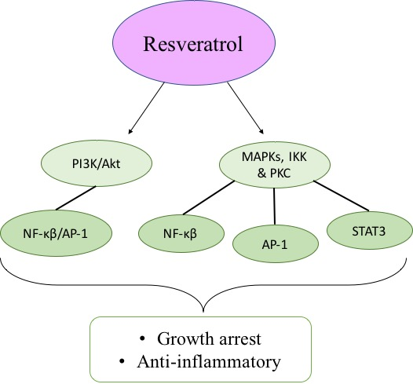
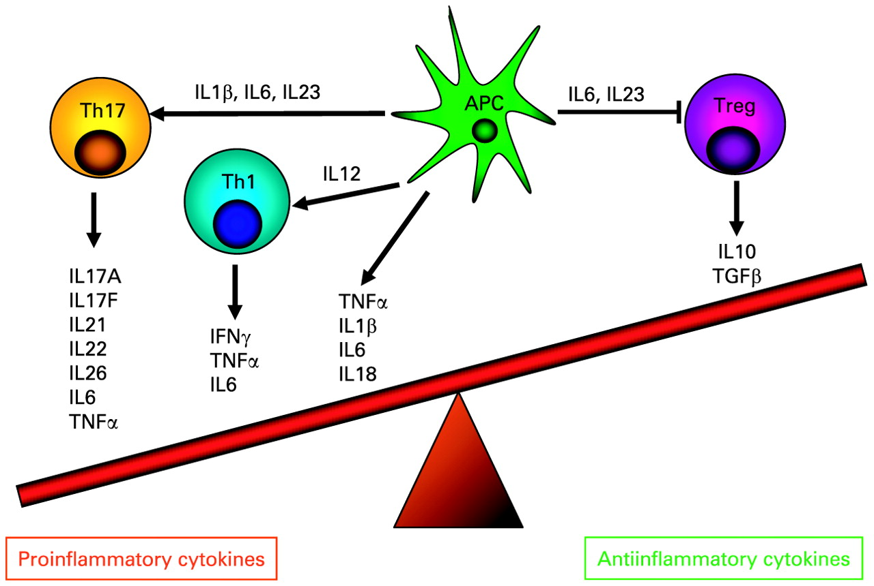
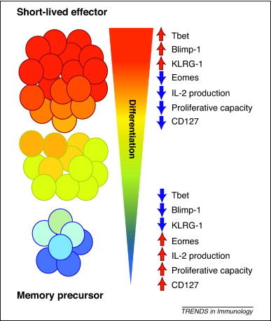
Enhancing the anti-tumor efficacy of chimeric antigen receptor-expressing T cells with naturally occurring plant stilbenes
Andrea Soles, Elle Richardson, Dr. Amorette Barber
Department of Biological and Environmental Sciences, Longwood University, Farmville VA
E259
Abstract
Methods
Results
Despite advances in treatment options, cancer remains the second leading cause of death in the United States. Many therapies use immune cells, specifically T cells, for cancer therapy. To enhance tumor recognition by T cells, chimeric antigen receptors consisting of signaling domains fused to receptors that recognize tumor antigens can be created and expressed in T cells. One receptor that is a prospective target for a chimeric antigen receptor is PD1 because the ligands for the PD1 receptor are expressed on many cancer types. Our lab has genetically engineered a chimeric PD1 (chPD1) receptor and has shown that chPD1-expressing T cells kill tumor cells, secrete inflammatory cytokines, reduce tumor burden, and increase survival in multiple tumor types. A current focus of cancer research is the development of combination therapies that enhance anti-tumor efficacy without increasing harmful side effects. Recently, a family of naturally occurring plant compounds called stilbenes have been shown to enhance T cell function. Therefore, we tested if stilbenes enhanced chPD1 T cell function in breast cancer. Addition of resveratrol, a stilbene found in berries, grapes, peanuts, and other plants, decreased proliferation, enhanced tumor cell killing, and increased secretion of proinflammatory cytokines (IFNγ, GM-CSF, TNFα, IL-17, IL-2, and IL-21) from chPD1 T cells. Presence of resveratrol also increased skewing of T cell differentiation to a central memory phenotype through reduction of AKT and mTORc1 signaling, reduced expression of T-bet and BLIMP-1 transcription factors, and increased expression of Bcl-6 and Eomes transcription factors. Hence, combination of resveratrol and chimeric antigen receptor-expressing T cells may enhance anti-tumor immune responses through inhibition of the AKT and mTORc1 pathways and skewing to a long-lived central memory phenotype.
Proliferation
Protein Phosphorylation
Viability
Cytokine secretion
Gene expression
Background
Cell Lines:
GL26I, GL26 & CT-2A (Glioblastoma)
E0771 (Breast)
Our lab has engineered a chimeric PD1 (chPD1) receptor to express in T cells and has shown that chPD1 T cells kill tumor cells, secrete inflammatory cytokines, reduce tumor burden, and increase survival in multiple tumor types.
Resveratrol, a stilbene found in berries, grapes, peanuts, and other plants, has been shown to alter anti- tumor immune responses through alteration of AKT and other signal transduction pathways.
Combination of resveratrol and chimeric antigen receptor-expressing T cells may enhance anti-tumor immune responses by altering T cell differentiation and cytokine secretion.
Figure 6. ChPD1-Dap10 & chPD1-CD28 T cells secrete pro-inflammatory cytokines when cultured with Resveratrol. After 24hr of co-culture, cytokine secretion was measured using ELISA or LegendPlex Analysis. Data representative of at least two replicates and are shown as averages and standard deviations of triplicates.
Results
A.
A.
Figure 7. Resveratrol alters gene expression of transcription factors controlling memory cell differentiation. Resveratrol reduced expression of A. T-bet and BLIMP-1 transcription factors, and B. increased expression of Bcl-6 and Eomes transcription factors. Data shown are representative of at least two replicates and are shown as averages and standard deviations of triplicates. * indicates that P< 0.05 compared to media.
*
B.
B.
A.
Figure 8. Resveratrol descreased activation of mTOR and AKT in chPD1 T cells. As resveratrol increased, there was a reduction of A. mTORc1 and B. AKT phosphorylation, but not total mTOR or AKT proteins. Data are representative of two biological repeats and are shown as averages and standard deviations or triplicates. * indicates that P< 0.05 compared to media.
Figure 1. Resveratrol's Anti-cancer properties
Figure 4. Resveratrol decreased proliferation of Breast and Glioblastoma cell lines. Cancer cell lines were incubated with Resveratrol for 24hr and A. proliferation was measured by MTT assay and B. viability was measured by LDH assay. Data are representative of three biological repeats and are shown as averages and standard deviations of triplicates. * indicates that P< 0.05 compared to media.
B.
A.
B.
Conclusions
*
*
Addition of resveratrol decreased tumor cell and T cell proliferation, enhanced tumor cell killing, and increased secretion of pro-inflammatory cytokines from chPD1 T cells.
Resveratrol supported differentiation of T cells to a central memory phenotype as shown by reduced expression of T-bet and BLIMP-1 and increased expression of Bcl-6 and Eomes.
Changes in T cell function was likely due to the reduction of AKT and mTORc1 signaling.
Combination of resveratrol and chPD1 T cells may enhance anti-tumor immune responses in Breast cancer and Glioblastoma.
Figure 2. Cytokine secreted by T cells to regulate immune response.
Figure 3. Tbet, Blimp-1 and Eomes control differentiation of memory T cells.
Figure 5. Resveratrol decreased proliferation of T Cells. Non-transduced T cells, wild type T cells, chPD1-CD28 & chPD1-Dap 10 T cells were incubated with Resveratrol for 24hr and A. proliferation was measured by MTT assay and B. tumor cells viability was measured by LDH assay. Data are representative of three biological repeats and are shown as averages and standard deviations or triplicates. * indicates that P< 0.05 compared to media.
Acknowledgements
This work was sponsored by Longwood University’s Faculty Research Grants, Office of Student Research, and Biological and Environmental Sciences Department.

