Slide 1
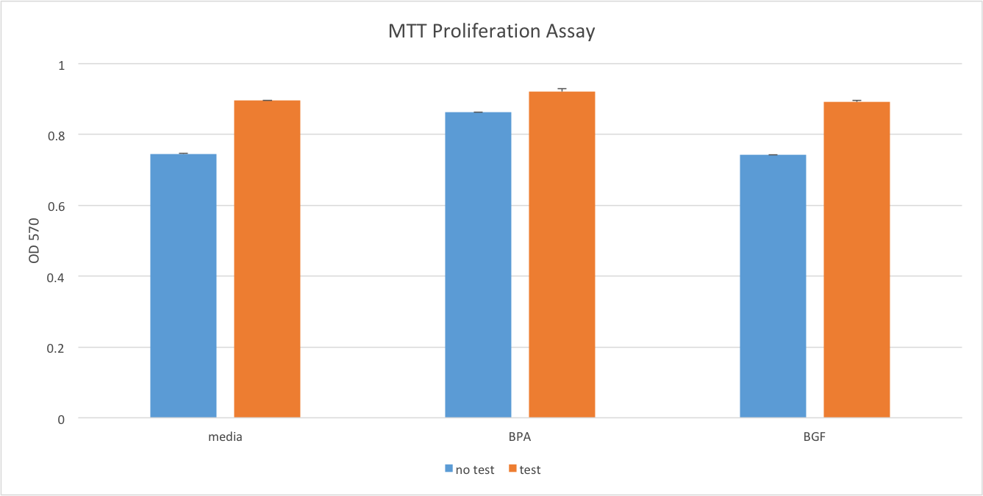
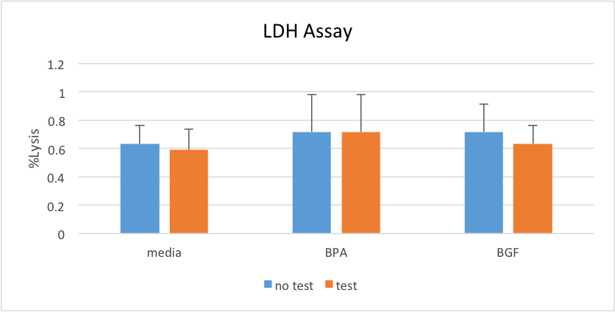
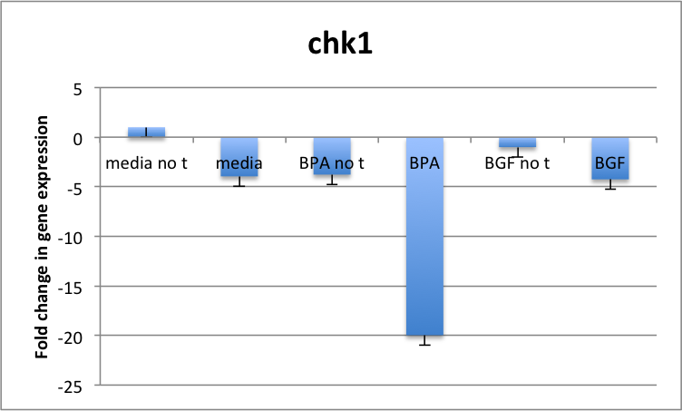
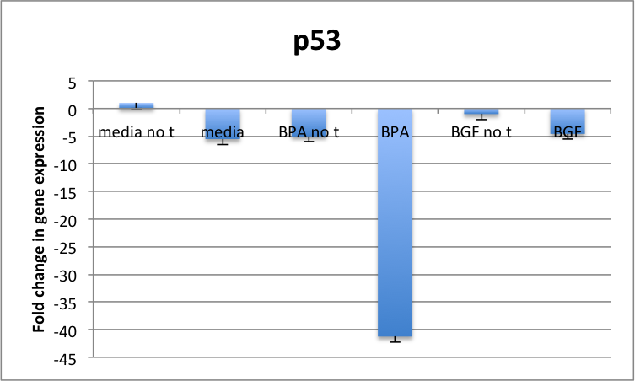
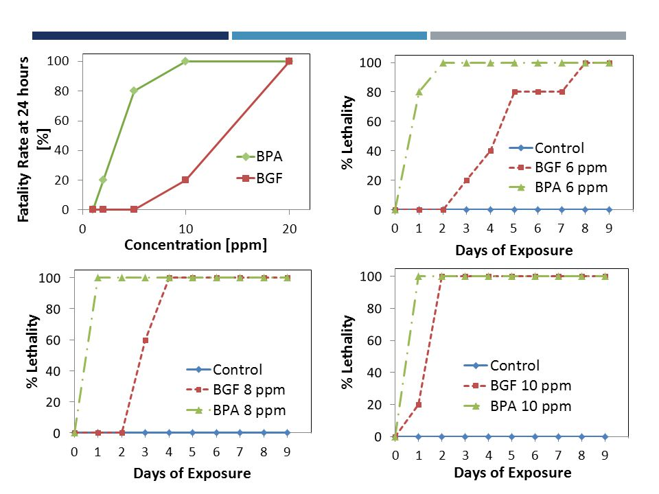
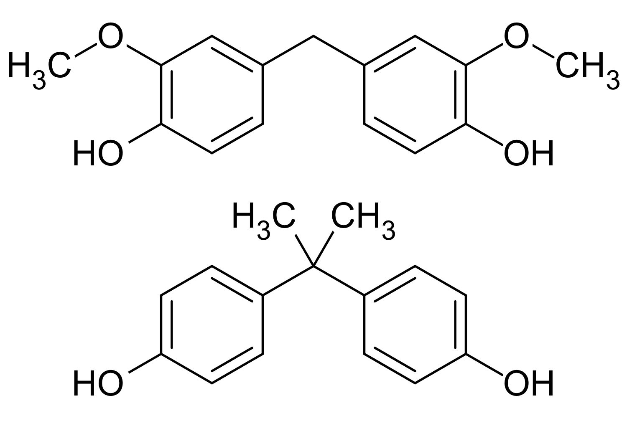
Comparison of the Interaction of BPA and BGF on Androgen Receptor in Murine Prostate Cancer Cells
Sep Harandi, Taryn Kowal, Rex Liggon, Andrea Soles
Biol. 450
Department of Biological and Environmental Sciences, Longwood University
Introduction
Results
Bisphenol-A or more commonly known as BPA, is a chemical found in many products used for structural purposes. It is mostly found in lining of cans, plastic products, recycled paper and even eyeglasses, along with children’s toys¹.
BPA is also known for leaching out to the environment causing DNA mutations².
Bisguaiacol F (BGF) is an alternative that would be more effective than BPA because it shares properties with BPA yet without the adverse effects³.
Exposure to BPA is known to disrupt the endocrine system within organisms, particularly systems involving the development of the prostate and breast ultimately leading to cancer⁴.
Our specific aim is whether or not BGF is a better alternative than BPA.
*
Figure 4: Increased levels of cell proliferation of samples exposed to testosterone. BPA showed the highest level of proliferation in each sample. BGF showed data similar to media. * represents a significant value (p < 0.05).
*
*
Fig. 1. Prostate cancer statistics.
Figure 5: Percent lysis of LDH release into the cells. Cell viability was measured by the release of LDH. None of the samples showed significant differences therefore all samples displayed similar cell viability levels.
A
B
Fig. 3. This figure compares different amounts of BPA and BGF and that correlates to fatality rates.
*
*
Fig. 2. Top structure is of BGF and the bottom structure is of BPA.
Figure 6: Decrease in expression of apoptotic and cell cycle genes in cells exposed to BPA and testosterone. A & B: The cells exposed to BPA without testosterone exhibited similar gene expression levels to the control. Both samples of BGF displayed normal levels compared to the media. BPA with testosterone’s fold change in gene expression was statistically significant in all of the genes tested.
Discussion
The genes tested were p53, p21, mdm2, chk1, and chk2. These genes are responsible for monitoring different phases of the cell cycle and checking for DNA damage.
Gene expression levels were lowered with BPA and testosterone compared to other samples due to both of their proliferating effects.
Decrease in gene expression aids in cancer formation by excess of proliferation and risk for mutations. Our genes in question control the cell cycle and apoptosis.
BGF was not shown to affect the normal levels of gene expression compared to the control.
To further check for the safety of BGF as a potential replacement for BPA, this compound’s effects on the estrogen receptor and its regulation of cell cycle genes should be tested.
Methods
Cultured 40,000 AD-Ca Cells and Treated them with Media, BPA, and BGF
MTT Proliferation Assay
LDH Cytotoxicity Assay and Snap Froze Cells for mRNA Isolation
Isolated mRNA, Created cDNA, and Performed RT-PCR
Data Analysis
Literature Cited
Konieczna A, Rutkowska A, Rachon D. 2015. Health risk of exposure to Bisphenol A (BPA). Rocz Panstw Zakl Hig. 66(1): 5-11.
Teng C, Goodwin B, Shockley K, Xia M, Huang R, Norris J, Merrick BA, Jetten AM, Austin CP, Tice RR. 2013. Bisphenol A affects androgen receptor function via multiple mechanisms. Chem Biol Interact. 203(3): 556-564.
Taylor and Francis. 2014. Chemitrends. Indian Institute of Chemical Engineers. 56(2):177-179.
Hong H, Harvey B, Palmese G, Stanzione III J, Ng H, Sakkiah S, Tong W, Sadler J. 2016. Experimental Data Extraction and in Silico Prediction of the Estrogenic Activity of Renewable Replacements for Bisphenol A. International Journal of Environmental Research and Public Health. 13(7):1-16.
Figure 1: http://www.al.com/opinion/index.ssf/2016/04/why_you_shouldnt_wait_to_check.html
Figure 2: https://michaelhparker.wordpress.com/2014/04/09/is-bisguaiacol-f-a-viable-alternative-to-bisphenol-a/
Figure 3: http://slideplayer.com/slide/9288666/

