Slide 1
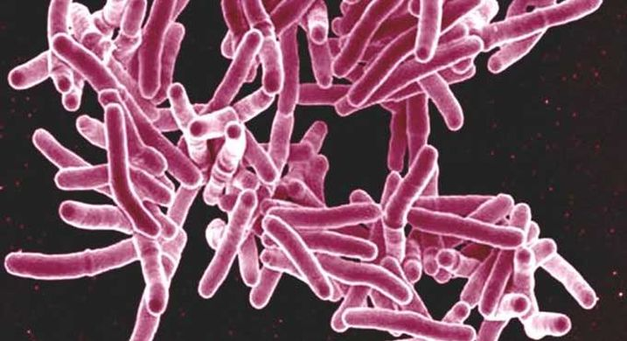
Mycobacterium tuberculosis
Andrea Soles

Slide 2
Origin and Characteristics
Species of pathogenic bacteria in the family, Mycobacteriaceae
First discovered in 1882 by Robert Koch
Has an unusual, waxy coat on its surface due to presence of mycolic acid
Bacillus shaped
Gram-positive
Highly aerobic
Causative agent of tuberculosis
Targets respiratory system and infects the lung

Slide 3
Tuberculosis
There are 2 different types: Latent and active
Latent: Do not have symptoms and not contagious
Infection is present in body and can eventually become active
Active: bacteria is multiplying in the body
Have symptoms and contagious

Slide 4
How is it spread?
Spread through air: coughing, speaking, singing
NOT spread by: shaking hands, sharing food, touching toilet seats, sharing toothbrushes, kissing
After inhalation, bacteria settles in the lungs and grows. Can spread to kidneys, spine, and brain

Slide 5
How to check for TB
Skin Test
Blood Tests
Chest X-ray

Slide 6
Symptoms
Cough that lasts for 3 weeks
Chest pain
Coughing up blood
Fatigue
Weight Loss
Fever and Chills
Night Sweats
Loss of appetite

Slide 7
Prognosis
With treatment, chance of full recovery is high
Not taking required medicine, not following medication regimen, or not doing anything at all will lead to disability and/or death

Slide 8
Treatment
Antibiotics
6 to 9 months
Common ones:
Ethambutol
Isoniazid
Pyrazinamide
Rifampin

Slide 9
Prevention
BCG (Bacillus Calmette-Guerin) vaccine
Not widely used in United States
Practice good hygiene

Slide 10
Is this something we should worry about?
Rate of decline in United States remains too slow to eliminate TB
Has been reported in all 50 states
Some TB strains have become drug resistant
The number of people who have died from TB has increased from 2015

Slide 11
Sources
https://www.cdc.gov/tb/topic/basics/default.htm
https://www.webmd.com/lung/understanding-tuberculosis-basics#1
https://www.cdc.gov/tb/publications/factsheets/statistics/tbtrends.htm
https://www.emedicinehealth.com/chest_x-ray/article_em.htm#what_is_drug-resistant_tb
https://www.cdc.gov/tb/publications/faqs/qa_latenttbinf.htm#Latent4

