Slide 1
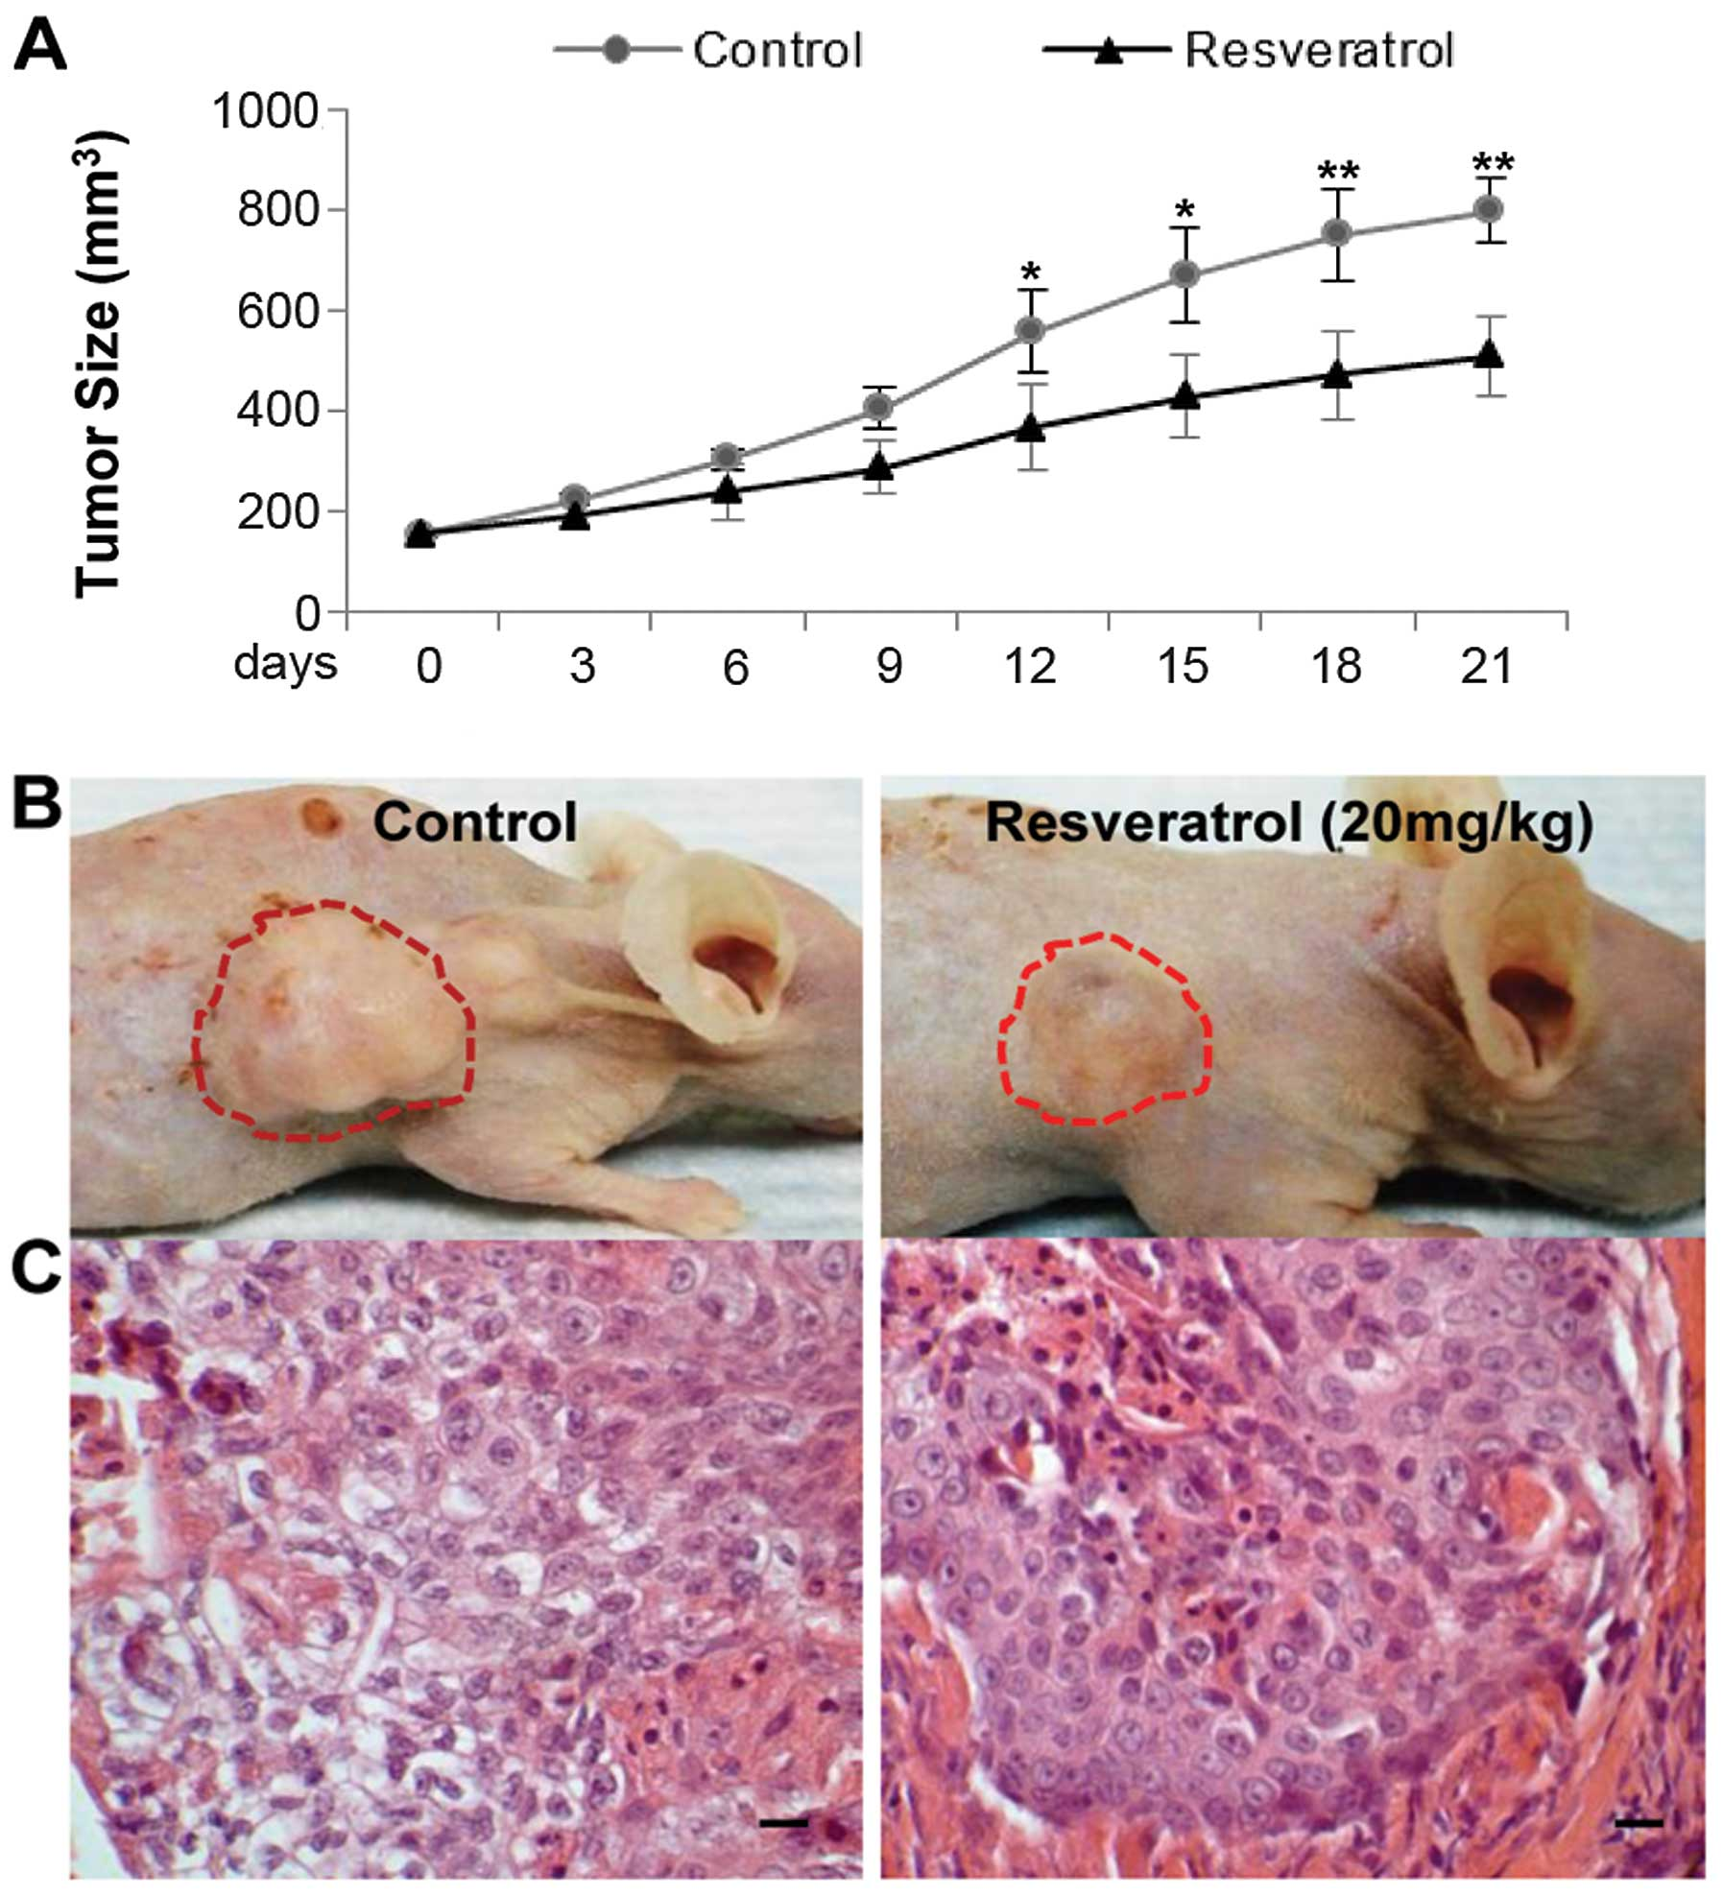
Enhancing the anti-tumor efficacy of chimeric-PD1 expressing
T cells with naturally occurring plant stilbenes
Andrea Soles and Dr. Amorette Barber
Department of Biological and Environmental Sciences, Longwood University, Farmville VA
Background
Results
Figure 5. Resveratrol increased tumor cell killing by chPD1 T cells. chPD1 T cells were incubated with E0771 breast cancer cells and resveratrol and tumor cell lysis was measured using an LDH assay. The chPD1T cells showed a significant increase in tumor cell lysis when incubated with resveratrol- *p<0.05.
T cells can be genetically altered to express receptors that enhance anti-tumor efficacy for therapy.
Chimeric PD1 (chPD1) T cells have been shown to secrete inflammatory cytokines, kill tumor cells, reduce tumor burden, and increase survival of mice with different types of tumors.
Resveratrol is a naturally occurring plant stilbene found in many plants including grapes, berries, and peanuts and has been found by other studies to enhance T cell responses by altering cytokine secretion.
The goals of this project are to determine if stimulation with resveratrol enhances the anti-tumor efficacy of chPD1 T cells.
Figure 2. Resveratrol decreased the proliferation of T cells. chPD1 T cells were incubated with resveratrol and T cell proliferation was measured using an MTT assay. All of the T cells showed a decrease in proliferation as the amount of resveratrol increased- *p<0.05.
*
*
*
*
*
*
*
*
Conclusions
Figure 3. Resveratrol decreased the proliferation of tumor cells and T cells. chPD1 T cells were incubated with E0771 breast cancer cells and resveratrol and proliferation was measured using an MTT assay. All of the cells showed a decrease in proliferation as the amount of resveratrol increased- *p<0.05.
Resveratrol decreased T cell proliferation but did not alter T cell survival.
However, incubation with resveratrol increased chimeric PD1 T cell killing of tumor cells.
Therefore, combination of chPD1 T cells and resveratrol may lead to enhanced anti-tumor efficacy.
Figure 1. Resveratrol’s effects on tumor size. Panel A shows how resveratrol can reduce tumor growth. Panel B is a visual representation of mice with the control treatment and resveratrol treatment. Resveratrol decreased the tumor size. Panel C is the same as Panel B but at the microscopic level¹.
*
*
*
*
Future Directions
Next semester, I will analyze whether incubation with stilbenes alters the differentiation of T cells by looking at the expression of key transcriptions factors, proteins in the mTOR signaling pathway, and cell surface proteins using RT-PCR and flow cytometry.
I will also investigate and analyze the cytokine secretion by the chPD1 T cells using ELISA and LegendPlex analysis.
Methods
Figure 4. Resveratrol did not alter T cell viability. chPD1 T cells were incubated with resveratrol and cell viability was measured using an LDH assay. The LDH assay concluded that resveratrol did not alter T cell survival.
Harvest T cells from murine spleen and express chPD1 receptors
Culture chPD1 T cells with E0771 breast cancer cells and resveratrol- MTT Proliferation Assay
Culture chPD1 T cells with E0771 breast cancer cells and resveratrol- LDH Cytotoxicity Assay
Acknowledgments
This research was supported by funding from Longwood University’s Department of Biological and Environmental Sciences and Faculty Research Grants.
Literature Cited
1. Zhang M, Zhou X, Zhou K. Resveratrol inhibits human nasopharyngeal carcinoma cell growth via blocking pAkt/p70S6K signaling pathways. International Journal of Molecular Medicine. 2013; 31: 621-627.

