Slide 1
Three Ages Project
Sierra Garland

Slide 2
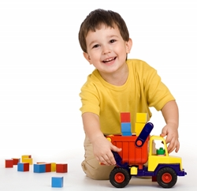
Eli - 4 years old (Early Childhood)
Difficulty paying attention
Youngest Child
Older sister
Suburbs
Dad and stepmother
Preschooler

Slide 3
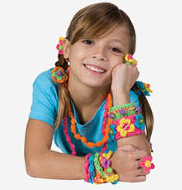
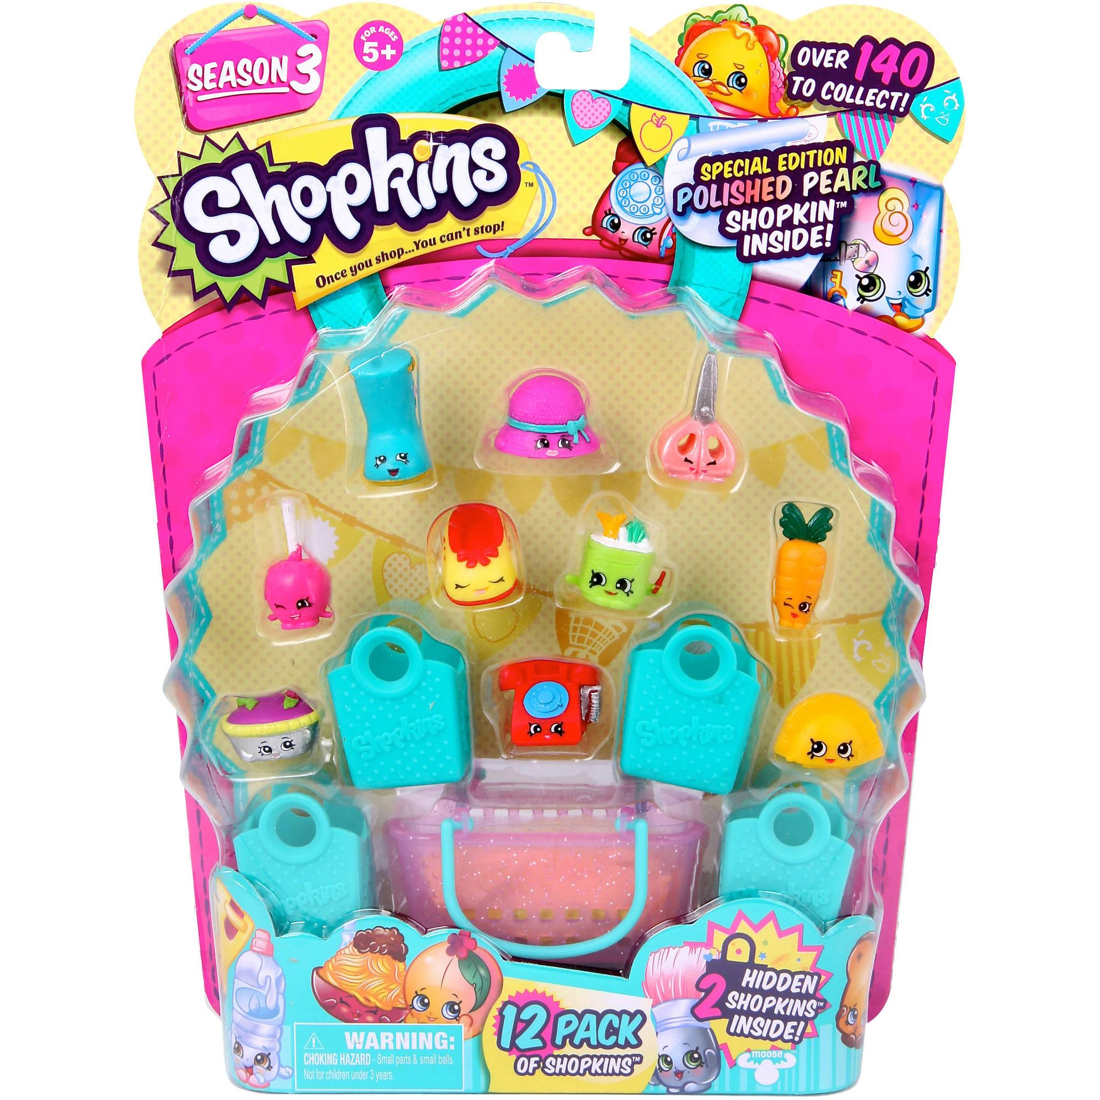
Bella- 9 years old (Late/Middle Childhood)
Engaged in side conversation
Oldest Child
Little brother
4th grade public school
Suburbs
Dad and stepmother
Obsessed with Shopkins

Slide 4
Mandy-15 years old (Adolescence)
Focused on phone
Youngest child
2 older brothers
Brother and wife
11th grade public school
Suburbs

Slide 5
Eli’s Questions and Answers
What animal represents you and why?
-A horse because I want to jump over things
How does money affect happiness? Why?
-Money makes me to buy something

Slide 6
Eli’s Questions and Answers
If you could be a color for a day, what would it be and why?
-Red because I want to be red and it’s my favorite color
How big is a cat? Is there anything similar in size to a cat?
-Uses hand motions
What makes you, you? What is your favorite part about yourself?
- I don’t know what I want to pick

Slide 7
Bella’s Questions and Answers
What animal represents you and why?
-A cat because it’s so furry and soft
How does money affect happiness? Why?
- You get to spend it on Shopkins

Slide 8
Bella’s Questions and Answers
If you could be a color for a day, what would it be and why?
-Red because it is my favorite color
How big is a cat? Is there anything similar in size to a cat?
-It depends how fat it is. A piggy bank
What makes you, you? What is your favorite part about yourself?
-That’s a hard question...my kiwi Shopkins, my grades and my eyes

Slide 9
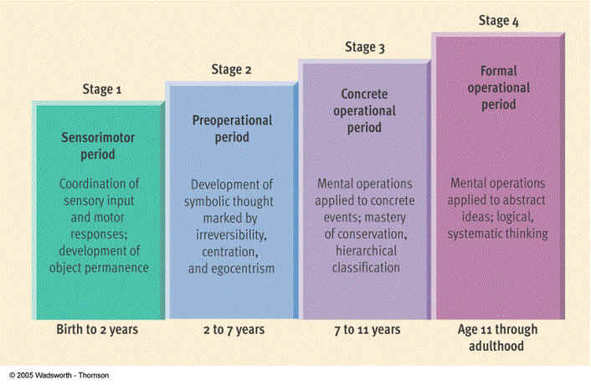

Slide 10
Mandy’s Questions and Answers
What animal represents you and why?
-A panda because it rhymes with my name
How does money affect happiness? Why?
-If you don’t have money you can’t buy what you want

Slide 11
Mandy’s Questions and Answers
If you could be a color for a day, what would it be and why?
-Purple because it represents royalty
How big is a cat? Is there anything similar in size to a cat?
-The size of a small teddy bear. A picture frame
What makes you, you? What is your favorite part about yourself?
-I’m really quiet. Physical or? I mean I like my lips

Slide 12
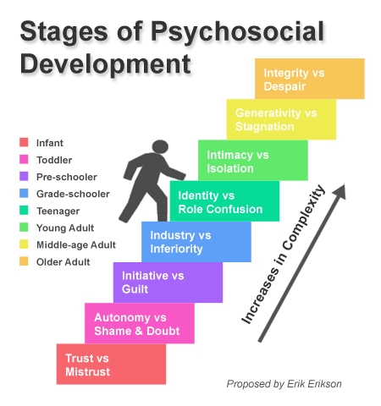

Slide 13
Sources
http://www.ebeanstalk.com/8-year-old-toys.php
http://www.growingtreetoys.com/category/3-and-4-year-olds
http://www.walmart.com/ip/Shopkins-Season-3-12-Pack/44706867
http://www.goodenoughmother.com/2011/12/smart-phones-and-kids-a-luxury-or-necessity/
https://www.pinterest.com/pin/362610207468323517/

