Slide 1
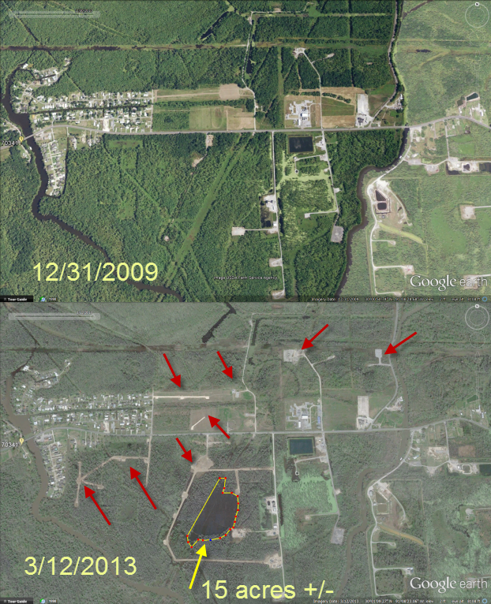
The Bayou Corne Sinkhole
Zach Sergi

Slide 2
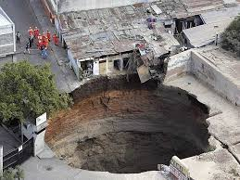
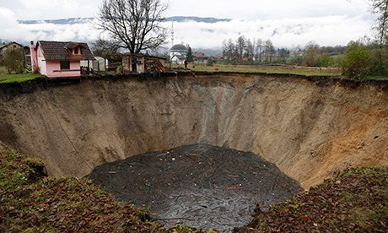
What is a sink hole
a hole formed in soluble rock by the action of water, serving to conduct surface water to an underground passage.
Caused by both naturel forces and human activity

Slide 3
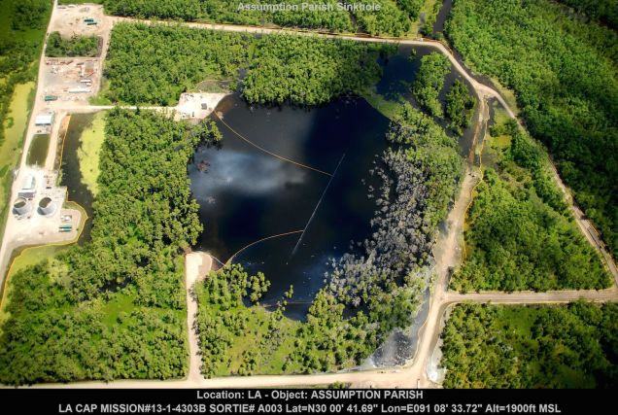
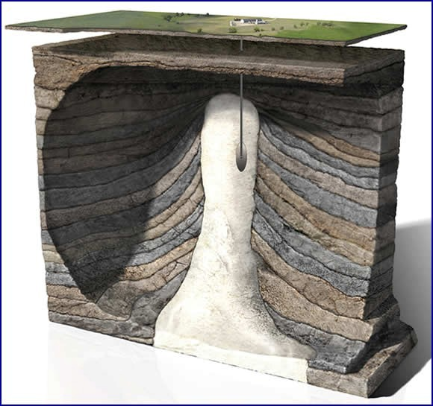
Cause of Bayou corne sinkhole
Failure of a underground salt cavern
Texas Brine Co. mined too close to a salt dome causing the side wall to collapse.
Causing the release of natural gasses into the water
Roughly 32.5 acres now and still growing

Slide 5
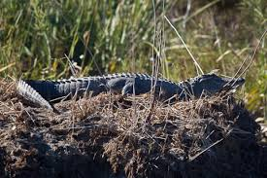
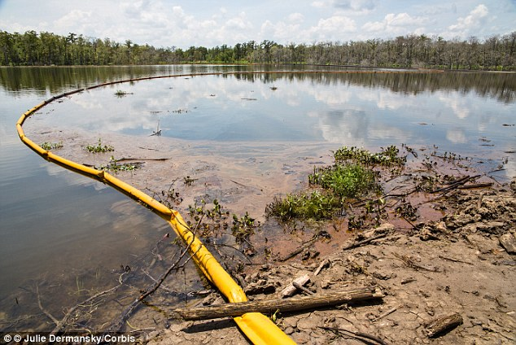
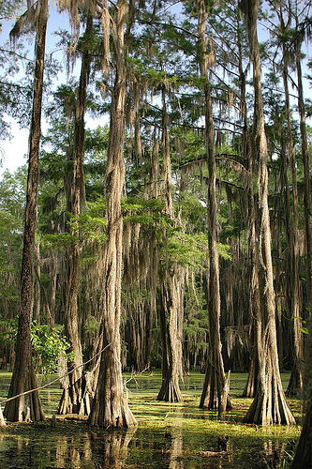
The ecological impact
Very little studies so far
Continued destruction of the cypress trees

Slide 6
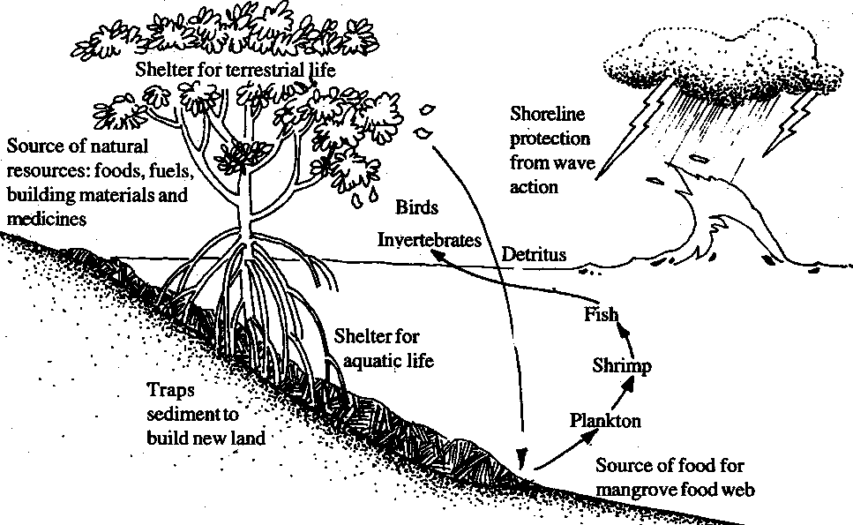
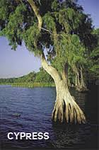
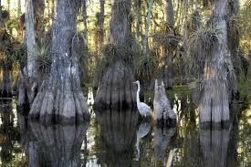

Slide 7
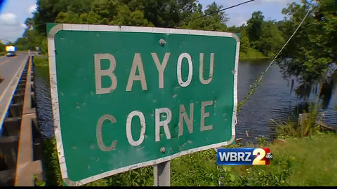
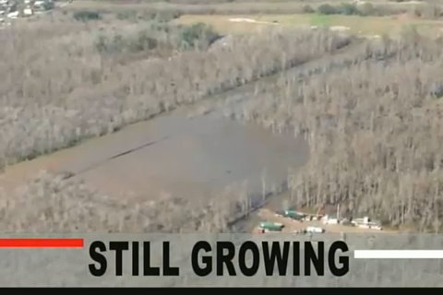
Continued expansion
More people will be evacuated from their homes
Plant life will continue to be destroyed
Continued breakdown of the wetland ecosystem
The ecosystem will continue to adapt daily to the new changes caused by the sinkhole

Slide 8
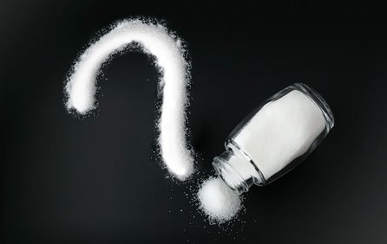
Questions?

Slide 9
Sources
http://www.opednews.com/articles/Bayou-Corne-Sinkhole-Still-by-Meryl-Ann-Butler-Bayou-Corne_Bayou-Corne-Sinkhole_Ecosystems_Fracking-150809-288.html
http://www.isciencetimes.com/articles/5580/20130708/louisiana-sinkhole-bayou-corne-texas-brine-dome.htm
https://www.youtube.com/watch?v=w-oykLjCcpc
http://news.nationalgeographic.com/news/2013/08/130812-florida-sinkhole-disney-world-explainer-urban-science/
PIERRE-LOUIS, RENDRA. "Drowning Cajun Country." In These Times 39.1 (2015): 44. Supplemental Index. Web. 8 Oct. 2015.

