Slide 1
App Reviews
By: Noah Sears

Slide 2
SWORKIT KIDS
Sworkit Kids is an app that introduces kids to basic flexibility, agility, strength, and balance exercises.
Sworkit Kids is a free app without any additional in app fees.

Slide 3
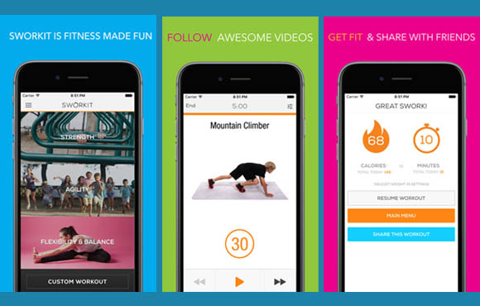
How does it work?
The app is very easy to use.
The main menu give 3 options for types of workouts
Strength
Agility
Flexibility & Balance
You then select the amount of time you want to work out.
There is a video demonstration on how to do the exercise and it tells you the amount of time you will do it.

Slide 4
Who can use it?
This app could be used by both teachers and students.
Teachers could you the app for introducing students to basic strength, agility, flexibility, and balance workouts.
In class, students could follow along with the app’s workout for their lesson.
Additionally, students could download the app on their device and use it outside of Physical Education class.

Slide 5
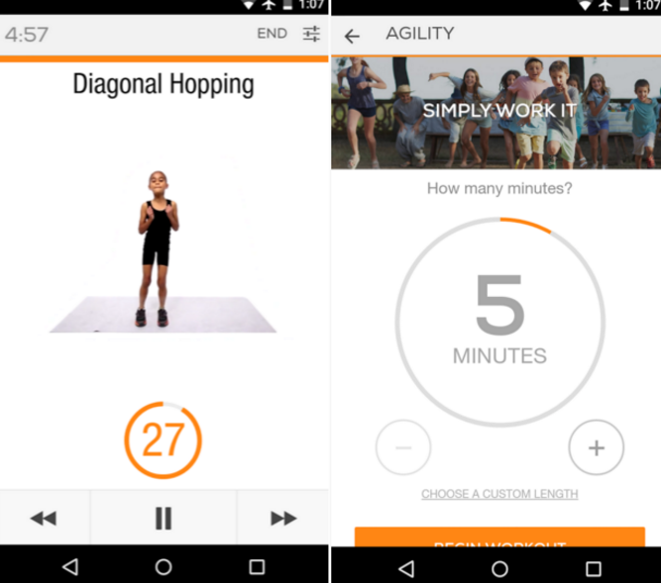
Final Review
Sworkit Kids is a easy application to operate. It is easy for children of all ages to understand.
There are not any in application fees, so the cost is completely free.
The app allows both teachers and students to operate inside and outside of class.
I would definitely recommend this to my fellow college students or any Physical Education Teacher.

Slide 6
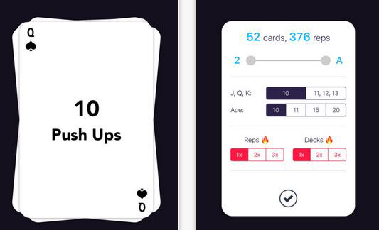
Sweat Deck
Sweat Deck is an application which has built in exercise for students or anyone who uses it.
It operates in the format of a deck of cards.
For example, a 7 card might appear with it saying push ups, so then you would do 7 push ups.
There are several in application upgrades that may be purchased, however it is not necessary to do that.

Slide 7
How does it work
Sweat Deck is an easy application to operate
The user can select the specific cards they want to do, or have them randomly selected for you.
An example of workout would be 10 push ups, 8 crunches, 9 burpees, and 8 squats. Then as soon as that workout is finished, you can stop or keep doing as many as you like.

Slide 8
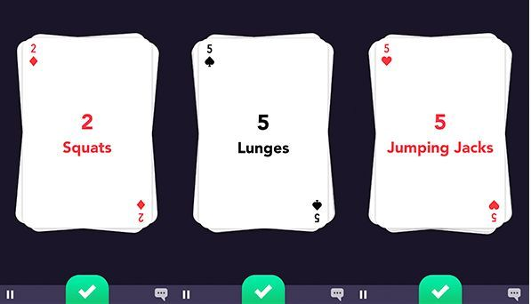
Who can use it
This app could be used by both teachers and students
Teachers could you the app for introducing students to basic full body workouts
In class, students could follow along with the app’s workout for their lesson.
Additionally, students could download the app on their device and use it outside of Physical Education class.

Slide 9
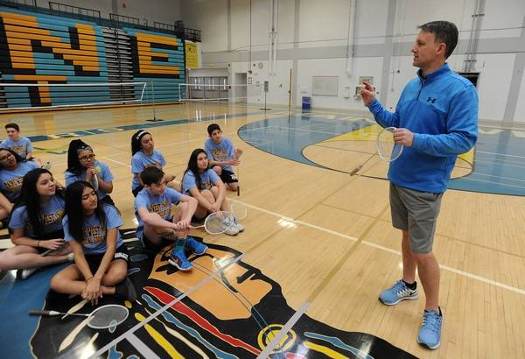
Final review
Overall this is a very good application for both Physical Education Teachers and students.
Sweat Deck is easy to operate and does not have any mandatory in application costs.
I would recommend this application to Physical Education Teacher so that if they wanted to, they could somehow incorporate it into their lessons.

