Slide 1
Oil spill damage and prevention
Searra Richardson

Slide 2
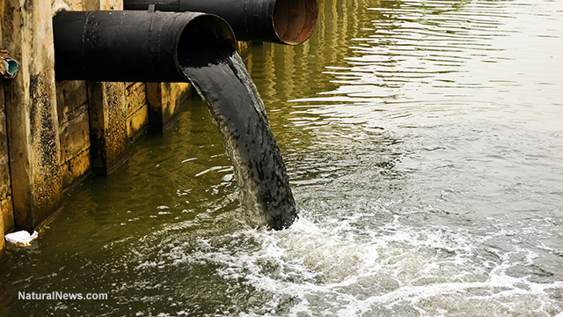
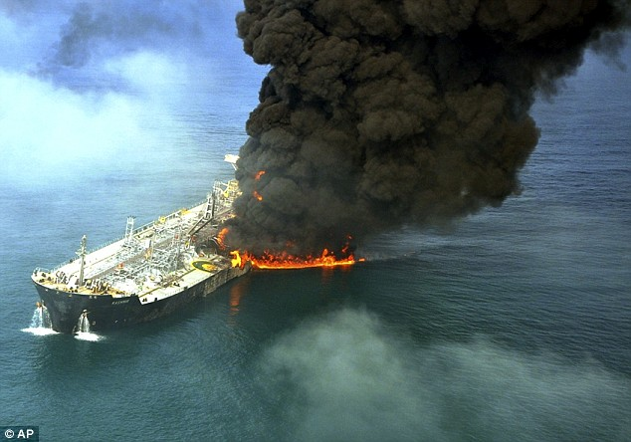
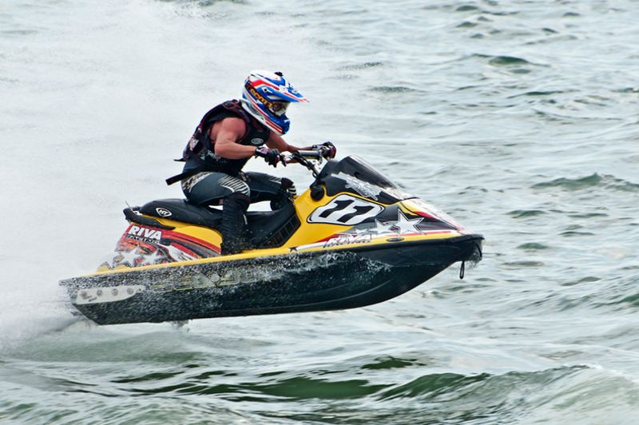
Causes
Accidents or explosions of tankers and rigs
Water sports
Land run-off
Oil dumping

Slide 3
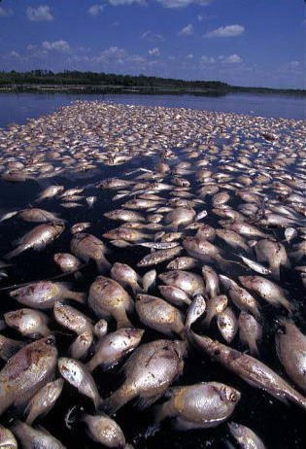
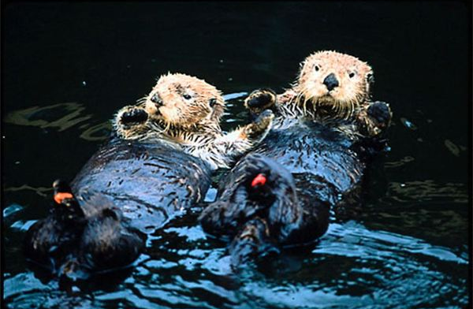
Effects on wildlife
Damages ecosystems and food chain
Acute vs. Chronic effects
Fish: enlarged livers, reproductive issues, respiratory problems, stunted growth and fin erosion
Birds and mammals: high risk of hypothermia, lung, liver, and kidney damage, skin irritation, weakened immune system

Slide 4
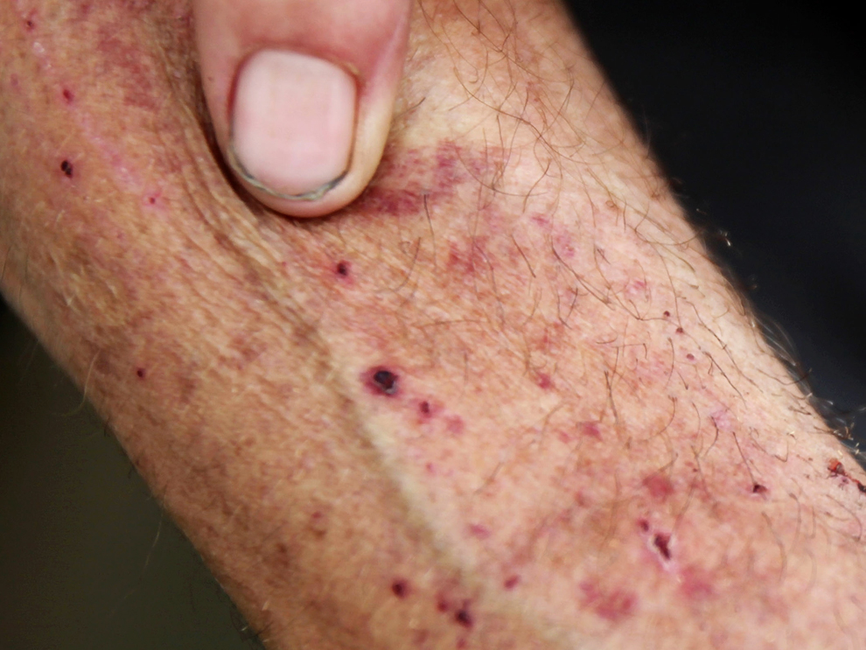
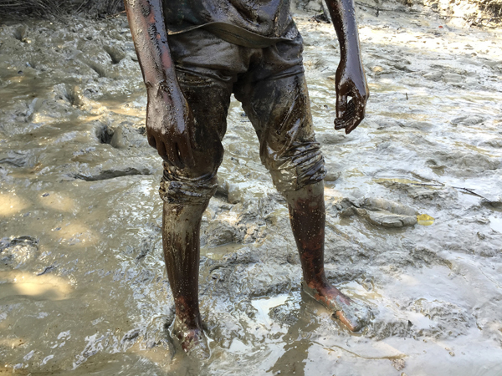
Effects on humans
Direct exposure: physical contact and breathing it in
Indirect exposure: bathing, eating, and drinking it
Irritation of eyes and skin, burns, dizziness, headaches, organ damage, respiratory problems

Slide 5
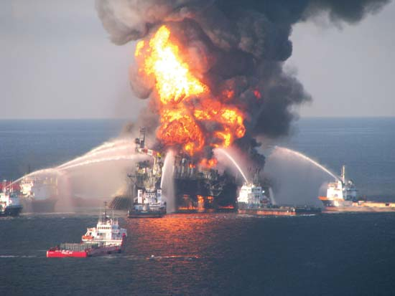
Gulf oil spill
April 20th, 2010
11 killed
Deepwater Horizon oil rig exploded
87 days to stop resulting in about 130 millions gallons of oil spilled
Used many different methods to try to clean up the oil

Slide 6
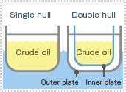
Preventative methods
Inventory checks on rigs and tankers
Monitoring wells
Check water underground for traces of oil
Use of double hull ships instead of single hull ships
Extra layer of watertight protection with space in between to act as a buffer

Slide 7
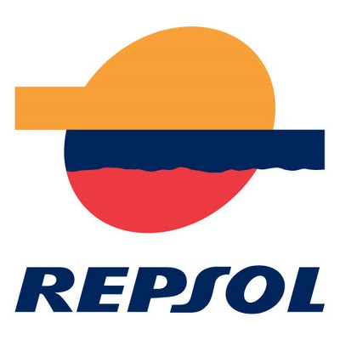
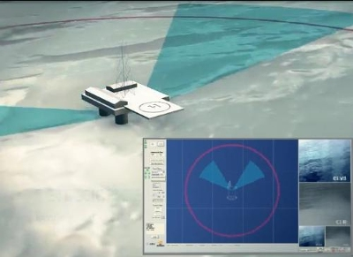
Hydrocarbon early and automatic detection system (heads)
2009: Indra and Repsol joined to create new system
Three main elements
Sensor
Radar
Two algorithms
Can identify leaks as far as 5 km and as small as 10 liters
90% detection rate vs an average of 65% of previous systems
Detects objects around to avoid collisions

