Slide 1
Three Age’s Project
Ashley Schweizer

Slide 2
Rationale
Compare the responses of all participants and identify differences and similarity
Be able to identify theorist in participants answers

Slide 3
Expectations
I expect my youngest participant to lack abstract or logical thinking and provide me with short/quick answers
I except my middle childhood participant to provide me with some logical answers but still demonstrate his innocence in his answers
I expect my oldest participant to provide me with detailed and abstract answers

Slide 4
Questions
Physical Questions:
What color are your eyes?
How many hours a night do you sleep? Are you tired if you don’t sleep enough?
Socio-emotional:
What do you do to make you laugh?
Do you like playing with friends at recess or by yourself?
Cognitive:
What books do you like to read?
What is your favorite class in school? Which class do you not like?

Slide 5
Meet the participants
Early Childhood interviewee- Kevin Dermody, five years old currently enrolled in kindergarten. Connection to participant- babysitter for the last three years. Interview conducted in his front yard
Middle Childhood Interview- Jackson Smith, twelve year old currently in seventh grade. Connection-babysitter for the last six years. Interview conducted over the phone
Adolescence- Michelle Nauls, 18 years currently in college. Connection- best friends for the last four years

Slide 6
Early Childhood Interview: Kevin
Cognitive: What is your favorite class in school? Which do you not like?
“I guess I like math. I’m awesome at math. I do not like spelling because I don’t.”
Related to Piaget’s preoperational stage of egocentrism.
Physical: How many hours a night do you sleep?
“I only sleep three hours a night. I sneak down stairs and watch videos of slim on my laptop after mommy and daddy go to sleep.”
Related to Vygotsky's intuitive thought and Piaget’s preoperational stage of egocentrism

Slide 7
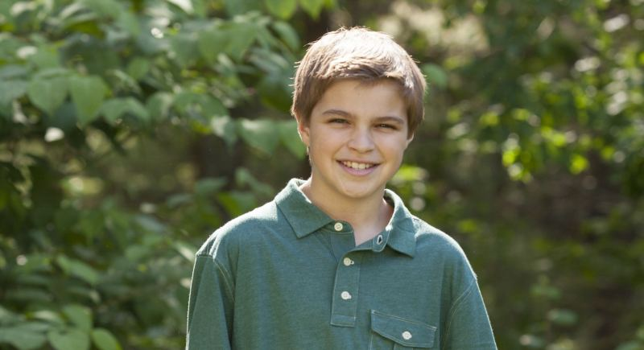
Middle Childhood Interview: Jackson
Cognitive: What genre of books do you like to read/ what type of books?
“I like to read fiction books or book about the ocean with my dad. He really helps me understand the book.”
Related To Vygostky, as the dad is acting as a teacher in the house
*Physical: How many hours a night do you sleep?
-”I sleep about eight hours a day because if I don’t I am cranky.”
-Related to Piaget’s concrete operational stage as Jackson is able to think logically.

Slide 8
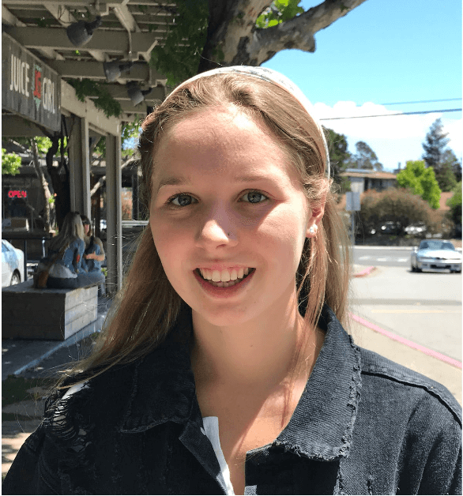
Adolescence Interview: Michelle
Cognitive: What academic topics interest you?
“I am really interested in science. I am studying to become a neuroscientist so anything in that genre really sparks my interest. I hope to have my own practice in a few years.”
Related to Marcia’s Identity: She is in the identity achievement status, has a set future planned
Socio- emotional: Do you like working in groups or by yourself? Why?
“I’m 50/50 with this question and it usually depends on the class and the people. If it’s a class I’m really interested full of reliable people, I want to work in a group, but if I know majority of the people in my class will slack off, I most likely will try to work alone. I don’t like having to do all the work for my group so its usually based on the situation I’m in.”
She demonstrates Piaget’s formal operational stage when she talks about working in groups because she is “systematical planning” and doing what is best for her grade

Slide 9
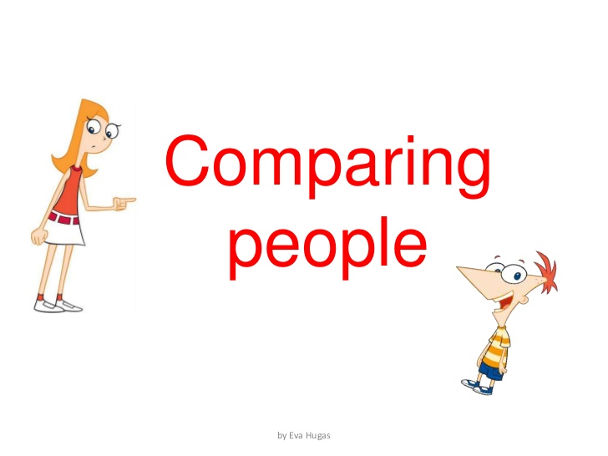
Comparison
As expected, Kevin gave the most illogical answers as seen with the sleeping question. Even Jackson was able to give a more logical saying “I sleep about eights hours a night, if I don’t sleep enough I am normally cranky the nest day.”
Michelle gave the most complex answers and showed the most interest in her future and had a concrete plan in play.

Slide 10
Recommendations
Kevin- less screen time so he isn’t so attached, maybe place him in some after school activities to let him develop some new interest
Jackson- teach him more about self-confidence and self-love because when I asked him if he liked to play alone at recess or with friends, he took this offensively and wanted to make sure I knew he had friends
Michelle- Spend more time with friends, her answers demonstrate the importance she places on school but she also needs to have a social life

Slide 11
Sources
David L, "Identity Status Theory (Marcia)," in Learning Theories, July 23, 2014, https://www.learning-theories.com/identity-status-theory-marcia.html.
McLeod, S. A. (2018, June 06). Jean Piaget's theory of cognitive development. Retrieved from https://www.simplypsychology.org/piaget.html
Oswalt, Angela (2018) Vygotsky Social Development Emphasis https://www.mentalhelp.net/articles/vygotsky-s-social-developmental-emphasis/
Levine, Laura (2018) Child Development: An Active Learning Approach (Print)

Slide 12
Questions?

