Slide 1
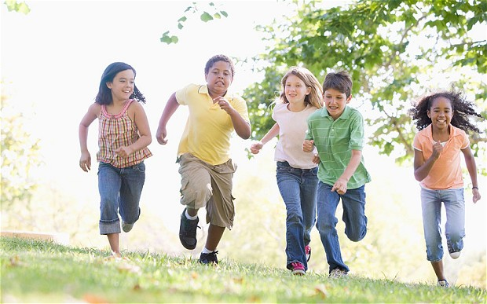
The Value of Physical Education
Karlie Schauer

Slide 2
Physical Education vs. Physical Activity
Physical Activity is simply a behavior; such as walking.
Physical Education is a school curriculum that give the children skills to remain physically active for the rest of their lives.

Slide 3
http://www.sparkpe.org/blog/healthy-body-healthy-mind-the-benefits-of-physical-activity-in-school/

Slide 4
http://www.sparkpe.org/blog/healthy-body-healthy-mind-the-benefits-of-physical-activity-in-school/

Slide 5
Academics
Many studies have been done to research the correlation between physical education and the many aspects of academics.
Most studies have come back with astoundingly positive correlations.

Slide 6
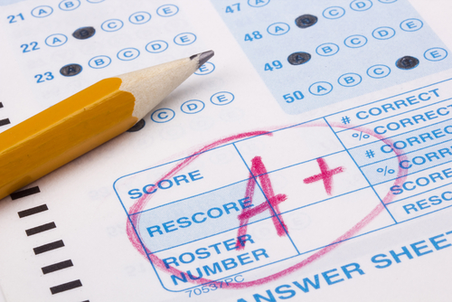
Academics (continued)
Physical education has been shown to benefit many different areas of education, including:
Higher academic scores
More movement/exercise helps to create better blood flow to the brain
Encourage critical thinking
Increase motivation
Fewer disciplinary incidents

Slide 7
http://www.exercise4learning.com/

Slide 8
http://www.sparkpe.org/blog/healthy-body-healthy-mind-the-benefits-of-physical-activity-in-school/

Slide 9
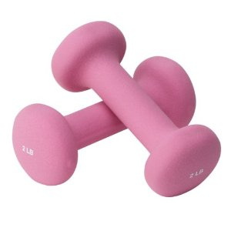
Health
Many studies have also shown a correlation between physical education and health.
Now, this seems like an obvious positive correlation, but health incorporates more than just being in shape or not getting colds.

Slide 10
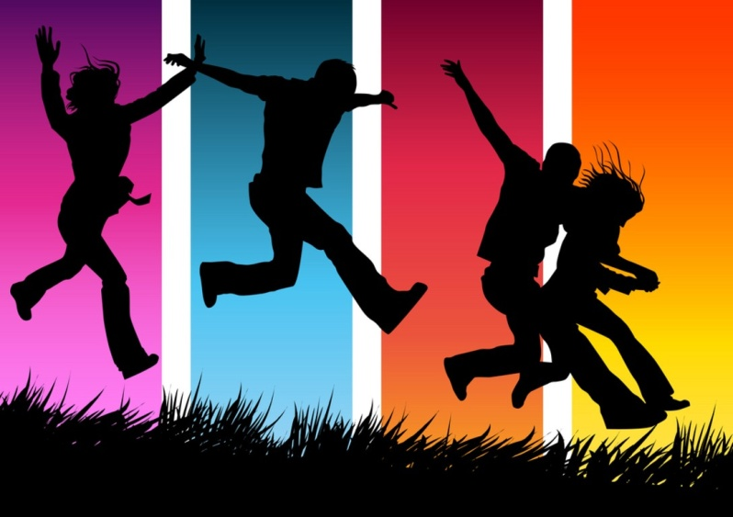
Health (continued)
The health benefits that students get from physical education are vast
Decrease obesity rate
Decrease stress
Increase self esteem
Decrease chronic diseases
Promote overall health and well being
Promote future activity*

Slide 11
http://www.dsr.wa.gov.au/support-and-advice/research-and-policies/organised-recreational-activity-and-mental-health

Slide 12
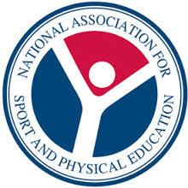
We even have National Standards!
Standard 1 - The physically literate individual demonstrates competency in a variety of motor skills and movement patterns.
Knows how to move
Standard 2 - The physically literate individual applies knowledge of concepts, principles, strategies and tactics related to movement and performance.
Applies that knowledge

Slide 13
National Standards (continued)
Standard 3 - The physically literate individual demonstrates the knowledge and skills to achieve and maintain a health-enhancing level of physical activity and fitness.
Knowledge to maintain healthy lifestyle
Standard 4 - The physically literate individual exhibits responsible personal and social behavior that respects self and others.
Social Responsibility

Slide 14
National Standards (continued)
Standard 5 - The physically literate individual recognizes the value of physical activity for health, enjoyment, challenge, self-expression and/or social interaction.
Finds the value in physical activity

Slide 15
So what does all this mean?
All these graphs, words, and standards really mean the same thing…
As physical education teachers, we are not only preparing children for an active lifestyle but we are also giving them skill sets that will help outside of our gymnasium.

