Slide 1
Text Set
Theme: Health Education
Karlie Schauer
EDUC 432

Slide 2
Rational
Why I chose this topic
  Most PE teachers seem to speed through health so that they can get back into the gymnasium.
  With this new generation being labeled Generation O, health is a big concern.

Slide 3
SOL’s
K.1 The student will identify and describe key health and safety concepts.
a) Recognize the importance of making healthy food choices (e.g., eating a variety of foods from all food groups, eating breakfast, choosing healthy snacks, eating at least five fruits and vegetables a day).
c) Describe different types of physical activity.
2.2 The student will identify personal health decisions and health habits that influence health and wellness throughout life.
b) Describe how food choices, regular physical activity, and getting enough sleep are essential components of a healthy lifestyle.

Slide 4
SOL’s (con’t)
3.1 The student will explain that health habits and practices impact personal growth and development.
  e) Describe the benefits of physical activity and personal fitness.
5.1 The student will analyze the impact of positive health behaviors and risky behaviors on personal health.
  h) Describe how physical activity, sleep, and good health are related.

Slide 5
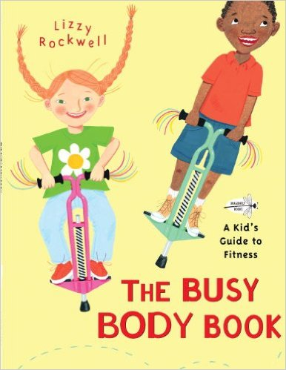
The Busy Body Book: A Kid’s Guide to Fitness
By: Lizzy Rockwell
I chose this book because it isn’t just a book for the teacher to read to the class. This is an interactive book that will help motivate students to get up off the couch and get moving.
Grade level PreK-3
Dragonfly Books. The Busty Body Book: A Kid’s Guide to Fitness. Retrieved from https://www.amazon.com/Busy-Body-Book-Guide-Fitness/dp/0553113747/ref=zg_bs_3237_9.

Slide 6
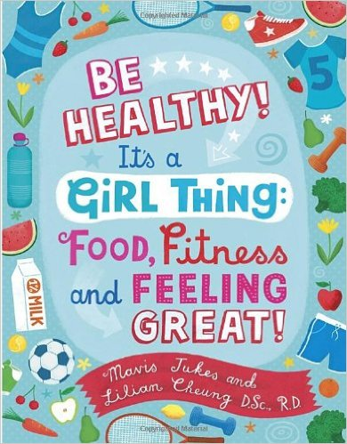
Be Healthy! It’s a Girl Thing: Food, Fitness and Feeling Great
By: Mavis Jukes
I chose this book because it tackles some very important topics for young girls. This book covers thing such as basic nutritional information, safe exercising, tips on how to eat right, and even tough topic of body image issues.
Grade level PreK and up
Knopf Books for Young Readers. Be Healthy! It’s a Girl Thing: Food, Fitness and Feeling Great. Retrieved from https://www.amazon.com/Be-Healthy-Its-Girl-Thing/dp/0679890297/ref=zg_bs_3237_22.

Slide 7
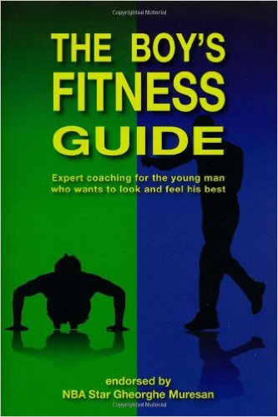
The Boy’s Fitness Guide
By: Frank Hawkins
Similar to the previous book, this book is specifically designed to help young boys learn more and achieve their fitness goals. This book talks about the basics of exercise, eating right, and also building confidence and self-esteem.
Grade Level 7 and up
Big Book Press. The Boy's Fitness Guide: Expert Coaching for the Young Man Who Wants to Look and Feel His Best. Retrieved from https://www.amazon.com/Boys-Fitness-Guide-Coaching-English/dp/0979321913/ref=zg_bs_3237_63.

Slide 8
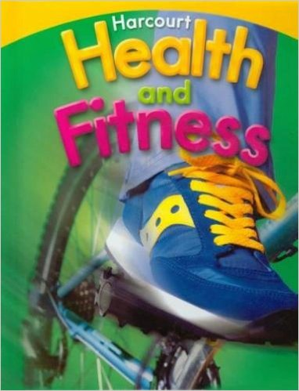
Health and Fitness
By: Harcourt School Publishers
I found a textbook company that makes these books for each grade level. This particular book is geared toward the fourth grade and their specific standards. There is also and optional workbook that teachers can use alongside the textbook.
Grade level 4
Harcourt School Publishers. Health and Fitness. Retrieved from https://www.amazon.com/Harcourt-Health-Fitness-Grade-4/dp/0153551259/ref=pd_sim_14_1?_encoding=UTF8&psc=1&refRID=KQPY1RZVXNRQ35CJ28V2.

Slide 9
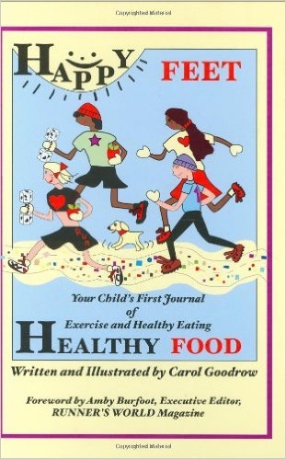
Happy Feet, Healthy Food
By: Carol Goodrow
This book is another ineractive book, designed to get the students moving and conscious of their activity and diet. This book is broken down into weeks, with diet/exercise logs, snack suggestions, and lists of activities and games to keep the student active.
Grade Level 4-7
Breakaway Books. Happy Feet, Healthy Food: Your Child’s First Journal of Exercise and Healthy Eating. Retrieved from https://www.amazon.com/Happy-Feet-Healthy-Food-Exercise/dp/1891369466/ref=zg_bs_3237_40.

Slide 10
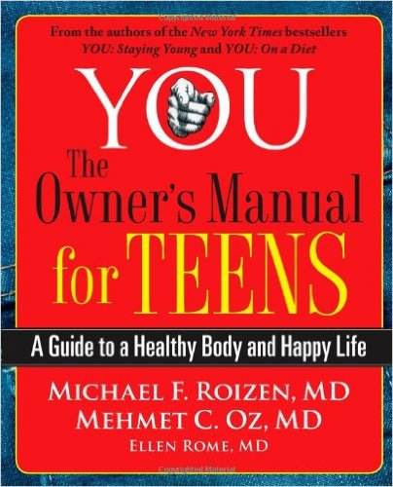
YOU: The Owner’s Manual for Teens
By: Dr. Michael Roizen & Dr. Mehmet Oz
This book not only cover my goal SOL’s about exercise and eating right, but also discusses topics such as sexual health and biological changes in the brain/overall body. This book seems to cover most of the topic these young students need.
Grade level 6 and up
Scribner. YOU: The Owner's Manual for Teens: A Guide to a Healthy Body and Happy Life. Retrieved from https://www.amazon.com/YOU-Owners-Manual-Teens-Healthy/dp/0743292588/ref=pd_bxgy_14_img_2?_encoding=UTF8&psc=1&refRID=J9X7V08ZN3DKF82Z678S.

Slide 11
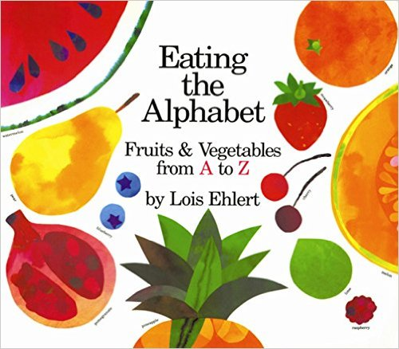
Eating the Alphabet
By: Lois Ehlert
This book teaches students upper and lower case letters while also teaching them about various fruits and vegetables from around the world.
Grade level Pre-k
HMH Books for Young Readers. Eating the Alphabet. Retrieved from https://www.amazon.com/Eating-Alphabet-Lois-Ehlert/dp/015201036X/ref=zg_bs_3230_21.

Slide 12
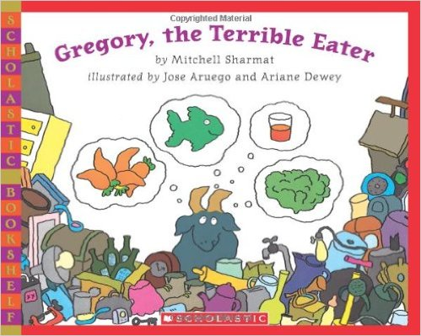
Gregory, the Terrible Eater
By: Mitchell Sharmat
This book tells of a goat and how he is made fun of for eating healthy. He begins to eat poorly to please everyone, but then loses control. He must then try to find the balance between healthy and unhealthy eating.
Grade level Pre-k-3
Scholastic Paperbacks. Gregory, the Terrible Eater. Retrieved from https://www.amazon.com/Gregory-Terrible-Eater-Mitchell-Sharmat/dp/0545129311/ref=sr_1_1?s=books&ie=UTF8&qid=1477252538&sr=1-1&keywords=gregory+the+terrible+eater.

Slide 13
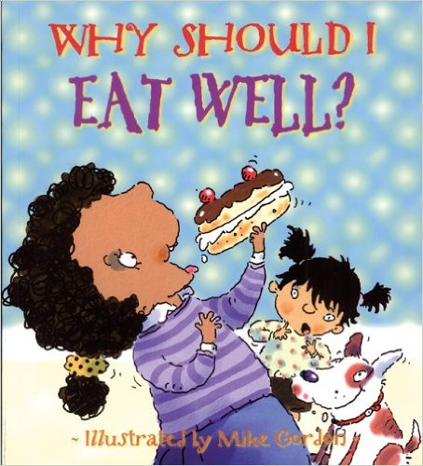
Why Should I Eat Well?
By: Claire Llewellyn
This picture book helps to tell children the importance of eating right and how it impacts health and fitness.
Grade level Pre-k-3
Barron’s Educational Series. Why Should I Eat Well?. Retrieved from https://www.amazon.com/Why-Should-Eat-Well-Books/dp/0764132172/ref=sr_1_2?s=books&ie=UTF8&qid=1477253032&sr=1-2&keywords=childrens+health+books.

Slide 14
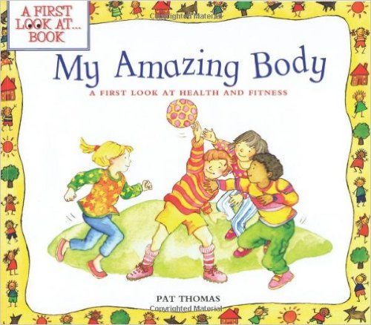
My Amazing Body
By: Pat Thomas
This book talks more about health and fitness verse just eating well. This book also helps prepare students to make positive decisions for themselves.
Grade level Pre-k-2
Barron’s Educational Series. My Amazing Body. Retrieved from https://www.amazon.com/My-Amazing-Body-Health-Fitness/dp/0764121197/ref=zg_bs_3237_43.

Slide 15
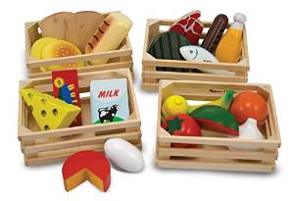
Play Food
Play food can be used in a variety of ways for multiple grade levels. Younger children can simply sort the foods into healthy and unhealthy piles. Older students can use the play food to show a substitute for an unhealthy choice.

Slide 16
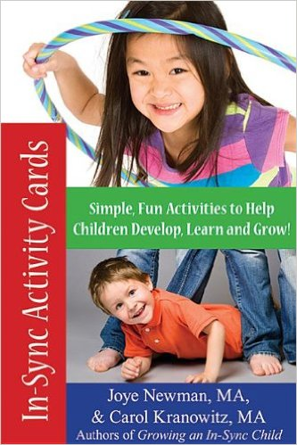
In-Sync Activity Cards
By: Joye Newman & Carol Kranowitz
These activity cards range from beginner level up to advanced level. Each card tell the user why and how the activity work, any equipment you may need, and ways to make each card more difficult.
Grade level PreK-6
Sensory World. In-Sync Activity Cards: 50 Simple, New Activities to Help Children Develop, Learn, and Grow! Retreived from https://www.amazon.com/Sync-Activity-Cards-Activities-Children/dp/1935567357/ref=zg_bs_3237_97.

Slide 17
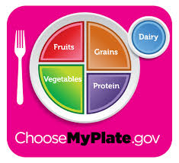
Myplate.com
Myplate.com allows the student to interact with the plate portions as well as learn more about each food group. The website also has a handful of games for students to test their knowledge through.

Slide 18
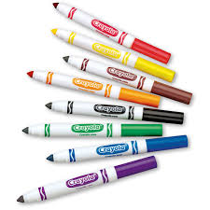
Markers
Markers could be used for a variety of things in the health classroom. Younger students can simply be given pictures of healthy foods to color. The older students could be asked to color what they think a dinner would look like according to myplate.

Slide 19

Kahoot
Kahoot is an online resource that teachers could use to help the students prepare for a test or simply review new material. The teacher just needs to put in questions and answers, then the students can use classroom iPads/laptops to play the game.

