Slide 1
Fitbits in the Gymnasium
Karlie Schauer
November 20, 2015

Slide 2
Why I chose fitbit
Fitbits are still rather new technology
  Not much information
Personal experience with my own fitbit

Slide 3
Weighing the options
Pros
Cons
No batteries
Very similar to traditional pedometer(depending on the style of fitbit)
Bluetooth synching
No struggle of making sure it is on the hip properly
Must be charged individually
Potential to be costly

Slide 4
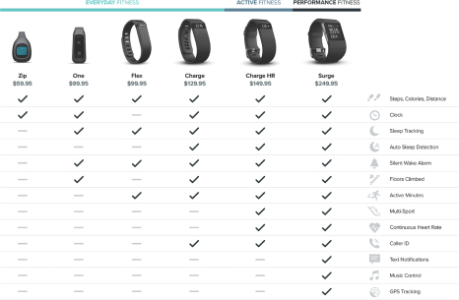

Slide 5
Types of fitbits
Zip
  Basic pedometer
  *uses batteries
  $59.95
Flex
  Worn on wrist
  Incorporates math
  $99.95

Slide 6
Types of fitbit (continued)
Charge HR
  Heart rate monitor and pedometer together
  Some elements unnecessary in PE setting.
  $149.95

Slide 7
Why Choose Fitbit?
Participation
  Motivation
Attendance
Record keeping
Student Knowledge
  Understand their personal physical activity
  Potential to help outside of classroom

Slide 8
Discounts?
Contact fitbit themselves
Amazon or eBay

Slide 9
Sources
Fitbit
  https://www.fitbit.com/compare

