Slide 1
Multi-Genre Projects

Slide 2
Overview
Today for class we will be reading through some excerpts from texts and picking out good usage of tone and elaboration---Recall what those mean below:
Tone: attitude; mood; feel
Elaboration: details
This exercise will help you develop your writings for your multi-genre projects and help you make use of tone and elaboration in your writings
When finished with the excerpts, you will answer questions in your journals about your life to brainstorm for your multi-genre projects

Slide 3
I can…
These are your I can statements:
I can analyze multi-genre mentor texts
I can incorporate tone and elaboration in my writing
I can understand that tone and elaboration effect writing
By the end of today’s class, you should be able to do the underlined and bolded one above.

Slide 4
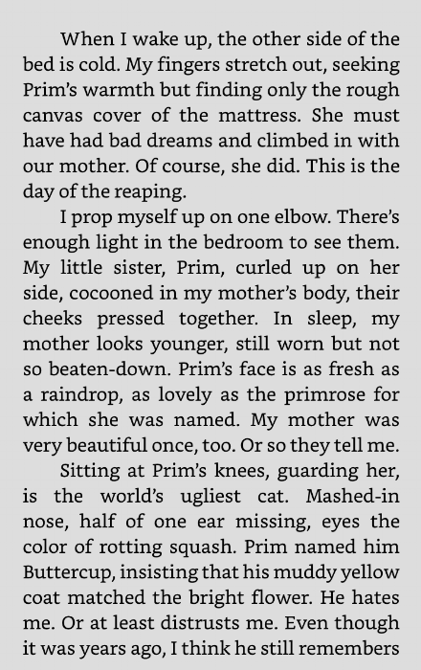
Exercise
I will model how to complete your exercise for today
The text I chose to use is: The Hunger Games by Suzanne Collins (excerpt to the right)
I read this excerpt, and I noticed:
Elaboration in the details of the narrator’s morning---“my fingers stretch out, seeking Prim’s warmth…”--- “my little sister, Prim, curled up on her side, cocooned in my mother’s body, their cheeks pressed together”---and in the details of the cat
Tone: very stale tone---can tell something is going to happen

Slide 5
Strategies
Can you picture the moment happening from the word choice?
Focus on details
What feeling do you get from the reading, if any?
Pay attention to punctuation
If there are pictures, what is happening in them?

Slide 6
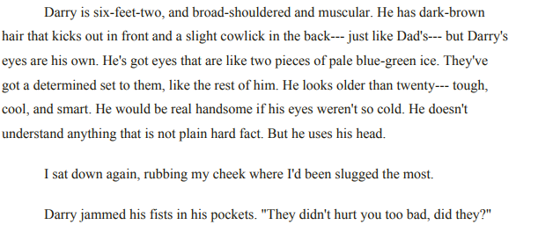
Together
Let’s read this excerpt from The Outsiders by S.E. Hinton together
Recall the strategies in the slide before this one
Write down what you notice about elaboration and tone (3-5 minutes)

Slide 7
Answers from Previous Slide
Compare your answers with my answers
In the excerpt, these are the things I would have highlighted:
Elaboration:
Description of Darry is very detailed
The strong verb “jammed”
Tone:
In this excerpt, the tone is very observant because Ponyboy is paying close attention to Darry’s features and what he does
Continue for your next assignment

Slide 8
Directions
Pick one of the excerpts from the list by clicking this bullet point--your choices are:
Monster by Walter Dean Myers (graphic novel)
The Magic School Bus Lost in the Solar System by Joanne Cole
Newspaper article about a 60th birthday
Magazine article about first day of school
Just Mercy: A story of Justice and Redemption by Bryan Stevenson
The Fault in Our Stars by John Green
A Book I'll Never Write by Devon Eaton

Slide 9
As a Group
When you have chosen your excerpt, get together with the people who have chosen the same one as you & pick up one of the checklists on the front desk
Read through the excerpt with your group (10 minutes)---make note of the tone and elaboration---write down your thoughts in your journal (10 minutes)
Discuss as a class the different usages of tone and elaboration in the excerpts and how it helped you picture what was happening (5-7 minutes)

Slide 10
Individually
Once finished with this exercise, access the list of questions to answer about yourself in your journal by clicking the link attached to this bullet point (it is okay if you do not finish before class is over)
Exit slip: Define tone and elaboration in your own words and explain how it can help improve your writing?

