Slide 1
Finding yourself in others

Slide 2
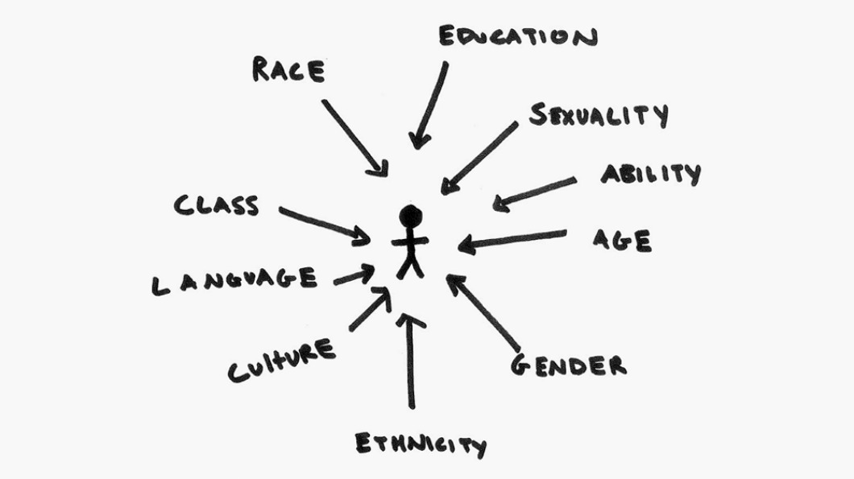
Who Am I?
In order to understand other individuals, you must first understand who you are as a person
First, we are going to complete an identity wheel to conceptualize who you are as an individual---take about 1-2 minutes
Some tips: race is white, black, brown, etc. while ethnicity is American, German, Spanish, French, etc.

Slide 3
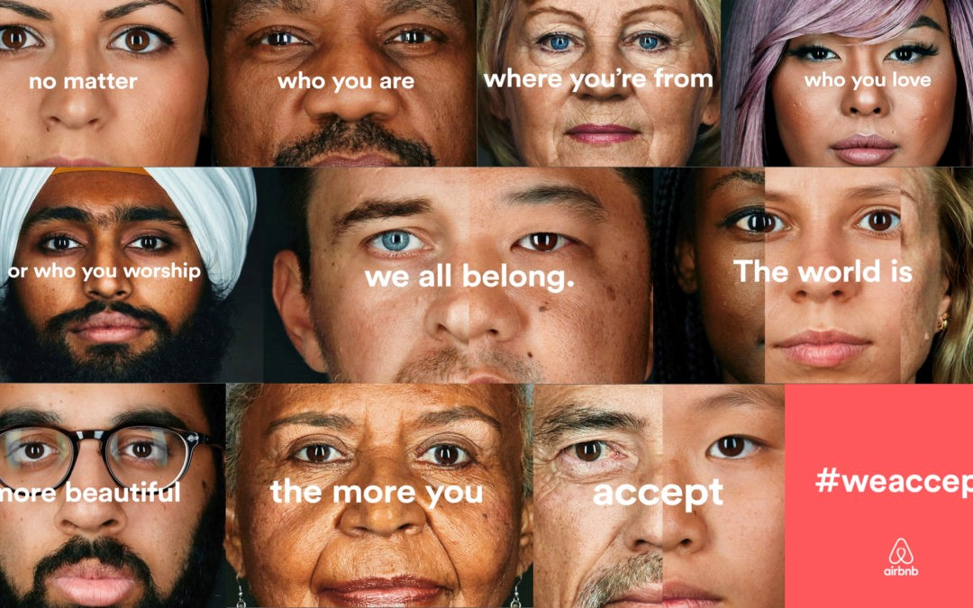
What is diversity? And what can it look like?
Share your identity wheel
https://www.cyh.com/HealthTopics/HealthTopicDetailsKids.aspx?p=335&np=286&id=2345

Slide 4
#TwitterFingers
In 140 characters or less answer this question taking 1-2 minutes (give it a catchy hashtag!):
How can we use literature to teach us about diversity and other cultures?
Share with the class your answer and hashtag

