Slide 1
Three Ages Project
Hannah Ramey
Longwood University

Slide 2
Selection of Interviewees
Billy:
Sarah:
Age 6
Early childhood developmental period.
Chosen because he is my cousin.
Age 10
Later childhood developmental period.
She is also my cousin and is Billy’s sister.
Emma:
Age 16
Adolescence developmental period.
Chosen because she is my sister.

Slide 3
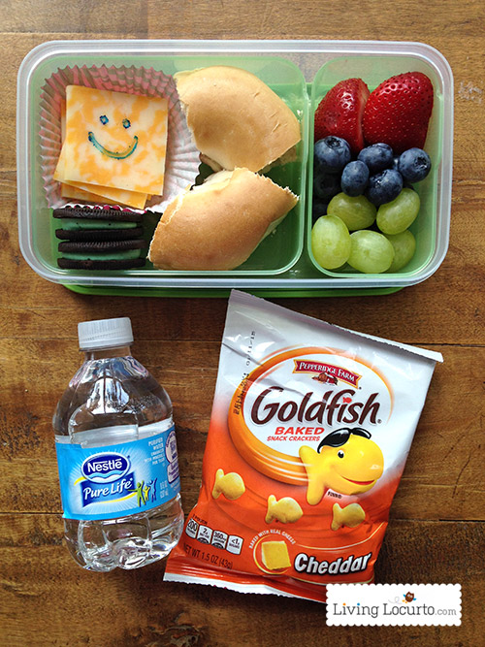
Billy: Physical Development
What do you typically eat at lunch when you go to school?
Billy’s response, “At school I pack my lunch. I bring peanut butter crackers, grapes, Oreos, and a sandwich with ham and mayonnaise on it.”
Getting the proper diet during early childhood plays a key role in maintaining proper growth and also to help deter obesity by developing good eating habits.

Slide 4
Billy: Cognitive Development
What is your favorite part about school and why?
Billy answered, “My favorite part is reading and taking tests on the books?” He commented that he likes getting a one hundred and not a ten on the tests he takes.
Here Billy shows he puts in extra effort for his favorite subject and cares about what grades he gets in the class.

Slide 5
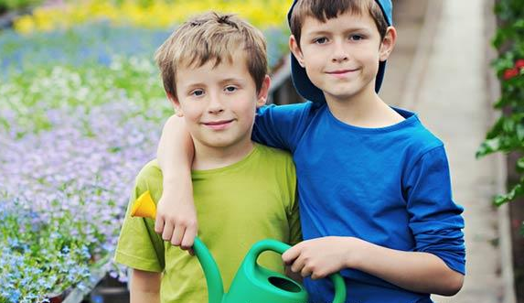
Billy: Socio-Emotional Development
How are your friends at school?
“I have about two close friends, but I especially like my friend Ryan because he is nice, kind, and likes to listen to things I have to say.”
In this phase of development kids are grasping to people they get along with and have common interests with, usually from the same sex. All the while developing their sense of self as they explore those options.

Slide 6
Sarah: Physical Development
Do you play any sports, if so what and how often do you do it?
“I do gymnastics where I get to learn new things like a bridge kickover, which I did by myself the other day.” She also told me she goes there about two times a week.
So, we can observe that her gross motor skills are well developed as she learns new tricks at gymnastics.

Slide 7
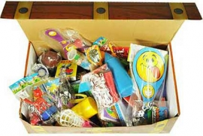
Sarah: Cognitive Development
How do you like your teacher this year and your teachers in previous years?
“I love my teacher this year she is really nice and doesn’t yell at me and has a treasure chest that we can get toys from if we are good all week. I liked all my other teachers in the past too.”

Slide 8
Sarah: Cognitive Development
Here Sarah shows she is in Piaget’s concrete operational stage of development. During this stage children increase skills in understanding logical and concrete information. The kids are able to focus on multiple aspects of a problem and understand things from different viewpoints (Cherry, 2018). She demonstrates this by applying that she likes her teacher for multiple reasons and gives me a concrete example of the toy box.

Slide 9
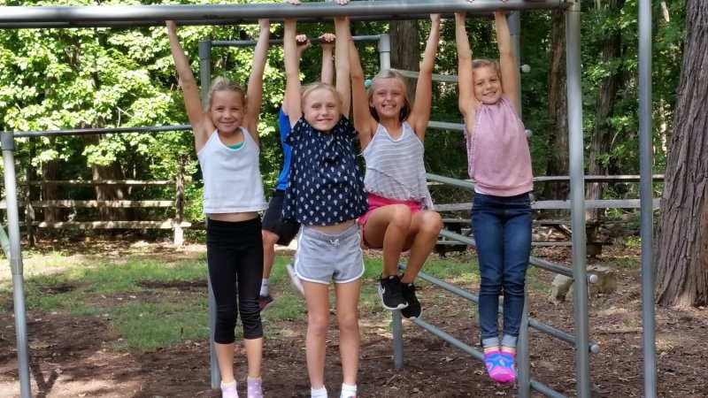
Sarah: Socio-Emotional Development
How are your friends at school?
She said, “I love my friends and have two good friends that are really fun to play with at reses, but I usually plays with a lot of friends. They have really good ideas at reses to make up stories.”
From this I can conclude that Sarah is fairly social and has a great community of friends around her to help her socially through this developmental domain.

Slide 10
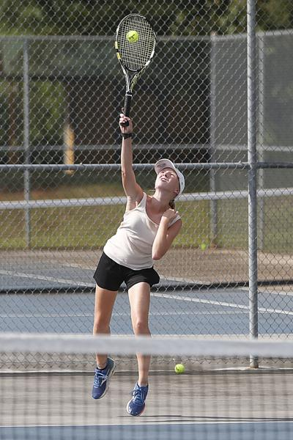
Emma: Physical Development
What is your favorite thing to do for exercise and how often do you do this?
“I like to take hikes and play tennis. I play tennis once a week right now because it is cross country season and I do that every day after school. But during the spring season I play tennis every day.”

Slide 11
Emma: Physical Development
Studies show that there is a general decline in the physical activity of adolescences as their age increases. However, with Emma participating in two different sports throughout the school year and hiking outside of school she is doing good with not conforming to this statistic.

Slide 12
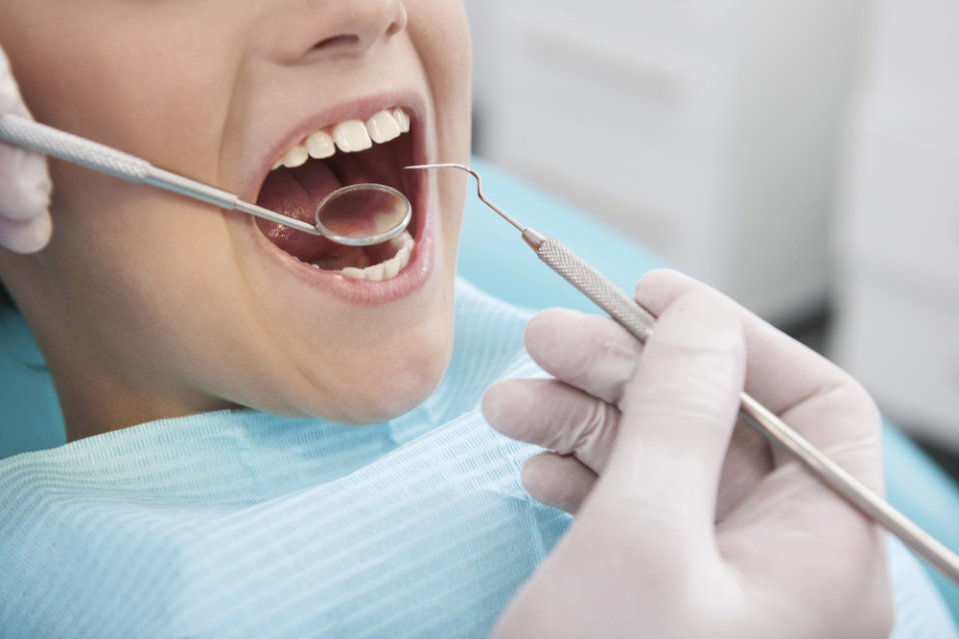
Emma: Cognitive Development
What do you want to be when you grow up?
“I want to be a dentist because I have never had a cavity in my life and I find it interesting how some people are more likely to get them, and some are not. The science behind how to locate and fix certain problems with teeth fascinates me.”

Slide 13
Emma: Cognitive Development
As the Ginzberg approach states that adolescence’s career choices are based on developmental periods in people’s lives such as the fantasy period, tentative period, and realistic period. I believe that Emma is in the tentative period, which is when people begin to think in pragmatic terms about the requirements of various jobs and how their own abilities might fit with those requirements. As she is interested in the science behind dentistry, and that being a topic that is also required for that schooling and job.

Slide 14
Emma: Socio-Emotional Development
How is your school life and your community of friends?
“It is pretty average. I go to school and classes which is not too stressful. I have a lot of acquaintances that I will talk to at school, but only one close friend that I hang out with sometimes outside of school.”

Slide 15
Emma: Socio-Emotional Development
“Studies find that adolescents from warm, supportive families are more socially competent and report more positive friendships. Further, there is evidence that authoritative parenting lessens the effects of negative peer influences” (Steinberg & Morris, 2001). These studies show that Emma’s situation makes sense, because she hangs out mostly with her family and not as much with her friends

Slide 16
Area of Interest:
For all of my interviews I asked them, “Where they would want to travel to in the world?” My findings for Billy and his sister were particularly interesting to me.
Billy replied, “Washington D.C., because it’s cool how they have the Washington monument.”
Sarah replied, “Washington D.C., because it was so fun to walk around and see the Washington state building and to go in the gift shops to get shirts and my dad got a hat. Me and my mom tried on some sunglasses and I thought that was so funny.”

Slide 17
Area of Interest: continued
This was apparently a trip they had already taken as a family and they both said that they would go back.
Billy however wants to go back to see something specific which shows us that he is in Piaget’s Stage of Preoperational Thinking. This is a stage when children’s use of symbolic thinking grows, mental reasoning emerges, and the use of concepts increase. Billy is almost out of this stage, but as he describes why he wants to go back simply based off of one thing, or symbol, we see that he is still making connections by using symbols. While Sarah recalled more specific memories from the trip.

Slide 18
Conclusion:
For my interview with Sarah, possible recommendations for her could be to keep pushing herself academically since she is showing such great potential with her studies. Another thing is to try and maintain that strong social network of friends she has from both school and gymnastics. Having a strong friend group can help children mentally by providing support for them, pushing them out of their comfort zones, and to make positive influences on them.
During this project I was able to learn more about topics we have been discussing all year in class and apply them to real world situations.
Here I was able to analyze my relatives and see how certain factors of their lives can be currently shaping who they will become in the future.

