Slide 1
Physical Education Apps
Rachael Wiseman
HPEP 203 - Technology for Health and Physical Education

Slide 2
Hudl Technique
Hudl Technique can be downloaded to any smartphone or tablet.
Hudl Technique analyzes different movements in super slow motion to provide a breakdown of technique for feedback in a sport, game, or activity.
Hudl Technique can be used by both teachers and students.

Slide 3
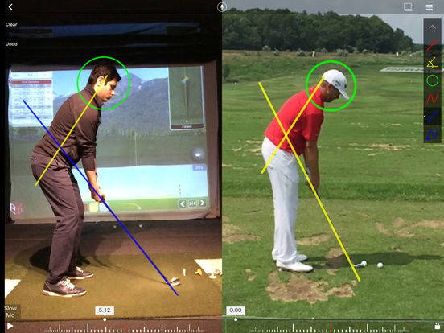
Hudl Technique
This app could be extremely beneficial for students of all ages in the physical education setting. Many students are visual learners, so with Hudl Technique they will be able to watch their own performance in comparison to a professionals to help them understand how to improve their skill performance.

Slide 4
Hudl Technique
This app is FREE to anyone with a smartphone or tablet that has a camera.
Overall, I think this app is one of my favorites to apply to a physical education setting. Every student may not have access to a smartphone or tablet, but there will be enough to share which allows every student to watch their own performance. Criticism can often be difficult to take when an individual doesn’t understand what they are doing wrong. I believe this is a great app to allow students to watch a broken-down analysis of their performance and even compare it to a professional. It is fairly simple to navigate through this app allowing it to be user friendly to a wide variety of age groups. Hudl Technique is a great way to motivate students to improve their technique.

Slide 5
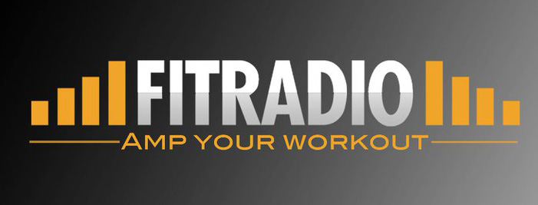
FIT Radio
FIT Radio can be downloaded to any smartphone or tablet.
FIT Radio provides access to an endless stream of high-energy music specifically designed to motivate.
FIT Radio is only used by teachers, but enjoyed by students.

Slide 6
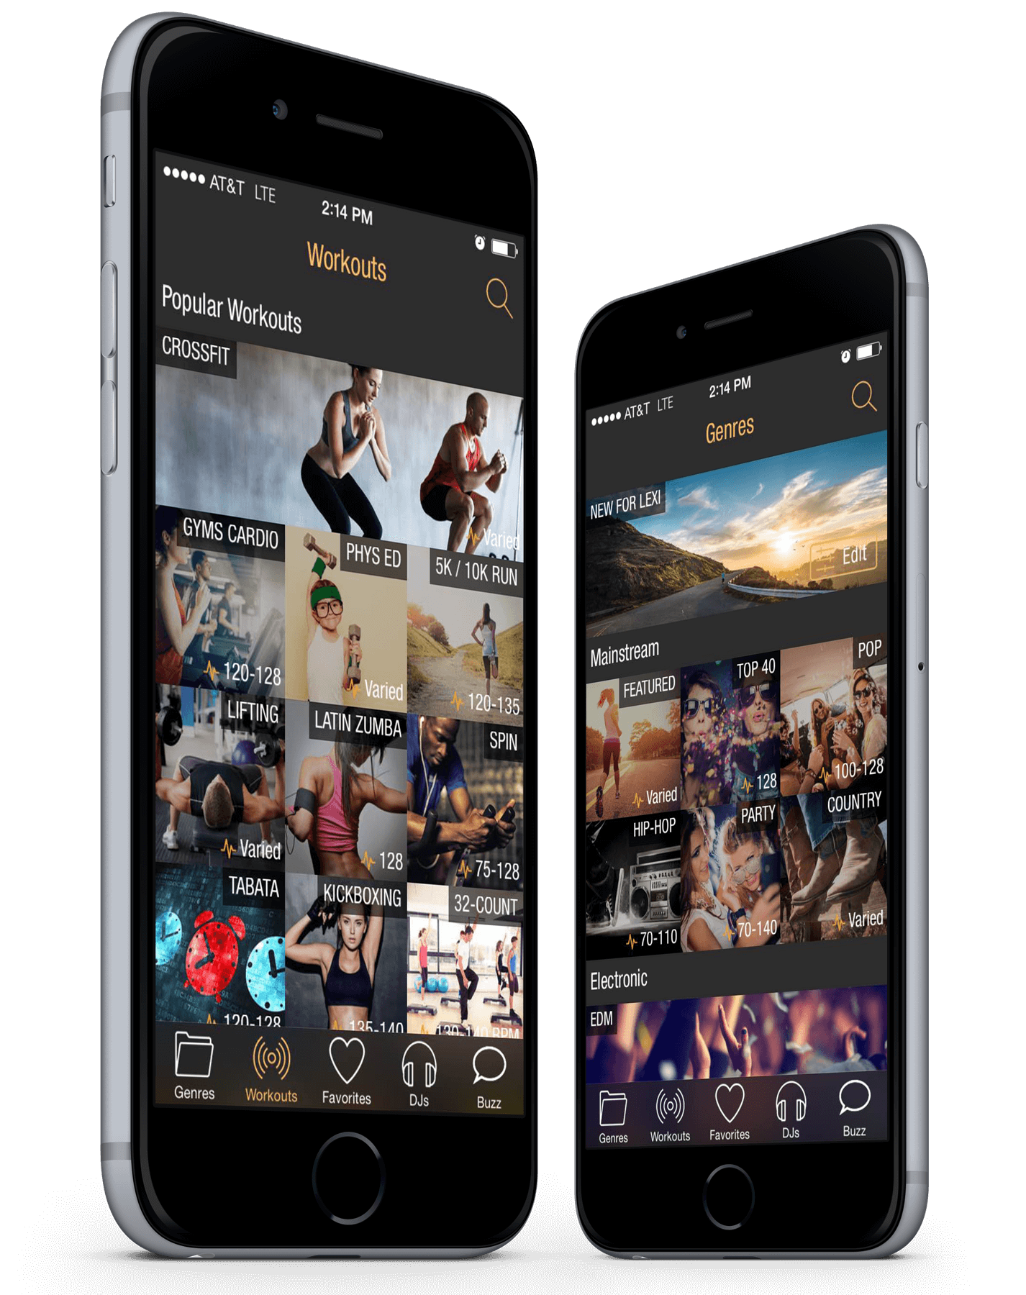
FIT Radio
Music is one of the most powerful tools used in the physical education setting. Music can be designated as a start and stop signal for activities and games. Music is also used to motivate students to power through their physical activities. To save time and stress of putting together appropriate playlists for students, teachers can stream their FIT Radio for continuous original mixes.

Slide 7
FIT Radio
This app is FREE to any user with a smartphone or tablet.
Only the teacher needs to have access to this app for everyone in the class to enjoy. Many students may not have access to a device that allows them to enjoy any music. Also, many students may not participate in any type of physical activity outside of physical education class. With that being said, it is very important that teachers find different ways to make physical activity fun. Music is an excellent way to motivate students of all ages. Again, this is a simple way to acquire appropriate music that is designed to drive students to get moving.

