Slide 1
APP Review
Ieuan Phillips

Slide 2
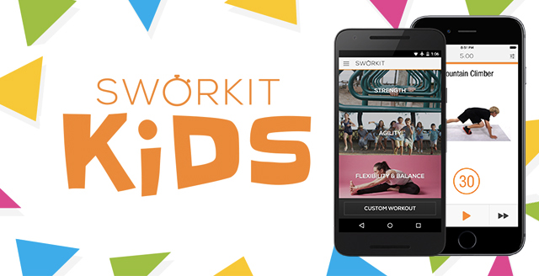
Swork-it kids
This is a great free physical education app that introduces kids to strength, agility, flexibility, and balance exercises. Easily customize activities and the length of your workout. This app shows kids demonstrating activities with proper technique, making it easy for your students to learn and follow along. Minimize instruction time and get your students moving right away. This app is used for both student and teacher. With a very simple menu screen that allows you to choose what exercise or action you will do. It’s FREE!!
Overall, this is a really good app to use and the fact that it is free just makes it that much better. With Swork-it,no gym, no excuse because it brings the workouts to you.

Slide 3
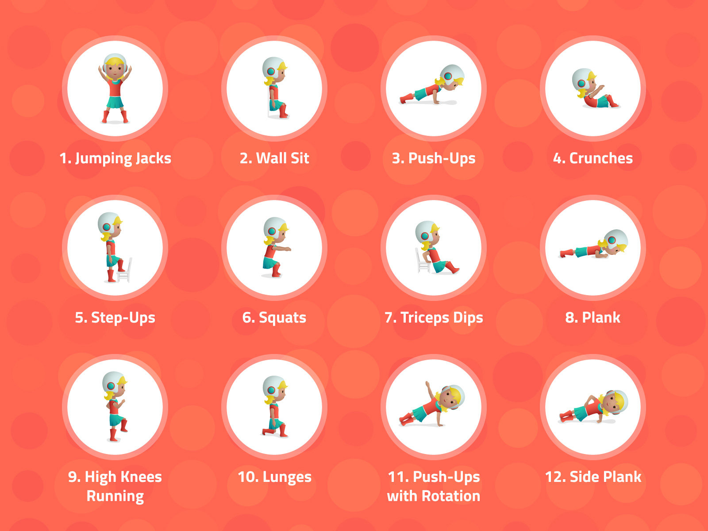
7-Minute Workout for kids
With the 7-minute workout app, students will be able to improve their endurance, strength, and flexibility. This free physical education app includes 12 easy exercises that will get students active starting at an early age. Each exercise will have a video demonstration, allowing students to develop and practice good technique. This can either be lead by the teacher or have them do it on their own.
Overall- this is also a good app but is missing volume. With this app it only focuses on the workout aspect of physical education rather than the whole picture.So unlike the other app that has demonstrations on balance and flexibility, strength and agility. This one is a lot simpler because it only has 12 total workouts in the app and all you have to do is press start workout and follow along. I personally am not the biggest fan of this app because of the lack of content in it.

