Slide 1
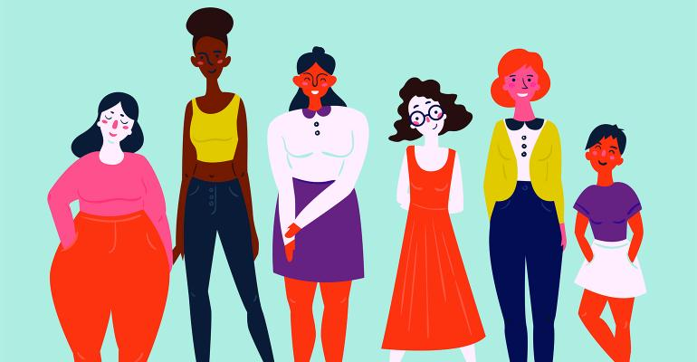
Is Objectification a Meme?

Slide 2

Video of Discussion

Slide 3
How many of you found this video funny?

Slide 4
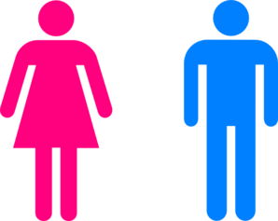
Why is this negative?
This video objectifies men and women and judges them based off of the stereotypes that men and women are placed under.
It creates a meme out of negative stereotypes and judgements based on sexual activity and looks.

Slide 5
Stereotypes
Stereotypes of Women being Shown
Stereotypes of Men
Pure
Good Bodies
Married
Womanizers
Constantly thinking about sex
In The Handmaid’s Tale women are expected to be pure; however, when in the club men are very sexual and women are judged based on their bodies.

Slide 6
Who is behind the Camera?
Written on the Body
  Does the gender matter?
I automatically assume it is a man that is more likely to objectify and that is behind camera.
Women can also set negative standards for femininity and masculinity.
Does the gender of the person making the video matter?

Slide 7
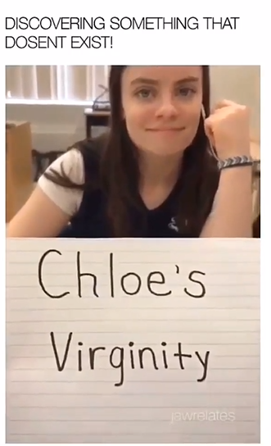

Sex for Men vs. Women
For the woman, it is a negative thing that she has had sex- if she has sex she is seen as less than, or a slut, or whore.
The man is being judged for not having sex- if he has sex he is seen as cool to his friends and will be admired and praised

Slide 8
Movie Relation
She’s the Man
Fifty Shades of Grey
As a women Viola is supposed to be prim and proper with the perfect body and her life figured out.
When Viola dresses as her brother she is expected to be a ladies man.
Anastasia is portrayed as a very pure woman who hasn’t been touched before Christian Grey.
Christian is portrayed to be hyper sexual.

Slide 9
Questions?

