Slide 1
School improvement
Social skills
Vernestine Payne

Slide 2
It shall be the mission of George M. Hampton Middle School to holistically educate all students in a positive educational environment. We will challenge our students to reach high standards and assist them in evolving into life-long learners and responsible, open-minded citizens of the world.

Slide 4
teachers’ frustration

Slide 5
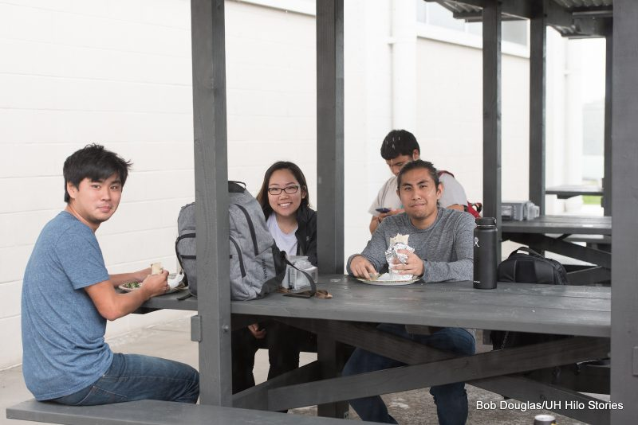
The Compromise

Slide 6
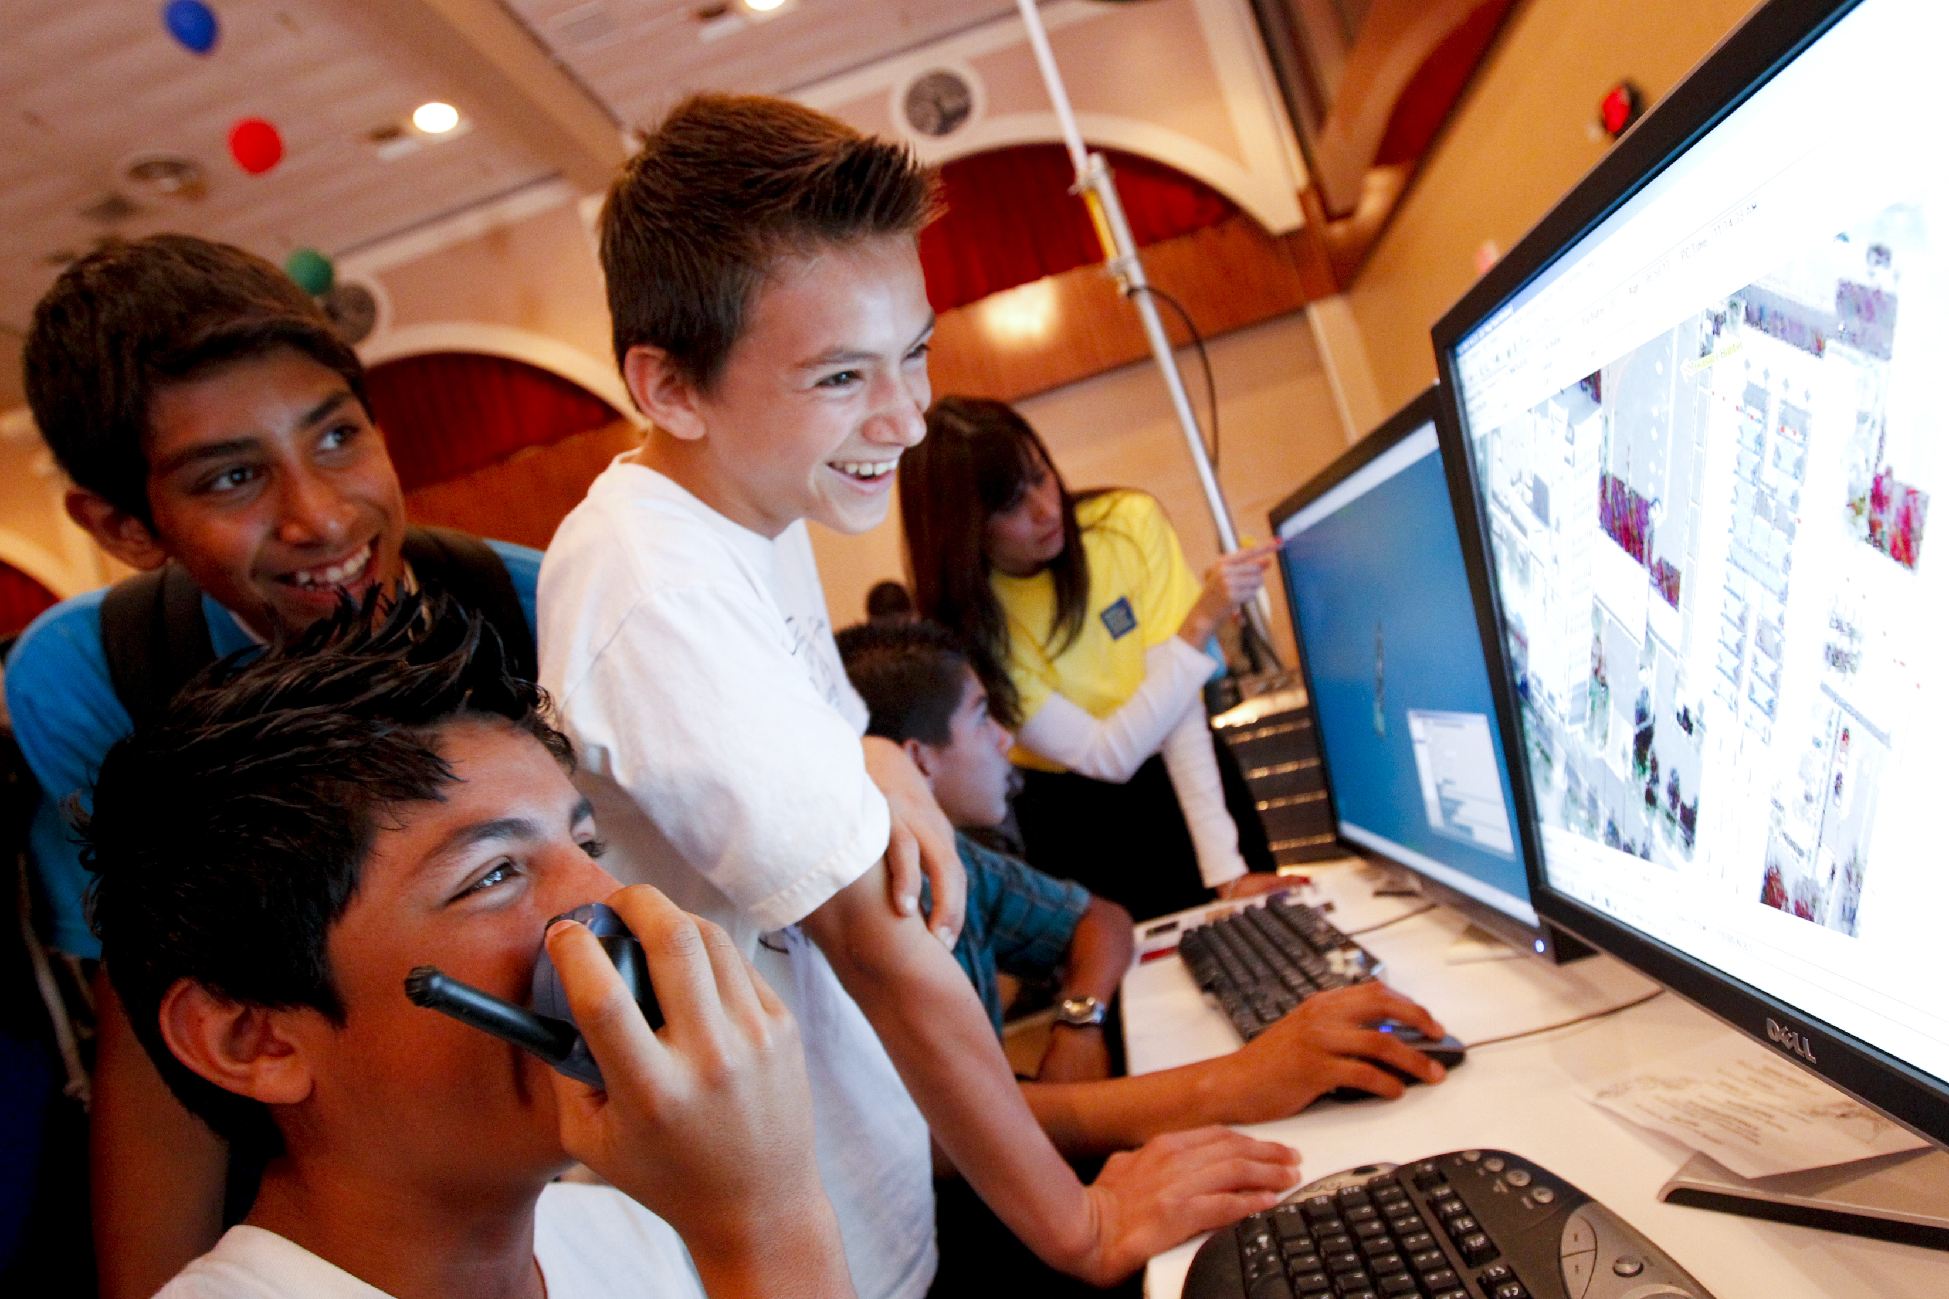
Social skill class
This Photo by Unknown Author is licensed under CC BY-SA

Slide 7
To ensure that students exhibit The Profile of a Graduate that includes the ability for students to attain and demonstrate productive workplace skills, qualities, and behaviors, this pilot program will target seventh graders. It will be a mandated elective class that all 7th graders will have for nine weeks. The curriculum would address topics such as:
●Social Media appropriateness ●Self Advocacy
●Anger Management ●Peer/adult relationships ●Peer pressure ●Bullying •Apologizing • Self Management • Assertion • Cooperation • Coping skills • Responsible Decision making • Empathy • Following directions • Giving feedback • Ignoring distractions •Requesting help • Responsibility • Self-control •Self Awareness • Team work •Social Awareness

Slide 9
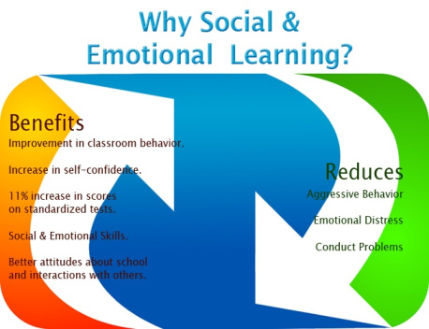

Slide 10
Budget
New teacher
Average salary: $66,942
Curriculum/supplies $2,500

Slide 11
Some may argue that this is a job for professional school counselors or that students should be taught these skills in elementary school.
School counselors may cover some of these topics during the few times classroom guidance lessons are done, however there is a greater need for a designated Social Skills class to teach, reteach and reinforce positive social skill.
We can’t expect our students to know what hasn’t been taught.

Slide 12
Goal of the Program and Data tracking
To reduce the number of administrative referrals
Increase instructional time in class (not out of class for disciplinary reasons)
Improve overall school climate (measured by staff, parent, students’ surveys)
Data will be tracked at the end of each quarter and again at the end of the year

Slide 13
Communication
●Newsletter
●Social Media
●Robocalls
●Presentation to parents over the summer

Slide 14
Social and emotional development should be as important as the academic focus. We live in a world where teamwork, group participation and collaboration are essential, recreationally and vocationally. The more we use all our talents and skills, the more complete individuals we will be. Let’s truly provide a holistic education to our children, so they can be responsible and productive world citizens.

Slide 15
Reference
https://hamptonms.pwcs.edu/
https://www.illuminateed.com/blog/2016/08/understanding-why-social-emotional-learning-is-important-for-schools/

