Slide 1
Anger management Anger = Danger
By: Montana Nelson

Slide 2
What IS ANGER MANAGEMENT?
Process of learning to recognize signs that you are becoming angry
Taking actions to calm down
Deal with the situation in a positive way
It affects all ages

Slide 3
Statistics
1 out of 5 Americans faces Anger Management problems
2/3 of American adolescents have experienced an anger attack that involved threatening violence

Slide 4
How can anger affect you
Anger can cause: headaches, insomnia, high blood pressure, and depression
Anger Attacks: uncontrollable feelings of rage expressed inward or outward
Get to know your anger: https://youtu.be/-HQIg3ZwAs0

Slide 5
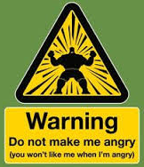
Warning Signs
Physical: headache, clenching, increased heart rate, shaking
Emotional: irritated, resentful, anxious
Other: sarcasm, losing sense of humor, raising your voice

Slide 6
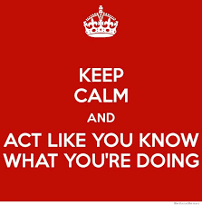
Anger Management Tips
-Deep breathing
-Problem solving
-Environment change
-Use humor
-Regular Exercise
-Counseling

Slide 7
Anger = Danger

Slide 8
references
A. (n.d.). Controlling anger before it controls you. Retrieved March 27, 2016, from http://www.apa.org/topics/anger/control.aspx
Anger - how it affects people. (2014, January). Retrieved March 27, 2016, from https://www.betterhealth.vic.gov.au/health/healthyliving/anger-how-it-affects- people
D. (2015, May 28). Get to Know your "Inside Out" Emotions: Anger. Retrieved March 27, 2016, from https://www.youtube.com/watch?v=-HQIg3ZwAs0
Harvard Medical School. (2012, July 2). Uncontrollable anger prevalent among U.S. youth: Almost two-thirds have history of anger attacks. ScienceDaily. Retrieved March 27, 2016 from www.sciencedaily.com/releases/2012/07/120702210048.htm
M. (2014, June 02). Anger management. Retrieved March 27, 2016, from http://www.mayoclinic.org/tests-procedures/anger-management/basics/definition/prc- 20014603
Miller, B., & Jones, A. (2016, March 03). What Are Anger Attacks? Retrieved March 27, 2016, from http://www.wisegeekhealth.com/what-are-anger-attacks.htm
Mills, H., PH.D. (2005, June 25). Recognizing Anger Signs. Retrieved March 27, 2016, from https://www.mentalhelp.net/articles/recognizing-anger-signs/
U. (n.d.). Ange Management. Retrieved March 27, 2016, from http://www.ucdmc.ucdavis.edu/hr/hrdepts/asap/Documents/Anger_Management.pdf

