Slide 1
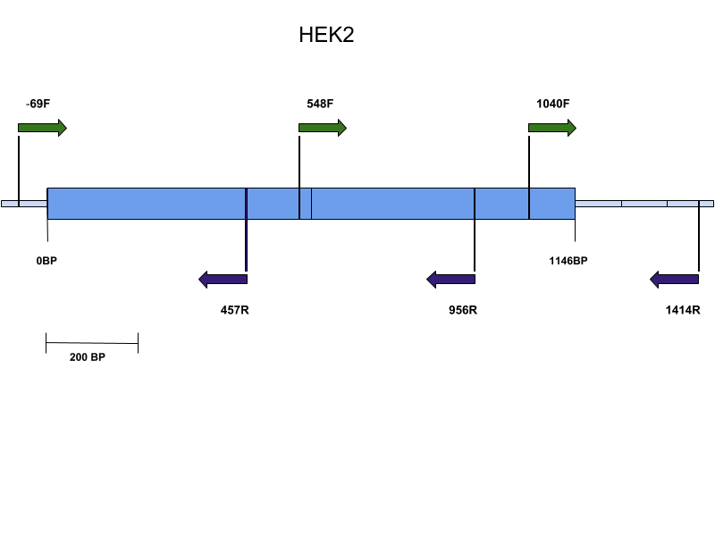
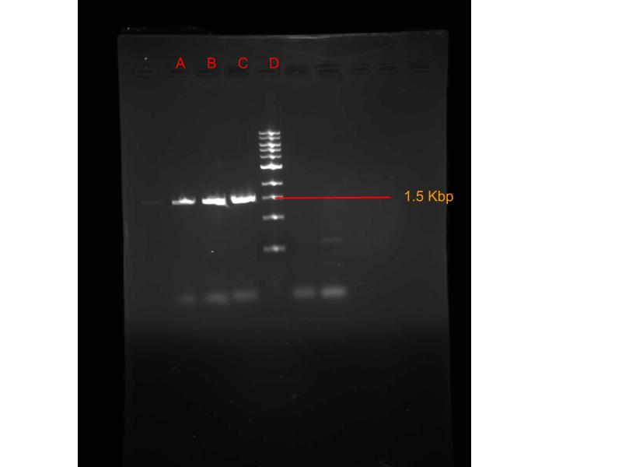
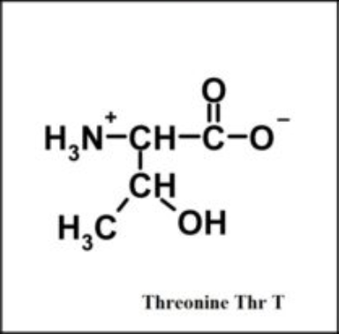
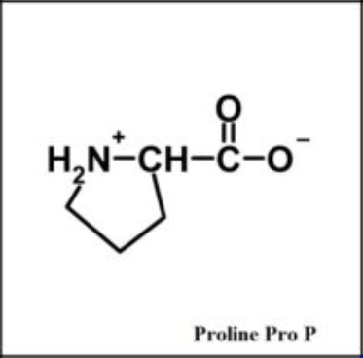
What the HEK2 is flocculation? Ryan Servis & Natalie Wood Cell Biology, BIOL 326 Longwood University
Background
Specific Aim
In brewing, flocculation is a process in which cells stick to form flocs that rapidly separate by sedimentation or rising to the surface. (1)
The individual flocculation levels of different yeast strains can affect pre-filtered color, taste, and clarity.
When comparing multiple proteins in the regulation of FLO genes, HEK2 was found to interact with multiple FLO genes.
HEK2 is a RNA binding protein that interacts with ASH1 mRNA to regulate protein translation.
The ability of HEK2 to bind mRNA may use the same mechanisms with the regulation of the flow genes.
Question
Does the change in the amino acid sequence, change in the expression of the FLO genes?
Hypothesis
When comparing HEK2 from strain K97 with other brewing strains, we anticipate a phenotypic change in the amino acids that could result in flocculation differences.
Methods
Preliminary results
Primer Design
Figure 2: Gel electrophoresis of HEK2 gene from K97 strain (Column A, B, C). All tested samples measured approximately 1.5 kilobase pairs.
PCR
Purification/ Electrophoresis
DNA sequencing
Figure 1: Custom HEK2 primer created using 3 forward primers (green arrows) and 3 reverse primers (purple arrows) to ensure complete and accurate amplification of target sequence by polymerase chain reaction (PCR). Total amplicon length is 1483 base pairs (BP) and target region 1146BP.
Multiple sequence alignment
Results
Discussion
MSA of DNA
MSA of Protein
A protein sequence change unique to the tested K97 strain occurs at amino acid 84 (figure 3).
Proline is unique due to its structural rigidity; commonly found on the edges of ß-sheets and start of α-helixes.
If amino acid 84 is not a proline, as it is in the other strains, this could result in improper α-helix formation.
STRAIN | 17 | 250 | 435 | 528 | 627 | 1050 | 1089 | 1114 | 1143
AWR1796 | A | C | C | C | G | T | C | A | C
EC1118 | A | C | C | C | G | C | C | A | C
LALVINQA23 | A | C | C | C | G | C/T | C | A | C
VL3 | A | C | C | C/T | G | T | C | A | C
PW5 | A | C | T | C | G | T | C | G | C
BY4741 | A | C | C | C | T | T | C | G | C
KYOKAI7 | T | C | C | C | G | T | T | G | C
UC5 | T | C | C | C | G | T | C | G | C
HEK2_K97 | A | A/C | C | C | G | T | C | A/G | A/G
VIN13 | A | C | C | C | G | C/T | C | A | C
STRAIN | 6 | 84 | 372
AWR1796 | E | P | K
EC1118 | E | P | K
LALVINQA23 | E | P | K
VL3 | E | P | K
PW5 | E | P | E
BY4741 | E | P | E
KYOKAI7 | V | P | E
UC5 | V | P | E
HEK2_K97 | E | T/P | K/E
VIN13 | E | P | K
Figure 3: Visualization of the structural differences of Proline (P) and threonine (T) at amino acid 84.
Conclusions
Figure 1: Strains are S.cerevisiae. First row indicates nucleotide base pair location. Only columns with nucleotide changes are shown. Experimental strand is highlighted in yellow.
Figure 2: Number indicates amino acid location in protein. Only locations where a nucleotide variation caused an amino acid change are listed.
K97 has a possible amino acid change that could affect the secondary protein structure consequently affecting protein function.
Further experimentation is necessary to test what, if any, affects the sequence changes in HEK2 have on yeast flocculation.
Acknowledgements
References
We would like to thank Master brewer David Steeves at Third Street Brewery for his knowledge and experience in the brewing industry as well as Dr. Wolyniak, professor at HS-C, for participating with his class in this research.
(1) Verstrepen, K. J.Derdelinckx, G.,Verachtert, H., and Delvaux, F. RYeast flocculation: What brewers should know. Applied Microbiology and Biotechnology 61 (2003):197–205.
Saccharomyces Genome Database https://www.yeastgenome.org
EMBL-EBI https://www.ebi.ac.uk
BLAST https://blast.ncbi.nlm.nih.gov/Blast.cgi

