Slide 1
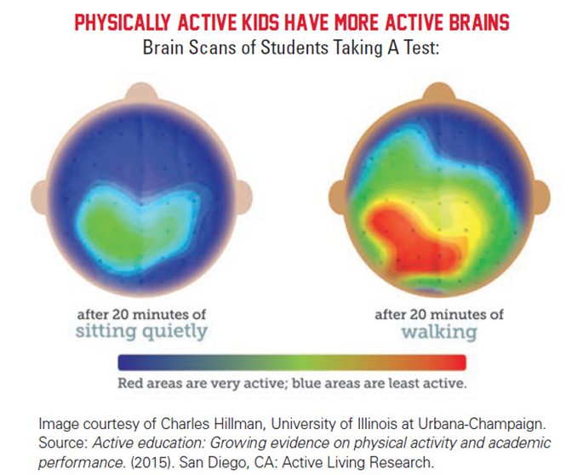
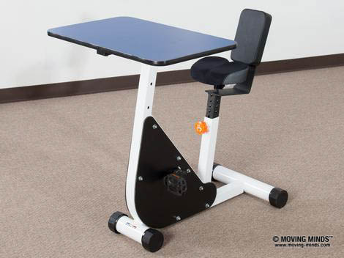
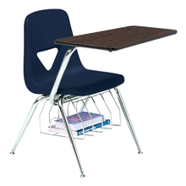
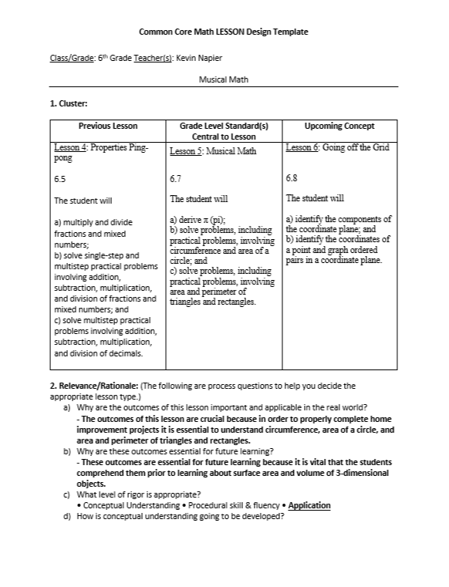
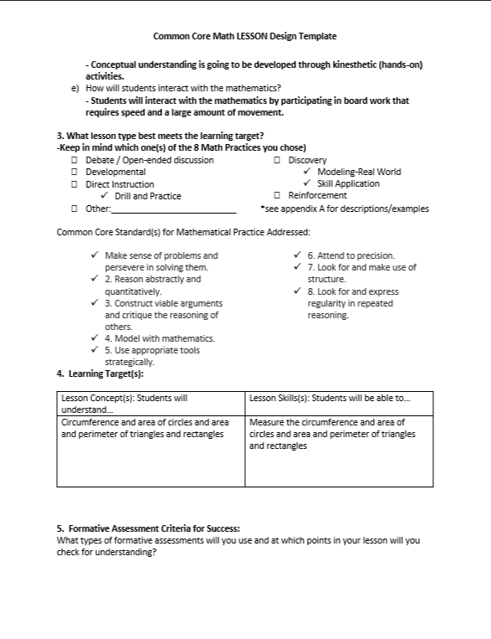
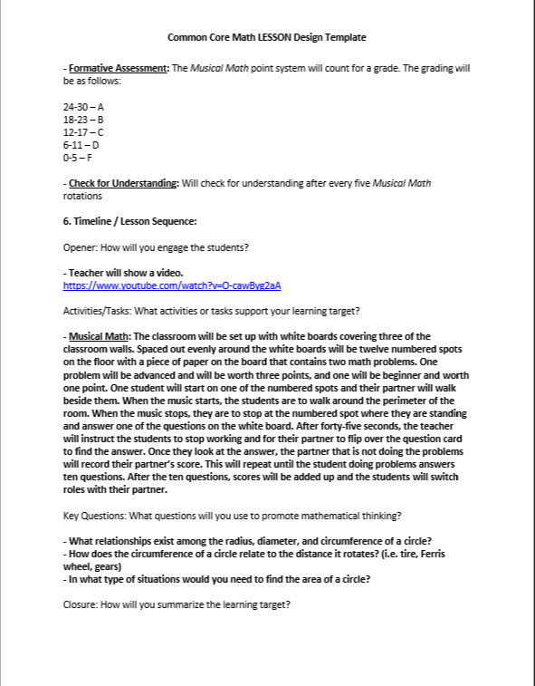
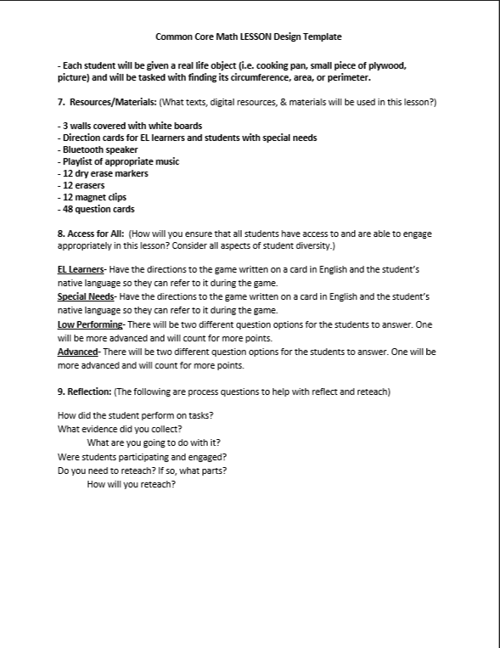
Infusing Movement into Middle School Math Curriculum
Kevin Napier
Advisor: Dr. Kari Hampton ‘04
Teaching Middle School Physical Education 378 – Longwood University
Abstract
In collaboration with Dr. Kari Hampton ’04, I have used my background knowledge in physical education to create 6th grade math lessons that are designed to get students moving in the classroom. Each of the lessons are directly aligned with the Virginia Standards of Learning (SOLs). These lessons will be especially beneficial to students who are primarily kinesthetic learners.
Kinesthetic Classroom
VS.
Lessons and Math SOLs
Lesson 1: Funky Fractions - SOL 6.2
Lesson 2: Insane Integers - SOL 6.3
Lesson 3: I’ve Got the Powers - SOL 6.4
Lesson 4: Properties Ping-pong - SOL 6.5
Lesson 5: Musical Math - SOL 6.7
Lesson 6: Going off the Grid - SOL 6.8
Lesson 7: Gettin’ in Shape - SOL 6.9
Physical Education SOLs
Motor Skill Development – SOL 6.1
Social Development – SOL 6.4
Schools in Virginia that have implemented kinesthetic classrooms:
Oak Ridge Elementary – Arlington, VA
North Fork Middle School – Quicksburg, VA
St. Christopher’s School – Richmond, VA
Chamberlayne Elementary School – Henrico, VA
John Kerr Elementary School – Winchester, VA
Floyd T. Binns Middle School – Culpeper, VA
Cale Elementary School – Charlottesville, VA
Sample Lesson Plan (Lesson 5)
Further Exploration
When I get a teaching position, I plan on writing a grant for kinesthetic classroom equipment and infusing as much movement as possible into my lesson plans. Additionally, I plan on doing a quantitative analysis to help prove that infusing movement into curriculum and classrooms improves test scores.
______________________________________________________
A special thanks to my faculty advisor, Dr. Kari Hampton ‘04.
Sources
(1). http://www.localkicks.com/community/news/2017-sols-shorter-math-and-reading-tests
(2). https://pbn.com/kids-count-ri-pe-teachers-want-more-professional-development121357/
(3). https://www.scoe.org/files/ccss-math-lesson-plan.docx
(4).https://www.schooloutfitters.com/resource/images/v20170920/Scholar_Craft/resized/SFT-525-FB-220-220.jpg
(5). https://www.moving-minds.com/files/image/301/medium/M_PedalDesk1_TH.jpg
(6). http://www.colonialhts.net
(7). http://www.youthfit.com/resources/funding-resources-/kc-locations-0

