Slide 1
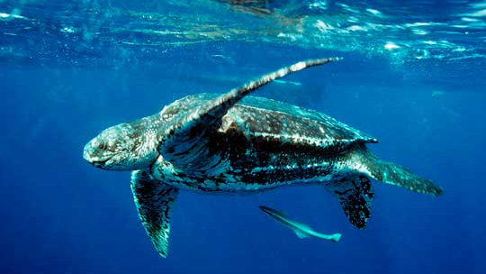
Exploring the Leatherback Sea Turtle
By: Stella Morris

Slide 2
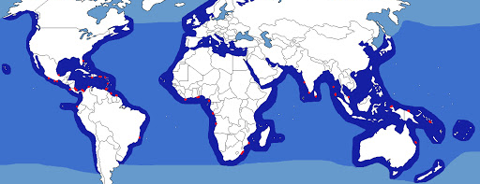
Leatherback Sea Turtle (Dermochelys coriacea)
Status: endangered species throughout entire range
Distribution:
Found throughout the world
Prefer warm, tropical waters
Atlantic, Pacific, and Indian Oceans
U.S. Fish & Wildlife Service. (n.d.).

Slide 3
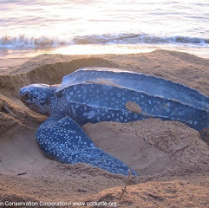
General Information
Physically largest sea turtle (~4-8 ft.)
Largest distribution range
Shell makeup:
Small bones
Rubbery cover
7 ridges
Grey coloring with light colored spots
Fins used for paddling through the water
U.S. Fish & Wildlife Service. (n.d.).

Slide 4
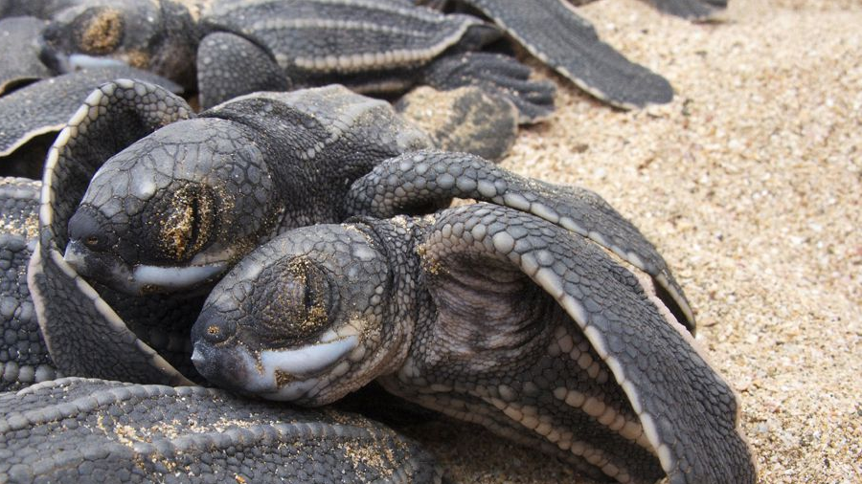
Natural History
Mainly feeds on jellyfish
Other sources of food:
Squid, crustaceans, sea urchins, etc.
Nesting
Occurs between March and July
Sandy beaches with vegetation
Female can nest 5-7 times during 1 season
80-85 eggs per clutch
Females migrate every 2-3 years to nesting beaches
U.S. Fish & Wildlife Service. (n.d.).

Slide 5
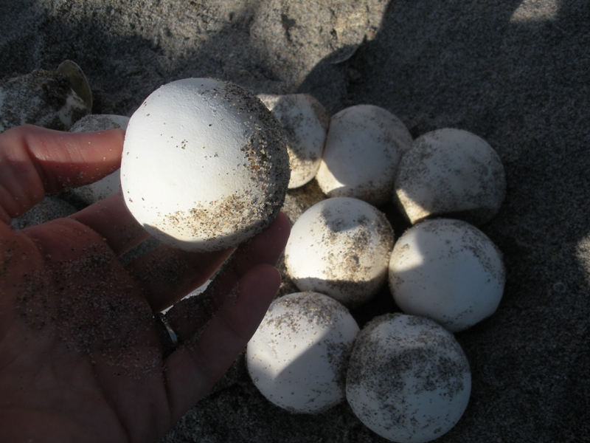
Ecological, Economic, & Cultural Value
Leatherback sea turtle eggs
Taken by humans
Used for food
Turtle meat used for food as well
Wallace, B.P., Tiwari, M. & Girondot, M. 2013

Slide 6
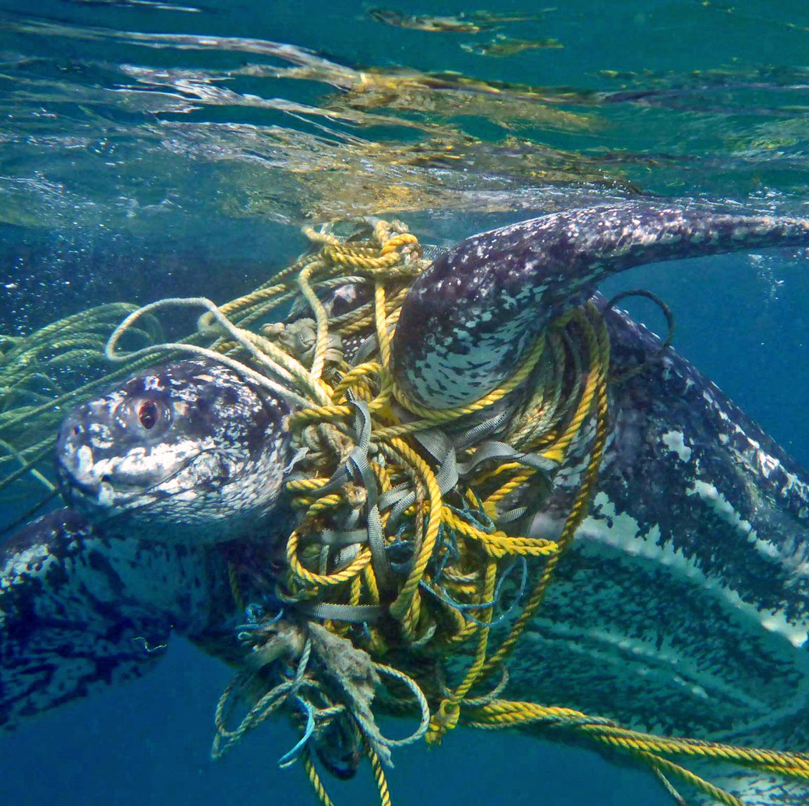
Reasons for Decline
Eggs and meat used for food by humans
Killed by fisheries
Habitat loss at nesting sits
Confusion due to coastal lights
Hatchlings move further inland instead of out to sea
Predation
Pollution
U.S. Fish & Wildlife Service. (n.d.).

Slide 7
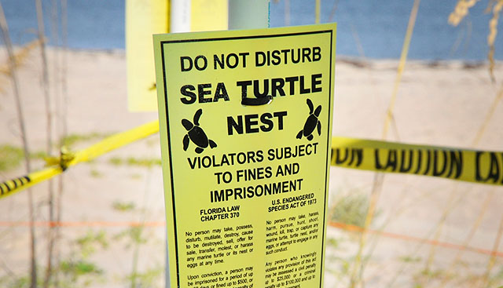
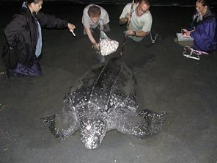
Conservation Actions for Leatherbacks
Many laws, treaties, and agreements in place towards protection
Listed under CITES Appendix I
Reserved for species in danger of extinction
Under protection of the Inter-American Convention for the Protection and Conservation of Sea Turtles (IAC)
Plans underway to protect nesting locations
Focus on preventing threats from commercial fisheries
Wallace, B.P., Tiwari, M. & Girondot, M. 2013

Slide 8
Conclusions
Leatherback sea turtles are in serious danger of extinction.
A major threat to this species is human interference.
More protections associated with each threat must be put into place to ensure survival.

Slide 9
References
U.S. Fish & Wildlife Service. (n.d.). Leatherback sea turtle (Dermochelys coriacea). https://www.fws.gov/northflorida/SeaTurtles/Turtle%20Factsheets/leatherback-sea-turtle.htm
Wallace, B.P., Tiwari, M. & Girondot, M. 2013. Dermochelys coriacea. The IUCN Red List of Threatened Species 2013: e.T6494A43526147. https://dx.doi.org/10.2305/IUCN.UK.2013-2.RLTS.T6494A43526147.en. Downloaded on 30 December 2020.

