Slide 1
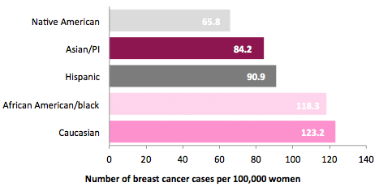
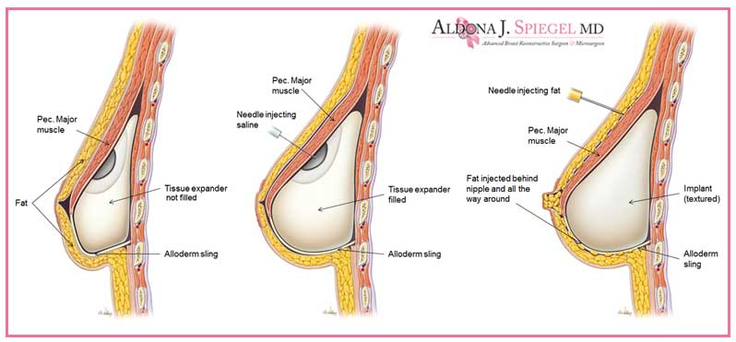
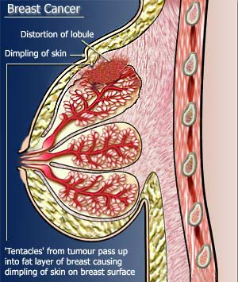
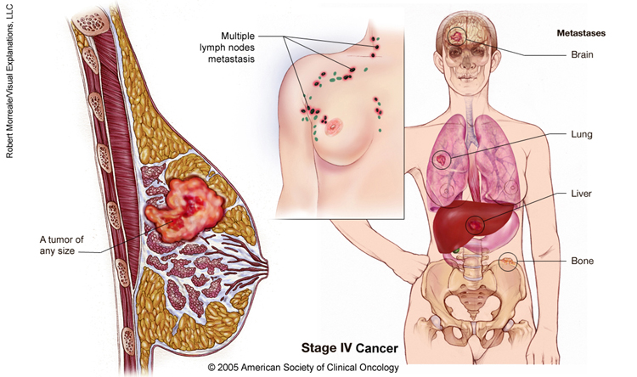
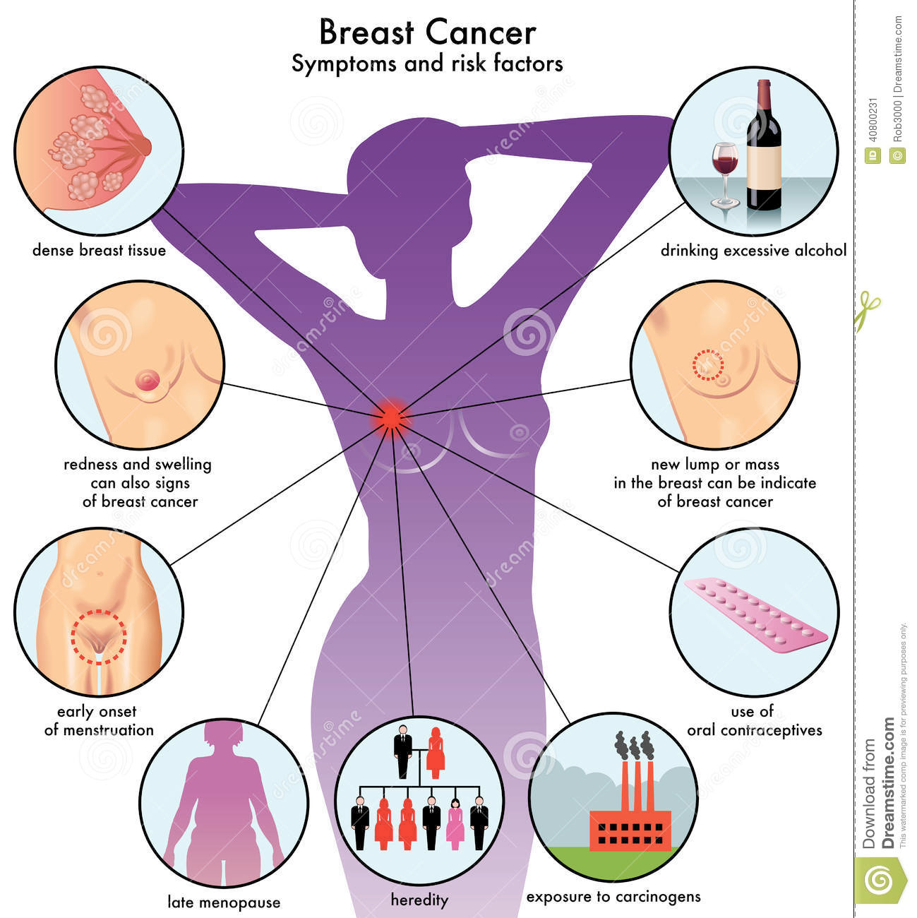
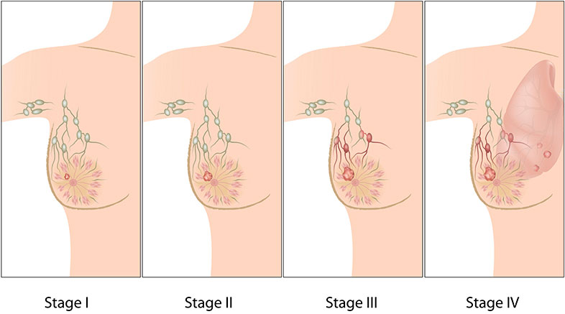
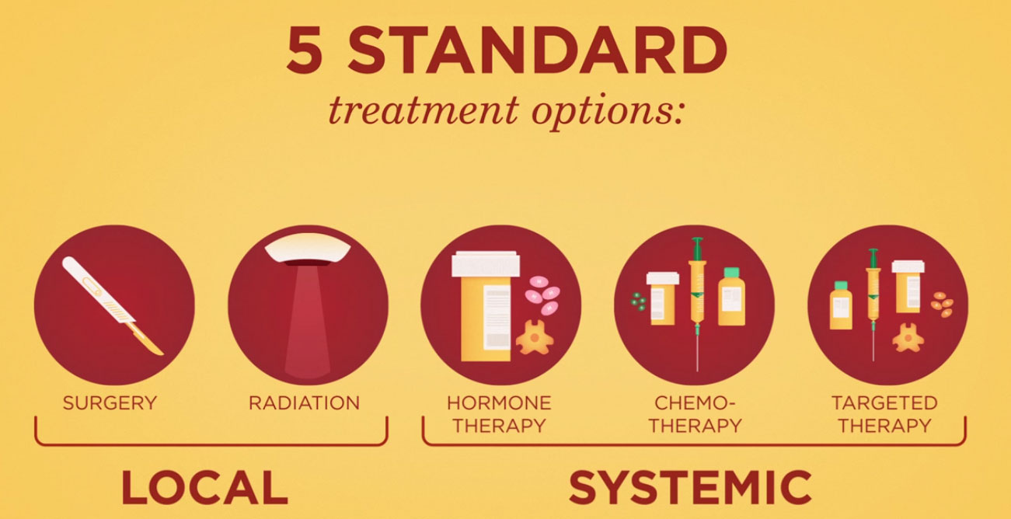
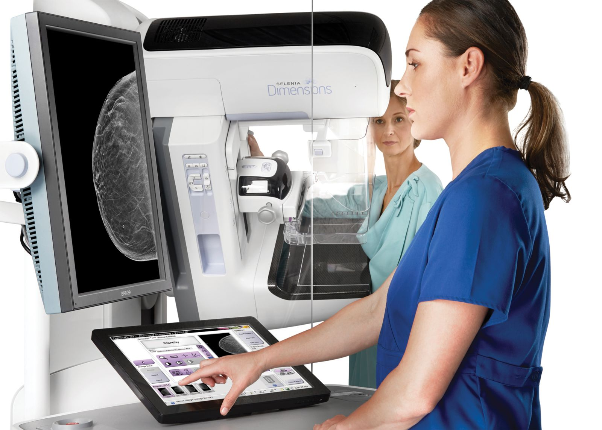
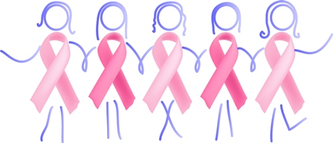
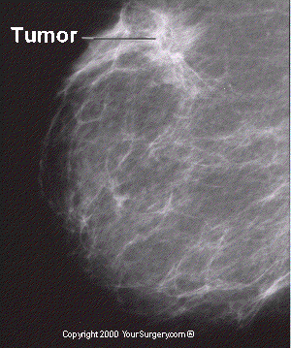
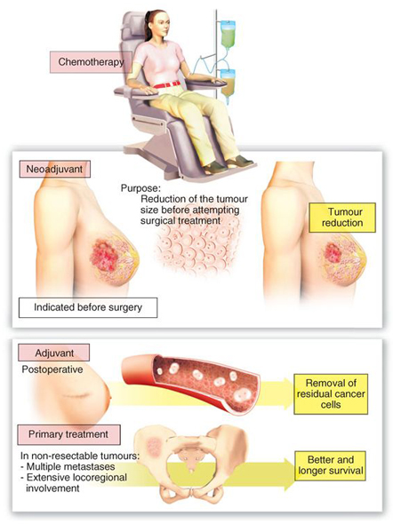
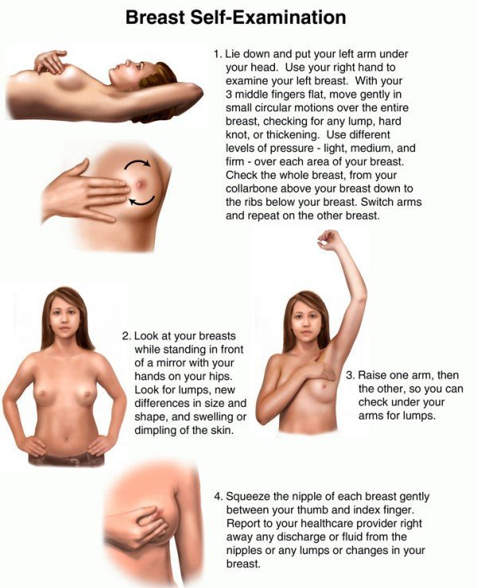
Breast Cancer
Rebecca Morra
Longwood University
Nursing 310
Fall 2016
What is breast cancer?
Cells in the breast grow out of control, forming a tumor that is often seen on a mammogram or palpated as a lump.
Malignant tumors can spread to surrounding tissues (metastasize).
Nearly all breast cancer affects women, but men can develop breast cancer too.
Signs and Symptoms
New breast lump or mass (most common symptom). Cancerous lumps are typically painless, hard, and have irregular edges, but breast cancers can be tender, possibly painful, soft, or rounded.
Swelling of the
breast
Skin irritation or
dimpling
Breast or nipple
pain
Nipple retraction
(turning inward)
Redness or
thickening of the
nipple or breast
skin
Nipple discharge
other than breast milk
Enlarged lymph nodes (if breast cancer has
spread)
Risk Factors
Being a woman
Age
Genetic factors
(BRCA1 and
BRCA2)
Family history of
breast cancer
Personal history of breast cancer
Race and ethnicity
Dense breast tissue
Starting menstruation before age 12
Menopause after age 55
Having radiation to your
chest
Exposure to
diethylstilbestrol (DES)
Alcohol consumption
Obesity or being
overweight
Having children
Birth control (oral
contraceptives and birth
control shot)
Hormone therapy after
menopause
Interview with a Stage 1 Breast Cancer Survivor:
How was your breast cancer found?
I had a mammogram in April of 2015 and nothing was seen. I felt a suspicious area while doing a self-breast exam a couple of months later.
Did you have choices as to how to treat your breast cancer?
I could have gone with radiation/drugs or just had my right breast
removed. The doctors weren’t convinced that there wasn’t cancer in
my left breast either. For peace of mind, I decided to have a bilateral
mastectomy and the sentinel node biopsy to ensure there was no cancer in my lymph nodes. The end result: no cancer in the left breast or lymph nodes (7 removed), and 8 more areas of invasive lobular carcinoma found in my right breast. I also had reconstruction surgery at the same time.
I know that your faith is very strong and that as well as your positive, uplifting outlook when dealing with your diagnosis and treatment, helped you through. Can you please elaborate on that?
Faith is a decision; it is something you have to learn. It needs to be a habit; you must work on it every day, just like love. I knew that regardless of what happened God would take care of me. Don’t get me wrong, there were days I had my doubts but I tried to stay focused on the positive and good things to come. You have to find the blessings in everything; even the trials and hardships. For whatever the reason, cancer was part of my journey.
What advise do you have for health care providers caring for breast cancer patients?
I think patience, compassion and understanding are the biggest things. I try to remember that just because one person’s pain or fear may be greater than another’s, that doesn’t negate the pain or fear felt by the person with the lesser pain or fear. Everyone’s pain and fear are their own and very real to them.
I would think family/friends may not know how to approach the topic when speaking with someone who is diagnosed with BC. Can you please share with me what you found helpful?
Just knowing that people are praying for you is extremely humbling. Being surrounded by family and friends who kept me and my mind occupied also helped. I worked up until the day I had surgery and then after surgery I constantly had someone with me. It kept my mind from wandering into places it didn’t need to be.
The one thing that was difficult was everyone telling me what they would do. That can be extremely overwhelming and can make you doubt the decisions that you have made. People need to listen and not judge because truly you don’t know what you would do until you have been in that person’s shoes. And for those who have walked in those shoes, everyone’s situation is different. There are so many variables with breast cancer that no two cases are going to be exactly alike so people will make
different decisions based on the information they have, the fears they may have,
past history, and what is best for them.
What coping methods did you use/find helpful during your diagnosis/treatment?
The key is to stay occupied. I worked up until the day I had my surgery. I figured there was no point sitting around and thinking about it. I had already accepted the cross I was given and knew that it truly was in God’s hands. I did ask the question, “Why me?” and the answer I got back was “why not me?”
What were your main concerns after your diagnosis?
Breaking the news to my mom and my kids. I really tried to stay upbeat when I told them. I stayed positive and did my best to not make them worry too much. My doctor really thought they found my cancer early so lucky for me I was able to give them that reassurance when I told them. I was worried about chemotherapy and losing my hair. I spoke with my hair dresser and she assured me that all would be well. She would help me with head coverings and my makeup. Lucky for me I never had to have chemotherapy. Will I get cancer again? This crosses my mind more than usual. But when I go down that road I really try to give it to God. My life is in His hands and He will always take care of me.
What is your treatment/follow up plan at this point?
Currently I am on tamoxifen and will be for about 5 years. I have follow-
up appointments with my breast doctor and oncologist every six months.
I also see my gynecologist every 6 months and have an ultrasound. They
found three ovarian cysts, so they will be keeping a close eye on that. I
will also follow-up with my plastic surgeon annually to ensure my
implants are okay.
Pathophysiology
Breast cells grow uncontrollably.
The overgrowth of cells leads to formation of a tumor.
Most breast cancers start in the ducts that carry milk to the nipple.
Breast cancer can metastasize to other parts of the body.
Treatment
Preventative Measure
Mammograms
X-ray picture of the
breast
Can detect breast
cancer early, before it
can be palpated.
Recommended yearly
for women 45 and older
Two types of
mammograms: screening
and diagnostic.
Self Breast Exams
Most lumps are benign, but every lump should be checked by a doctor.
About 20% of breast cancers are found by physical examination
Statistics
Aside from lung cancer, breast cancer death rates are higher than any other cancer for women in the U.S.
Aside from skin cancer, breast cancer is the most commonly diagnosed cancer in American women
A woman’s risk of developing breast cancer nearly doubles if she has a first-degree relative who has had breast cancer.
A male’s risk of developing breast cancer is approximately 1 in 1,000.
In 2016 there are more than 2.8 million American women with a history of breast cancer.
It is expected that approximately 40,450 women in the U.S. will die from breast cancer in 2016; death rates have, however, decreased steadily since 1989.
Coping with Breast Cancer Diagnosis
Support groups
Talking with friends and
family
Prayer
Meditation
Distraction
Notes:
http://www.cancer.org/cancer/breastcancer/
http://www.breastcancer.org/symptoms/understand_bc/statistics
http://www.breastrestoration.org/existingpatients/learn-more/illustration-implant-reconstruction/
https://www.dreamstime.com/stock-image-symptoms-risk-factors-breast-cancer-medical- illustrationimage40800231
http://ww5.komen.org/BCDisparities.html
http://www.puhuahospital.com/treatments/cancer/breast
http://sistersbychoice.org/spm001b/BeenDiagnosed/BreastCancerTreatment.aspx
https://www.ecr.co.za/shows/damon-beard/how-do-breast-self-exam/
https://lakenormanbreastcancersupportgroup.wordpress.com/about/
http://www.pekinhospital.org/index.cfm?pageID=85
http://www.encognitive.com/node/10403
http://conwaymedicalcenter.com/ClassesPrograms/BreastCancerSupportGroup.aspx
http://menopause-aid.blogspot.com/2013/12/tamoxifen-link-to-premature-menopause.html
http://www.mindsofmalady.com/2015/10/test-predict-breast-cancer-metastasis.html
http://advocates4breastcancer.org/index.php/about-breast-cancer/stages
http://westvalleyinternalmedicine.com/breast-cancer-know-the-statistics/
http://www.yoursurgery.com/ProcedureDetails.cfm?BR=4&Proc=36
http://www.i-revive.biz/breastcancer/

