Slide 1
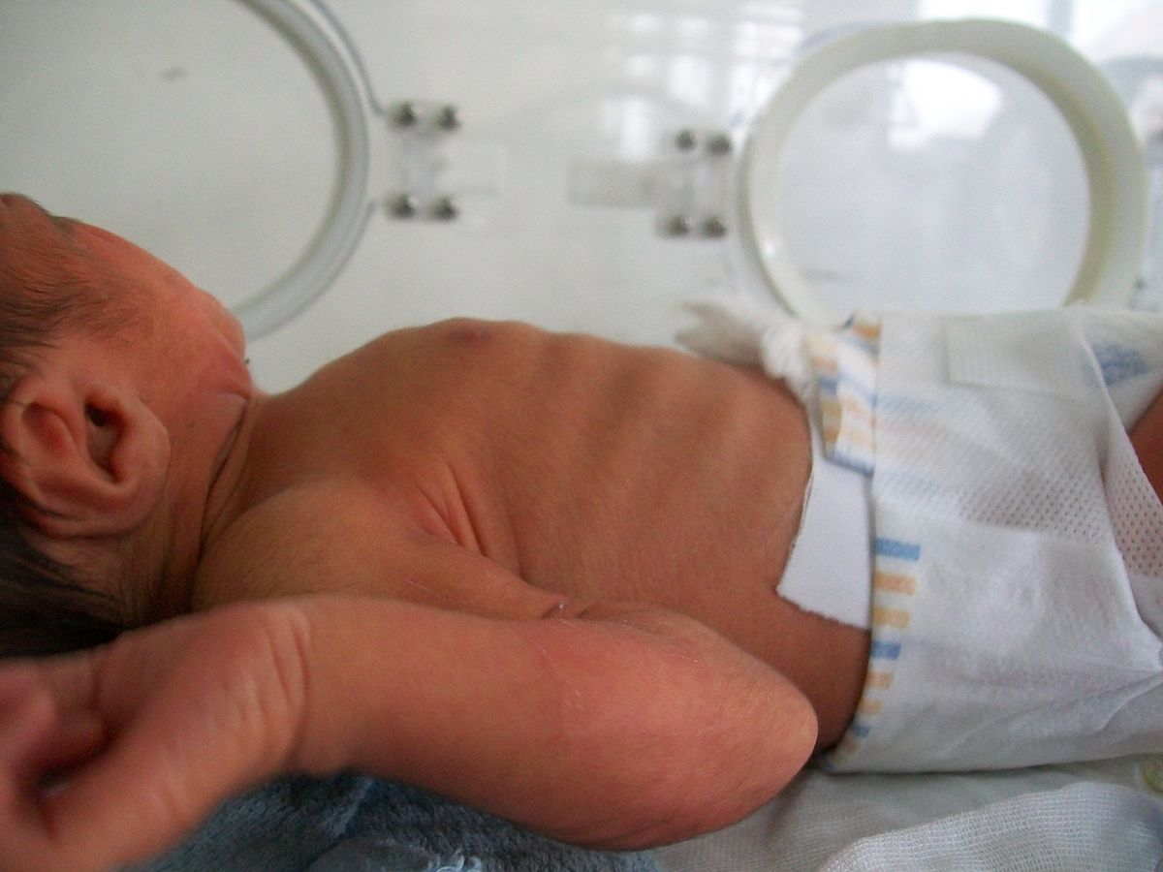
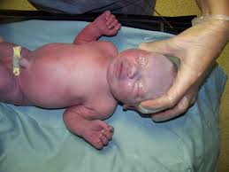
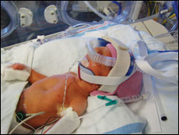
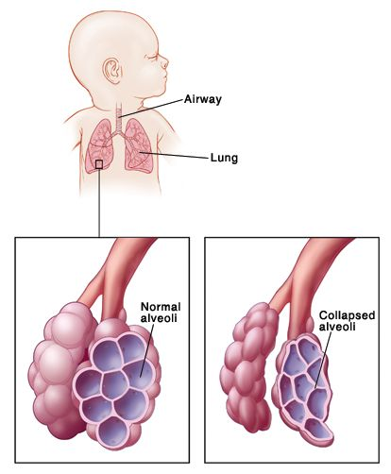
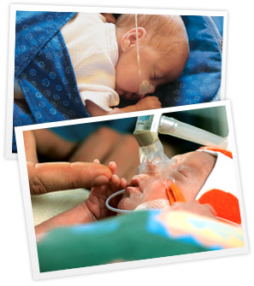
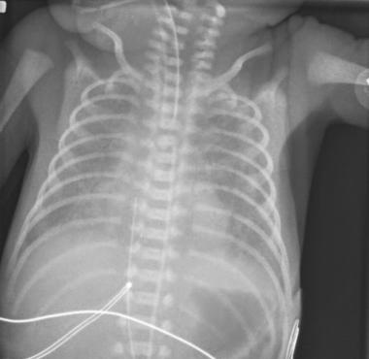
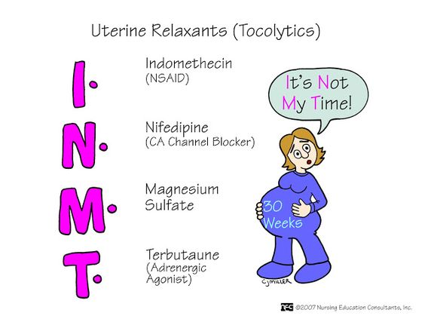
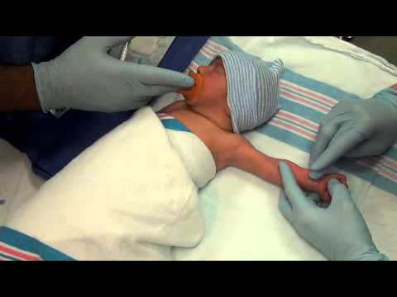
RESPIRATORY DISTRESS SYNDROME IN NEONATES
Maeleigh Ferlet and Rebecca Morra
http://a360-wp-uploads.s3.amazonaws.com/wp-content/uploads/rtmagazi/2015/08/preterm-infant-pediatric-neonate-oxygen-500-466x308.jpg
http://www.forbes.com/fdc/welcome_mjx.shtml
INTRODUCTION
SIGNS AND SYMPTOMS
TREATMENT
The Neonatal Intensive Care Unit (NICU) is an area in the hospital specifically designated for the care of newborns who have medical complications or are born prematurely
These newborn babies require intensive medical attention
Specialized care is needed due to the size and complexity of the neonates
Onset of symptoms occurs at birth or during the first few hours of life
Treatment for a neonate with RDS
Supplemental Oxygen (warm and moist)
Ventilator Support
Artificial Surfactant (helps restore normal lung function and keeps air sacs open)
ABGs
CPAP
Careful monitoring of vital signs (especially oxygen saturation)
Thorough respiratory assessment
Intake and output
Maintaining fluid intake and nutrition
Treat any underlying infection with antibiotics (obtain blood culture)
Maintaining a quiet environment
SIGNS AND SYMPTOMS
Rapid, shallow breathing
Substernal Retractions
Grunting
Nasal Flaring
Apnea (brief pauses in breathing)
Cyanosis: bluish coloring of skin
Decreased Urine Output
https://upload.wikimedia.org/wikipedia/commons/4/49/Sternal_retractions.JPG
https://www.virtua.org/-/media/Images/Virtua%20Enterprise/Virtua%20Corporate/Virtua%20Site/Teaser/topics/topic-NICU-and-Special-Care-Nursery-629x299.ashx?bc=ffffff&as=1&h=299&la=en&w=629
WHAT IS INFANT RESPIRATORY DISTRESS SYNDROME
Substernal Retractions
Common problem in neonates, particularly in premature babies
Complicates the neonate’s breathing ability
Occurs when lungs are not fully developed
Most often occurs in babies born six weeks or more before their due date
http://d1yboe6750e2cu.cloudfront.net/i/ec2f0511abf818b6e80815fae84fa22d5e27ee30
https://image.slidesharecdn.com/newbornassessmenthadi-130921062228-phpapp01/95/newborn-assessment-by-hadi-hospital-nicu-47-638.jpg?cb=1379744709
Cyanosis
Nasal Flaring
http://www.rtmagazine.com/2009/01/alls-quiet-in-the-nicu-infant-rds/
COMPLICATIONS
CAUSES
Pneumothorax
Pulmonary Hemorrhage
Impaired lung development and growth
Delayed mental and intellectual development
Scarring of lung tissue
Atelectasis (collapsed lung)
Sepsis from infection
Failure to thrive
Retinopathy of prematurity
Bronchopulmonary Diysplasia
Chronic lung disease
develops in preterms treated with oxygen and ventilation
Patent Ductus Arteriosis
Normally closes after birth
If open, oxygenated blood mixes with poorly oxygenated blood
Strains the heart and increases lung pressure
Caused by a lack of surfactant in the lungs
Surfactant helps the lungs move smoothly and prevents deflation of the alveoli
Genetics
RISKS
Premature birth
Sibling with RDS
Maternal diabetes
Fast labor
C-section or induction of labor prior to the baby being full-term
Delivery complications that decreased blood profusion to the baby
Multiple pregnancy (having twins or more)
(NY Times, 2017)
PREVENTION
DIAGNOSIS
Regular prenatal check-ups
Timing of the delivery (39 weeks or until baby’s lungs have fully matured)
Betamethasone: helps speed up development of the baby’s lungs and reduces the risk of RDS developing
Medications (tocolytics) to delay delivery
http://cdn.rtmagazine.com/rtmagazi/2014/03/premature-newborn-ventilation-500.jpg
http://www.babyfirst.com/en/images/sub/neonatal/resp_callout.jpg
A series of tests can be done to detect infant respiratory distress syndrome
Clinical evaluation
Chest x-ray
Lab tests to rule out infection
Arterial blood gas analysis to identify hypoxemia and hypercapnia
CONCLUSION
Respiratory distress syndrome is a common complication in newborns, particularly premature neonates.
Prevention is the most desirable, but there are many measures taken after birth to ensure proper lung development in infants with RDS.
If properly cared for after birth, many infants with RDS mature at the appropriate rate and live normal lives.
http://emedicine.medscape.com/article/409409-overview
https://www.pinterest.com/pin/201887995768737479/
http://allmedtech.com/besodphacinb.html
https://www.youtube.com/watch?v=4LSlOx4uaBg

