Slide 1
Shoe Research
By Maeve Losen

Slide 2
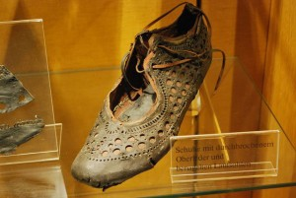
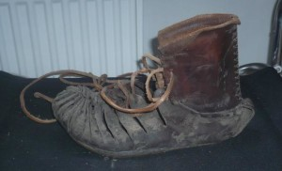
Roman Shoes:

Slide 3
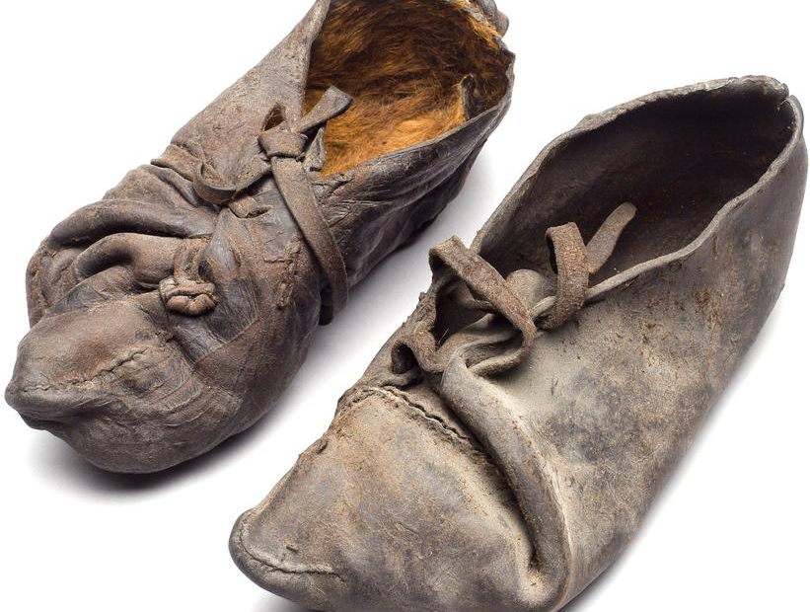
Bog Person shoes found in East Jutland; dated between 355-47 B.C.

Slide 4
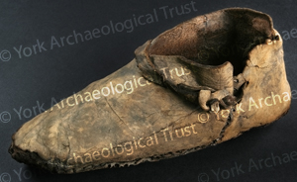
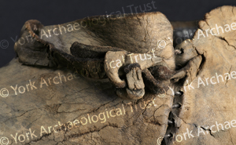
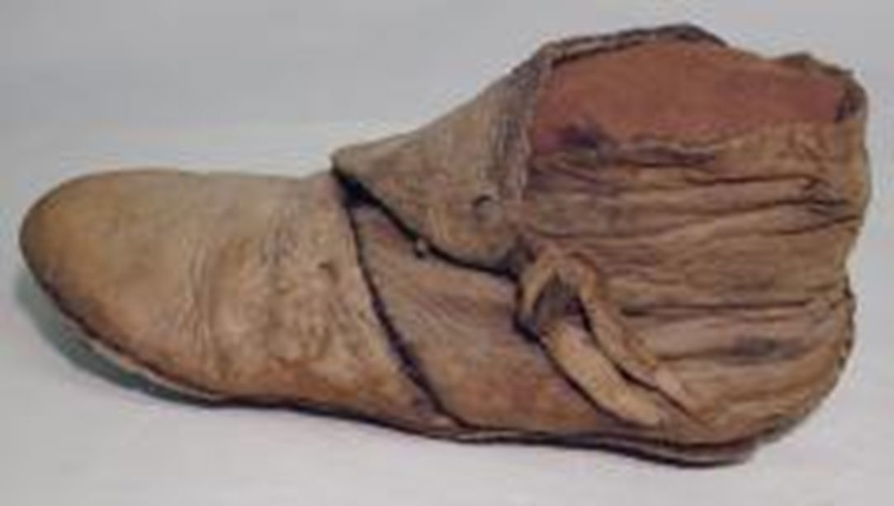
Viking Turn-shoes found in York; more than a 1000 years old

Slide 5
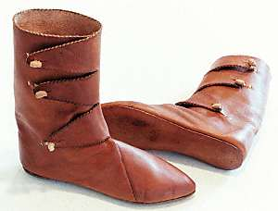
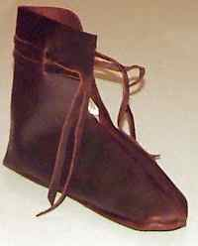
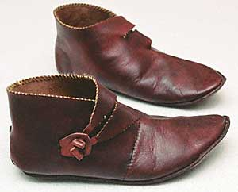
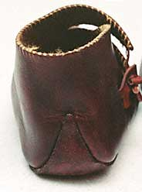
Modern recreations of Viking turn-shoes & detailing examples:

Slide 6
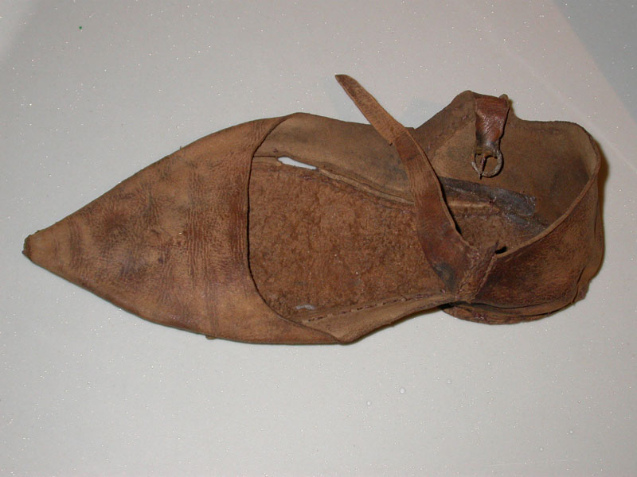
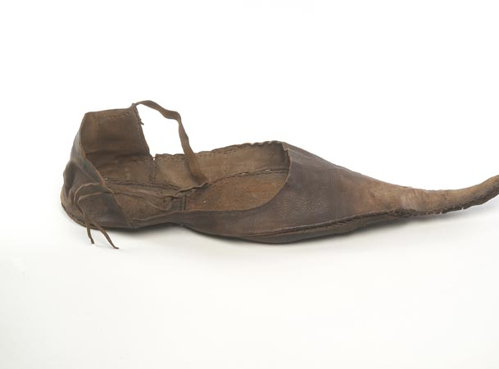
Poulaines-style:
Long, pointed shoe
Popular in Late-Medieval Period
Both date back to late 14th-century

Slide 7
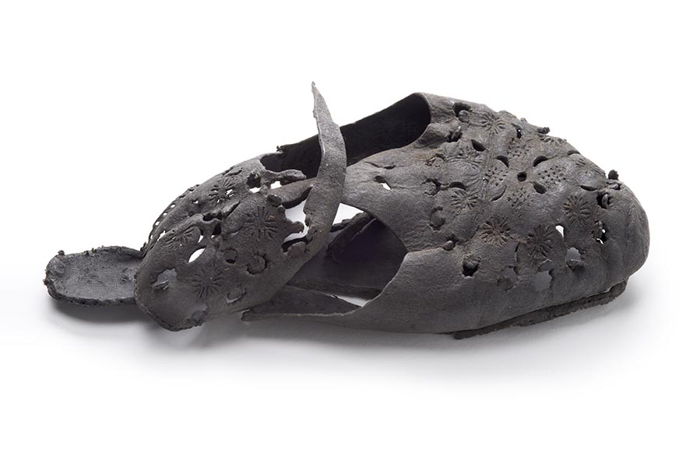
Leather Shoe:
Leather shoe w/ cut-out decoration
“Concealed shoe” aka folk tradition to put things in walls to ward evil spirits away from the home
Dated 1600-1699

Slide 8
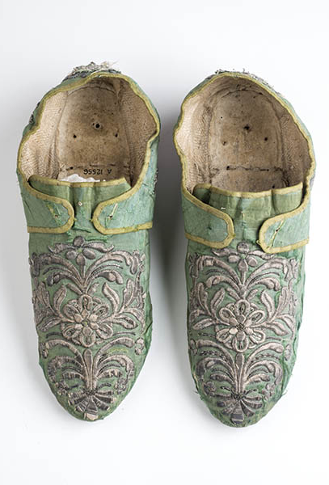
Silk Shoes:
Silk & Metal materials
Dated between 1751-1770

Slide 9
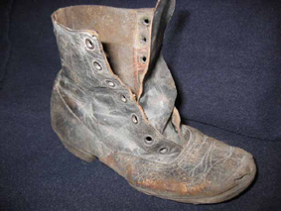
19th-Century Shoe
Another “Concealed Shoe”
Leather boot
Dated to 19th-century

Slide 10
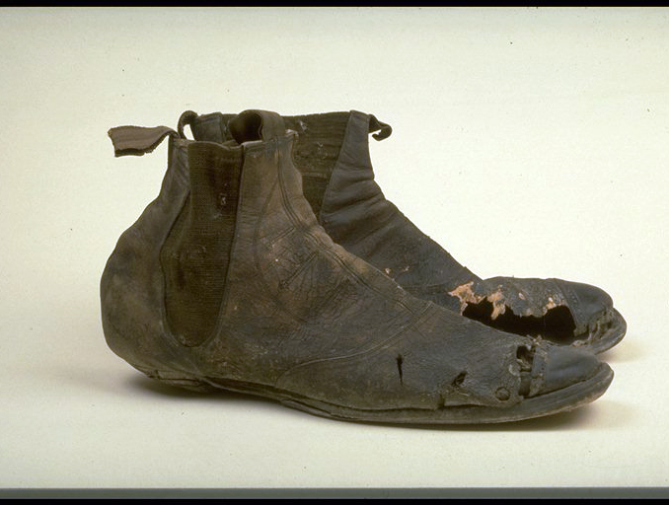
Men’s Boots:
Probably concealed shoes
Elastic side, hobnailed, & leather material
Dated between 1861-1870 in England

Slide 11
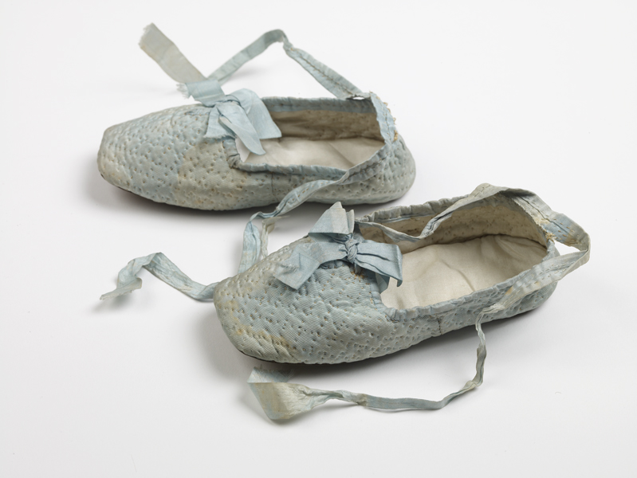
Baby Shoes:
Quilted silk, silk ribbon, & leather soles; hand-sewn
Worn by Princess Louise (b. 1848 - d. 1939), the fifth child of Queen Victoria & Prince Albert

Slide 12
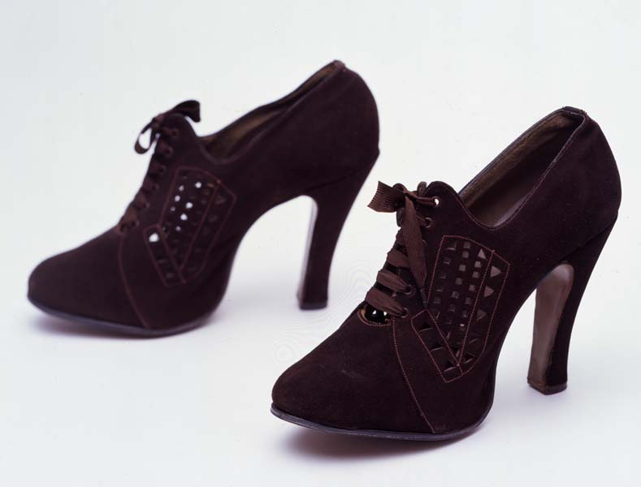
Fetish Shoes:
Brown-brogued suede
Dated between 1937-1939

Slide 13
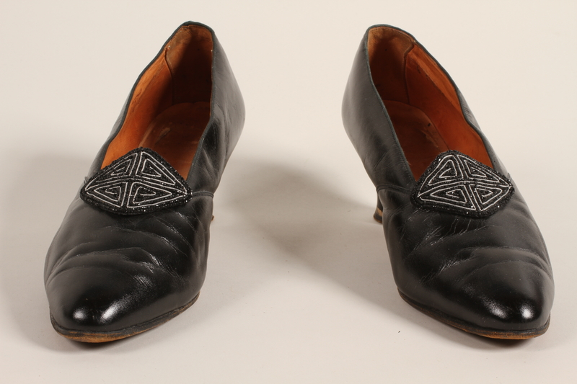
Pumps:
Dated between 1930-1939
Materials: leather
Worn by a German Romani of the Sinti group before & during the Holocaust

Slide 14
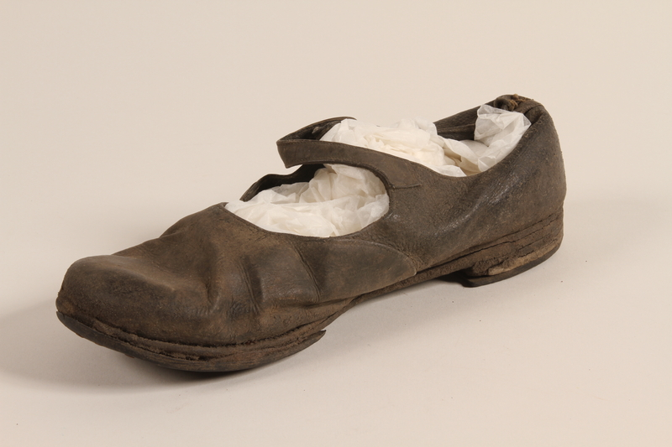
Shoe Worn by Female Concentration Camp Prisoner:
Dated ~1930-40; used in Latvia
Materials: metal, wood, & leather
Worn by Lenke Keszler (interned in sub-camp of Riga)
When Lenke was in Latvia, her foot became sore, she wore a blanket on her feet instead of the shoes, later got pulled away & killed; her daughter Clari saved the shoe & kept it while she was in hiding

Slide 15
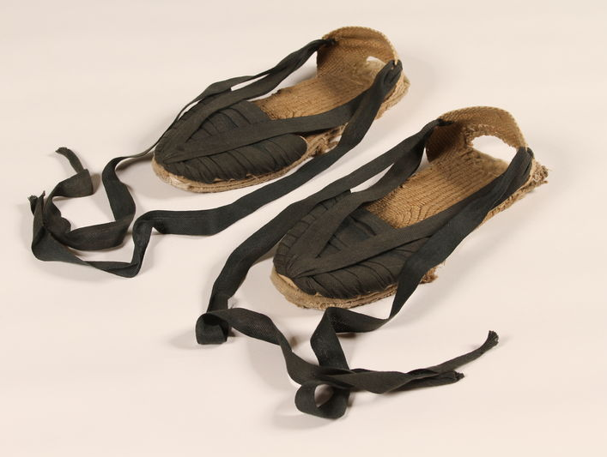
Pair of espadrilles used in disguise by anti-fascist refugees fleeing France:
Dated ~1940-49
Materials: raffia & cotton
People used such shoes to pass through France in disguise of peasants

Slide 16
Some of the shoes confiscated from arriving prisoners at the Majdanek concentration camp (between October 1, 1941 & July 22, 1944)

Slide 17
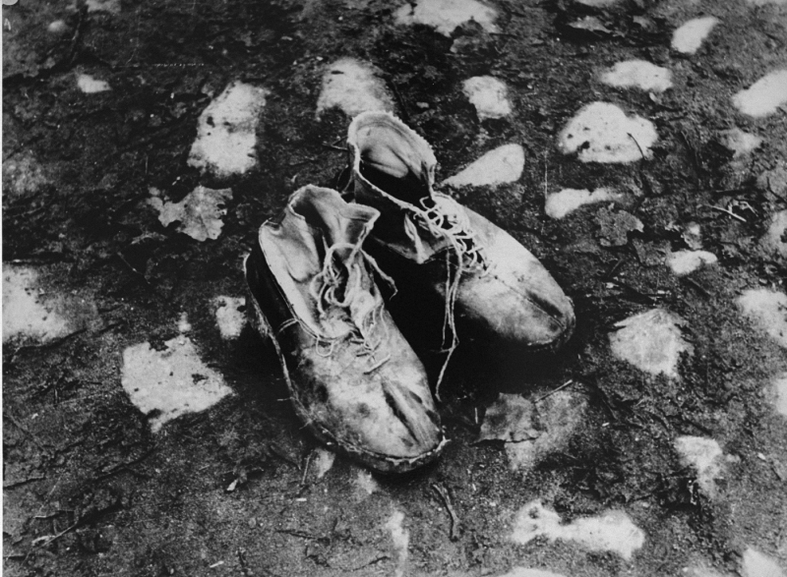
Shoes Left Behind:
Photo taken circa 1943 by George Kadish/Zvi Kadushin
A pair of shoes left behind after a deportation action in the Kovno ghetto (Lithuania)
Photographer George Kadish captioned the photo "The body is gone"

Slide 18
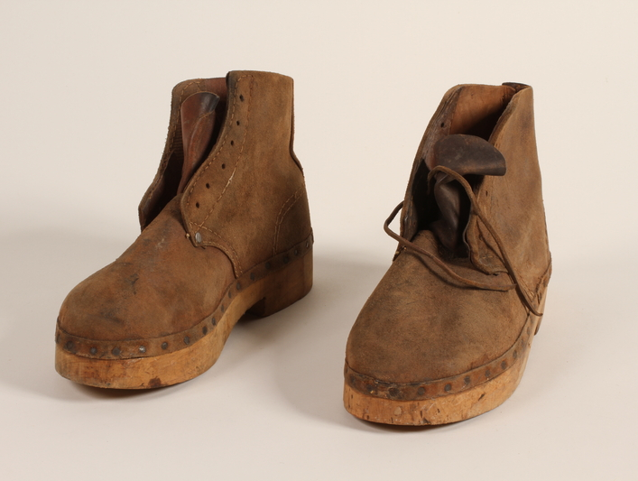
Mauthausan Concentration Camp Inmate Shoes:
~1945
Materials: leather, wood, metal, ink, & graphite
Made at Mauthausen concentration camp (Austria)

Slide 19
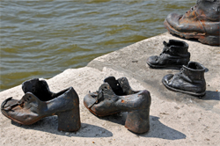
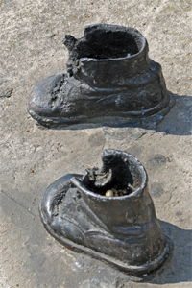
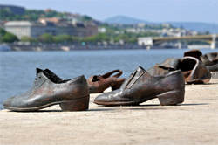
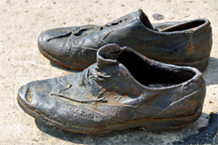
Shoes on the Danube Memorial in Budapest to commemorate Hungarian-Jews killed by the Arrow Cross Militiamen 1944-5:

Slide 20
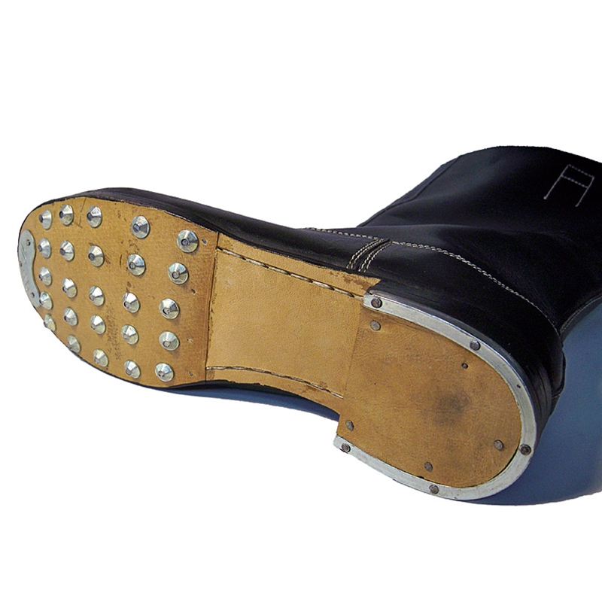
German WWII-era Hob nailed Boots:

Slide 21
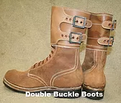
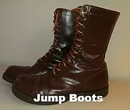
Corcoran American Paratrooper “Jump” Boots WWII-era:

Slide 22
Three Historical Shoes:
These are the three main historical shoes I researched
First: “Turnshoe” - was popular with the Viking population, as they were simple to make & less susceptible to wear & tear
Second: Upon arrival at camps, inmates either got to keep the shoes they came in - mostly if they were “Aryan” but sometimes Jews did as well; primarily, inmates had to turn in their shoes & were given uniform ones, which were often made out of leather, wood, & metal. Accounts say these shoes were very uncomfortable
Third: Corcoran Parachutist “Jump” Boots - designed by Lt. Colonel Yarborough in 1941 specifically for American paratroopers to give them extra ankle support for rough landings & get rid of the threat of risers entangling in leggings; they were sought after by everyone, due to their symbolism of being associated with the military elite

Slide 23
Shoe Casting Project Proposal:
I would like to create the ‘matching’ shoe to this one for my project
This pair has a sad story
Not only a reminder of the destruction of the Holocaust
Specifically represents the pain of individual victims – the separation of Clari (the donor/daughter) & the mother Lenke
Plan on coming in on mostly Wednesdays & Fridays (with a few Mondays) to work on this project

